Slide 1
Indiana Clinical and Translational Sciences Institute
2023 Annual Meeting
Cancer-Associated Fibroblast-Like Cells Predict Response to Immunotherapy in Glioblastoma
Maksym Zarodniuk

Slide 2
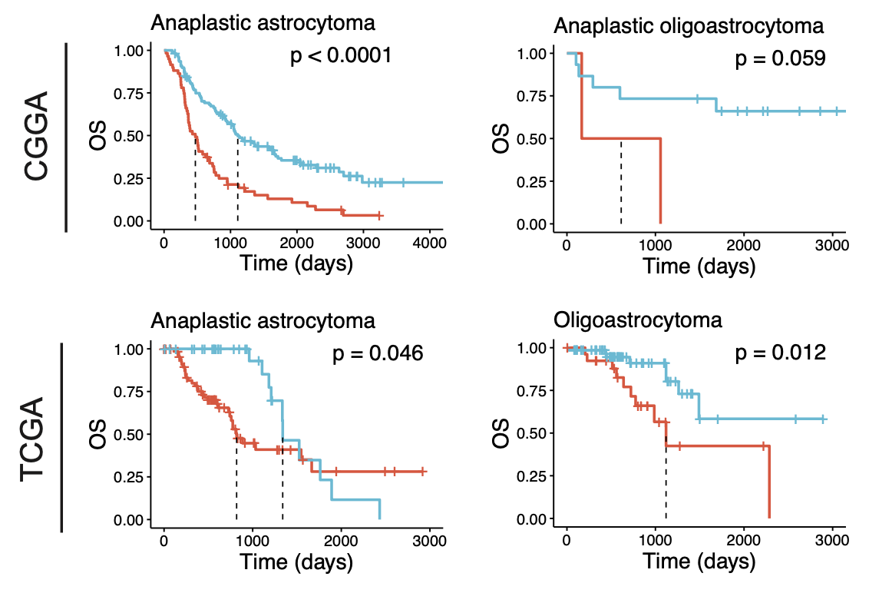
Extracellular matrix expression signatures in glioblastoma
We performed unsupervised clustering of extracellular matrix (ECM) gene expression data to stratify brain tumors into subtypes based on ECM gene expression
We identified a subset of brain tumors (ECM^{hi}) with high expression of fibrillar ECM components (COL1A1, COL5A1, FN1, LAMC1) commonly found in vascular basement membrane
ECM^{hi} signature is prognostic of poor patient survival in a number of grade 3 adult tumors, suggesting that it may have clinical and therapeutic relevance

Slide 3
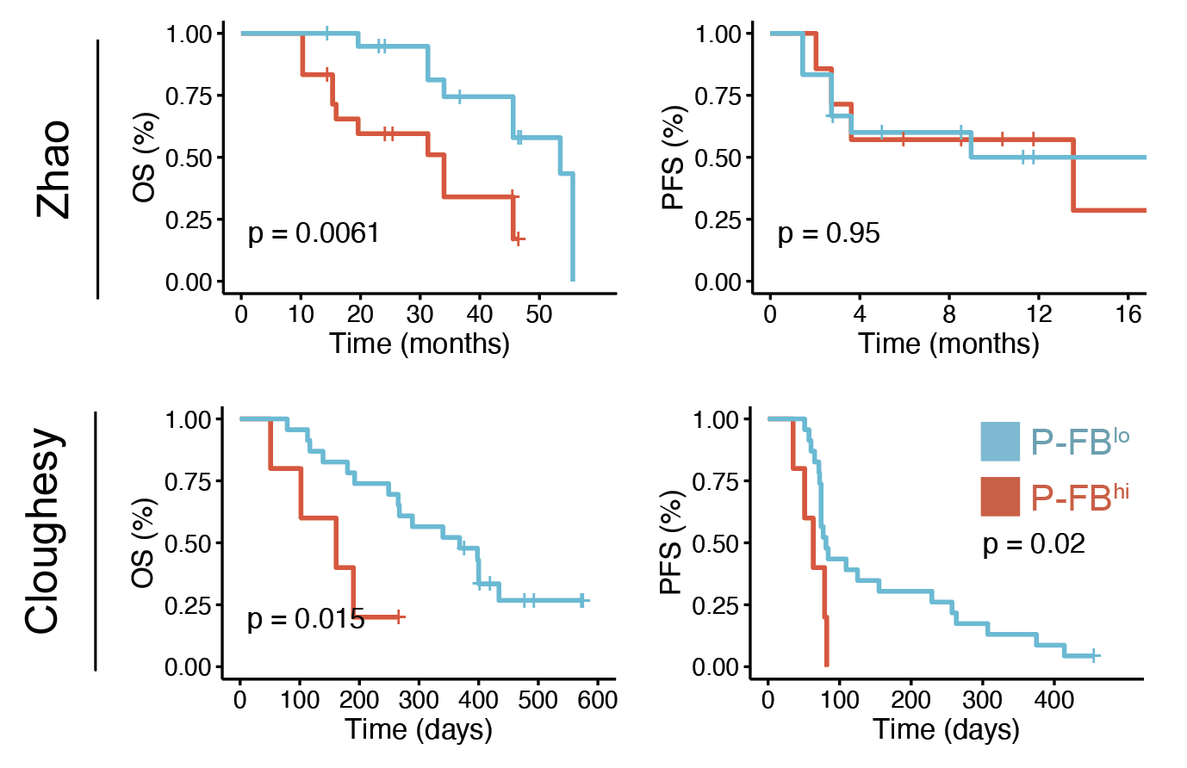
Perivascular fibroblasts predict ICB response in glioblastoma
Using single-cell RNA sequencing data (scRNA-seq) from a cohort of 16 GBM patients, we identified a population of perivascular fibroblasts (P-FB) that are enriched in ECM^{hi} GBM
Using RNA-deq data from clinical trial cohorts evaluating anti-PD1 immunotherapy, we found that the presence of perivascular fibroblasts is prognostic of treatment response

Slide 4
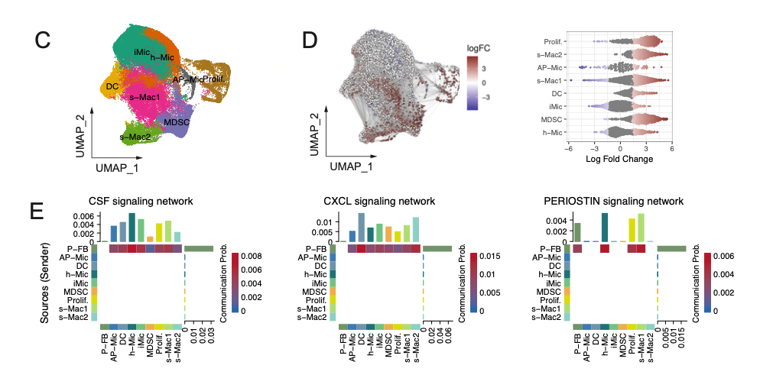
Fibroblast – myeloid cell crosstalk in glioblastoma
Differential abundance analysis of ECMhi and ECM^{lo} GBM samples revealed an enrichment of immunosuppressive myeloid cell populations.
Ligand-receptor network analysis predicted active chemoattractant signaling from fibroblasts to macrophages via pathways known to induce chemotaxis and alternative polarization of tumor-supporting M2-like macrophages.
Perivascular fibroblasts may contribute to the establishment of an immunosuppressive microenvironment by driving macrophage recruitment and polarization via chemotaxis and periostin signaling, respectively.

Slide 5
Grant Acknowledgement
This project was funded with support from the Indiana Clinical and Translational Sciences Institute which is funded in part by Award Number UL1TR002529 from the National Institutes of Health, National Center for Advancing Translational Sciences, Clinical and Translational Sciences Award. The content is solely the responsibility of the authors and does not necessarily represent the official views of the National Institutes of Health.”

