Slide 1

Indiana Clinical and Translational Sciences Institute
2023 Annual Meeting
Cannabinoid Receptor Type II Agonist LY2828360 Reverses Two Distinct Forms of Neuropathic Pain Without Producing Reward
Jonah L. Wirt, Kelsey Guenther, Shahin Saberi, Andrea G. Hohmann

Slide 2
Here’s what we found (Results)
Our studies revealed that Cannabinoid Type II Agonist LY2828360 Reverses Sciatic Nerve Pain and Chemotherapy Induced Peripheral Neuropathy Without Development of Tolerance in a 10-Day Chronic Dosing Paradigm.
Our studies also revealed that LY2828360 does not produce rewarding effects like morphine does in the conditioned place preference assay, and that LY2828360 blocks the rewarding effects of morphine in this assay.
These findings show that agonism of the CB2 receptor may hold promise both in treating distinct forms of pain, as well as in reducing the abuse liability of opioids such as morphine.

Slide 3

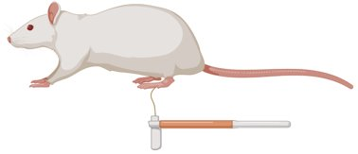
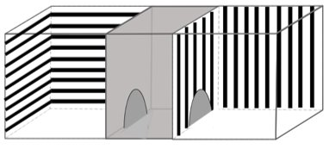
Here’s how we did it (Methods)
Surgical ligation of the sciatic nerve or chemotherapeutic treatment with the taxane agent paclitaxel were used to induce two distinct forms of neuropathic pain.
Mechanical von Frey stimulation (force (g) required to cause a paw withdrawal response) was used to assess mechanical hypersensitivity induced by sciatic nerve ligation or chemotherapy. A lower force required to cause a withdrawal response is indicative of more pain behavior.
Conditioned place preference testing was used to assess seeking behavior after pairing drugs to chambers with distinct visual cues. Significantly higher time spent in one chamber is indicative of an animal exhibiting seeking behavior for the drug it was paired with. This assay can be used to assess abuse liability of different drugs.
Sciatic Nerve Ligation
Von Frey
Conditioned Place Preference

Slide 4
Future implications for patients or the community/ or next steps
Example slide:
LY2828360 has been shown to be safe in human trials, although not efficacious in treating osteoarthritis pain in humans.
Based on this data regarding two distinct neuropathic pain subtypes, such as sciatic nerve pain and chemotherapy induced peripheral neuropathy CB2 agonist LY2828360 should be tested in humans suffering from these conditions.
LY2828360 having low abuse liability means that it may be a pain treatment option that could help attenuate the prescription of opioids in a clinical setting.
Based on our findings, LY2828360 may also reduce the abuse liability of opioids, and could be considered as a complimentary treatment to patients receiving opioids in a clinical setting so that there is less risk of abuse of this class of compounds.

