Slide 1

Role of R-loops in the HPV lifecycle
Ishan Sran

Slide 2
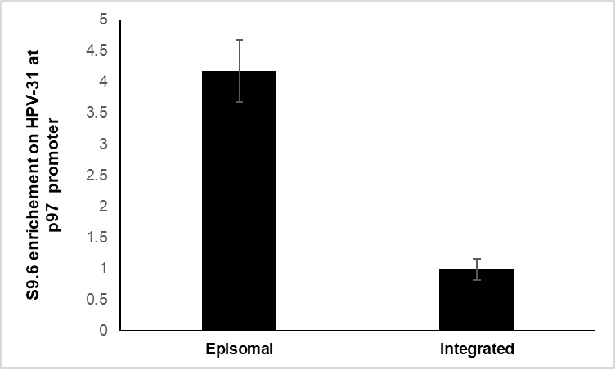
R-loops are present on the HPV-31 genome at the p97 promoter
DRIP in CIN612 episomal and integrated cells
*
Primers to p97 promoter
Notes:
R-loops are trimeric nucleic acid structures that form during transcription. These are DNA-RNA hybrids that can cause genomic instability and transcriptional conflicts.
I looked at whether R-loops form during HPV transcription AND replication. We detected r-loops in the HPV genome promoter, p97, using a DRIP procedure: DNA-RNA Immunoprecipitation.
We can see in this PCR graph that r-loops do from on the HPV genome, more r-loops form in the viral genome when DNA is in plasmid form v/s integrated. This may be because episomal HPV is more likely to transcribe and replicate DNA simultaneously, increasing likelihood of r-loop formation.

Slide 3
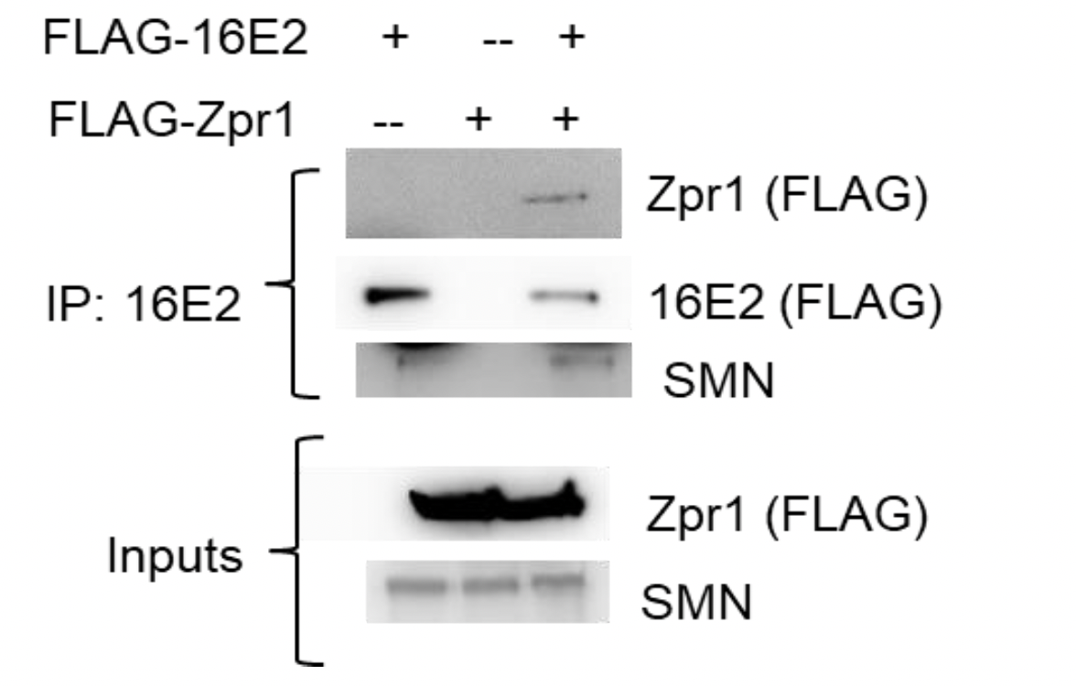
E2 complexes with SMN and ZPR1
Notes:
We also looked at r-loops resolving factors that interact with viral transcription factor, E2, located on promoter site.
We found out that the 1-667 of SETX does not immunoprecipitate with E2, therefore, it may not interact. SETX is a helicase that resolves r-loops. Our results don’t signify that senataxin does not resolve HPV r-loops, as SETX interacts directly with DNA and a co-IP, which only looks at protein-protein interactions, does not necessarily detect that.
We also found that ZPR1, zinc finger protein that recruits SETX, interacts with E2. We saw this repeatedly in our co-Ips.

Slide 4
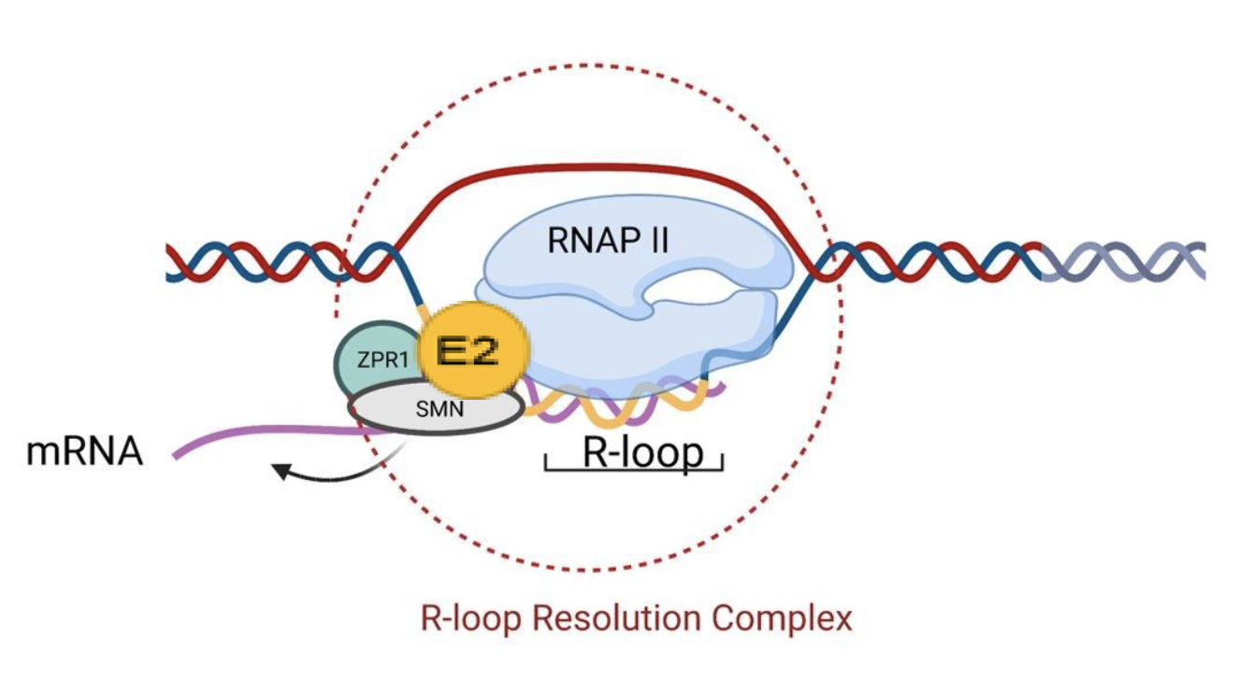
Conclusion
Notes:
In conclusion, ZPR1, SMN and E2 are likely to be involved in a r-loop resolving complex at the P97 promoter on HPV genome.
our experiments indicate that HPV may be using cellular machinery to resolve r-loops, and aid viral propagation like in the case of CMV and HSV.

