Slide 1
Validation of a citizen screening kit for environmental lead (Pb)
Matthew Sisk, Alyssa Wicks, Ornella Joseph, Jocelyn Keranen, Angela Herrmann, Gabriel Filippelli, Marya Lieberman, Graham Peaslee, Heidi Beidinger

Slide 2
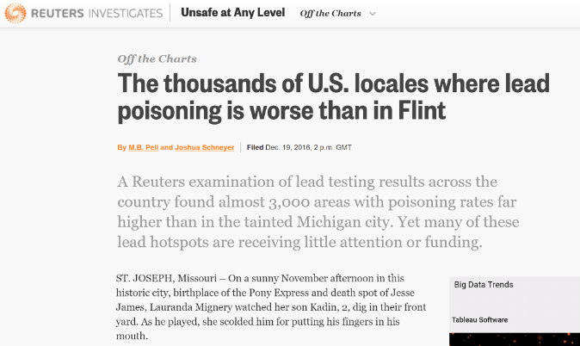
Lead exposure is still a problem all over the US

Slide 3
The Lead Screening Kit
Soil, dust and paint samples taken by a resident
Sent to lab at University of Notre Dame
Analyzed via XRF
Report returned to resident

Slide 4
Validation and translational potential
The screening kit and the traditional LIRA largely agree on lead hazards within individual households (~75 %), however, they sample slightly different things
Lead remains a public health hazard, especially in disinvested and impoverished areas and can cause significant neurological impacts
The lead screening kit is an effective way to give individual households a tool to combat lead exposure

