Slide 1

Indiana Clinical and Translational Sciences Institute
2023 Annual Meeting
The Potential Tripartite Connection: Alzheimer's Disease, Fracture Healing, and the Gut Microbiome
Reginald S. Parker

Slide 2
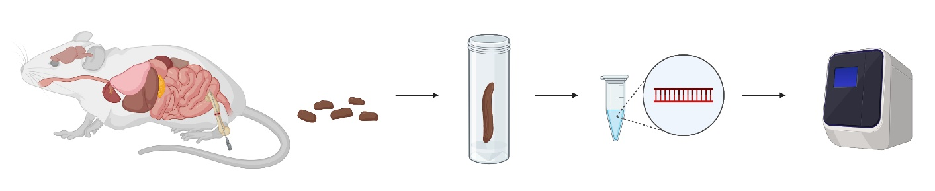
Materials and Methods
This study analyzed the bacterial phyla contents of 64 male 5xFAD (AD mouse model) using 16s rDNA analysis.
A fracture was surgically induced at the femoral mid-shaft of 32 mice.
There were four experimental groups employed: WT no surgery, WT surgery, 5xFAD no surgery, 5xFAD surgery
Fecal contents collected at various timepoints were used in a DNA extraction assay using Qiagen Dneasy Powersoil Pro Kit following the manufacturer's instructions.
16s rDNA was amplified using a QuantStudio 5 Real-Time PCR System using 2x Fast SYBR Green Master Mix, forward/reverse primers and DNA template.

Slide 3
Results
Preliminary qPCR data indicates a significant increase in Bacteroidota bacteria in the 5xFAD no-surgery mouse group 7 days after surgery.
We hypothesize that an interaction between these mice and anesthesia is causing changes in their microbiome, but further research is needed to confirm this.
Preliminary qPCR data has shown a significant decline of Actinomycetota bacteria in the 5xFAD surgery group 7 days after surgery.
This finding reveals the possible implication that surgery + AD creates an inhospitable environment for this phyla of bacteria.
These results are preliminary and require further testing before any concrete conclusions are made.
Notes:
Begin by stating the Super Big Results (state them in 3 key points, like an outline)

Slide 4
Future Directions
These results are the beginning of a study that will eventually incorporate data from both AD progression, gauged through behavior and histological analyses, and fracture healing, quantified using X-ray, mRUST scoring, microCT, and histology.
Eventually, we will gain a holistic view of the organism that will allow us to draw correlations between AD progression, fracture healing, and microbiome changes.
Next steps are to complete 16s rRNA Gene Sequencing to be able to view all of the phyla present in our fecal samples.
Bring mice to study completion at 20 weeks post-surgery.
Future studies will look at sex differences between male and female 5xFAD mice. Furthermore, we will test how novel bone healing agents may impact AD and microbiome.
Notes:
Before creating your 3 slides that will form your 2-minute video, think about how you would present your slides in a TWEET, and use that brief format to guide your points. Provide key takeaways for the most impact.

Slide 5
Grant Acknowledgement
The results of this work were supported with resources and the use of facilities at the Richard L. Roudebush VA Medical Center, Indianapolis, IN: VA Merit #RX003552 (MAK). The materials in this presentation were supported by the Department of Orthopaedic Surgery at Indiana University School of Medicine (MAK). The content is solely the responsibility of the authors and does not necessarily represent the official views of the any of the supporting organizations.
Contact: regparke@iu.edu
Notes:
If your project or training has been supported by the Indiana CTSI, your poster and PowerPoint presentation should include acknowledgement of the appropriate Indiana CTSI grant.
For your convenience, we have added this list of award sources to the last slide of the PowerPoint template. Please review the list of award sources and delete those that did not contribute to the conduct of the research reported in your presentation.
If your project or training was supported by other grants, please remember to acknowledge those grants as well.

