Slide 1

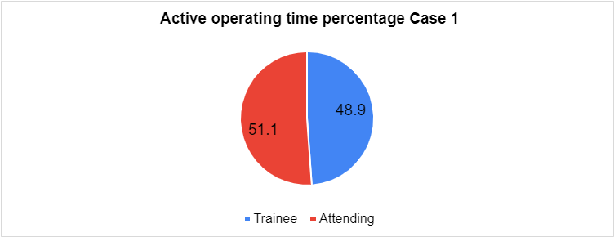
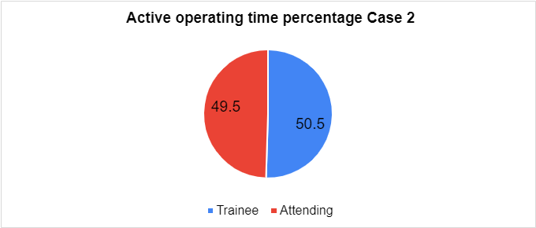
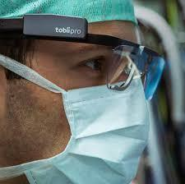

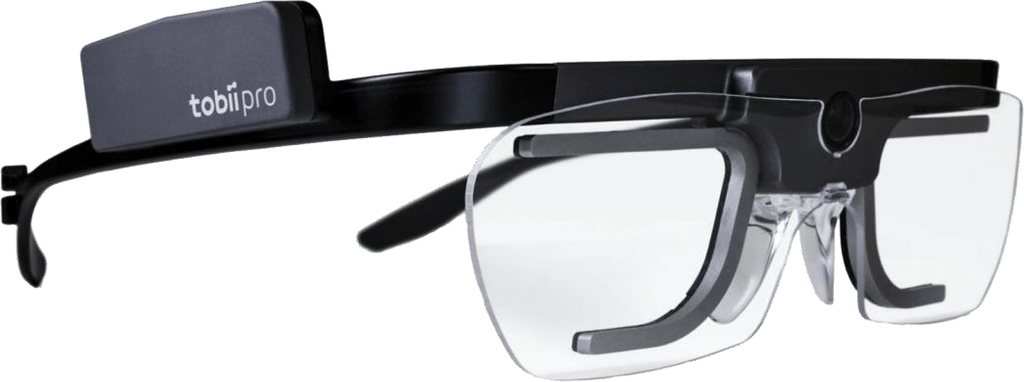
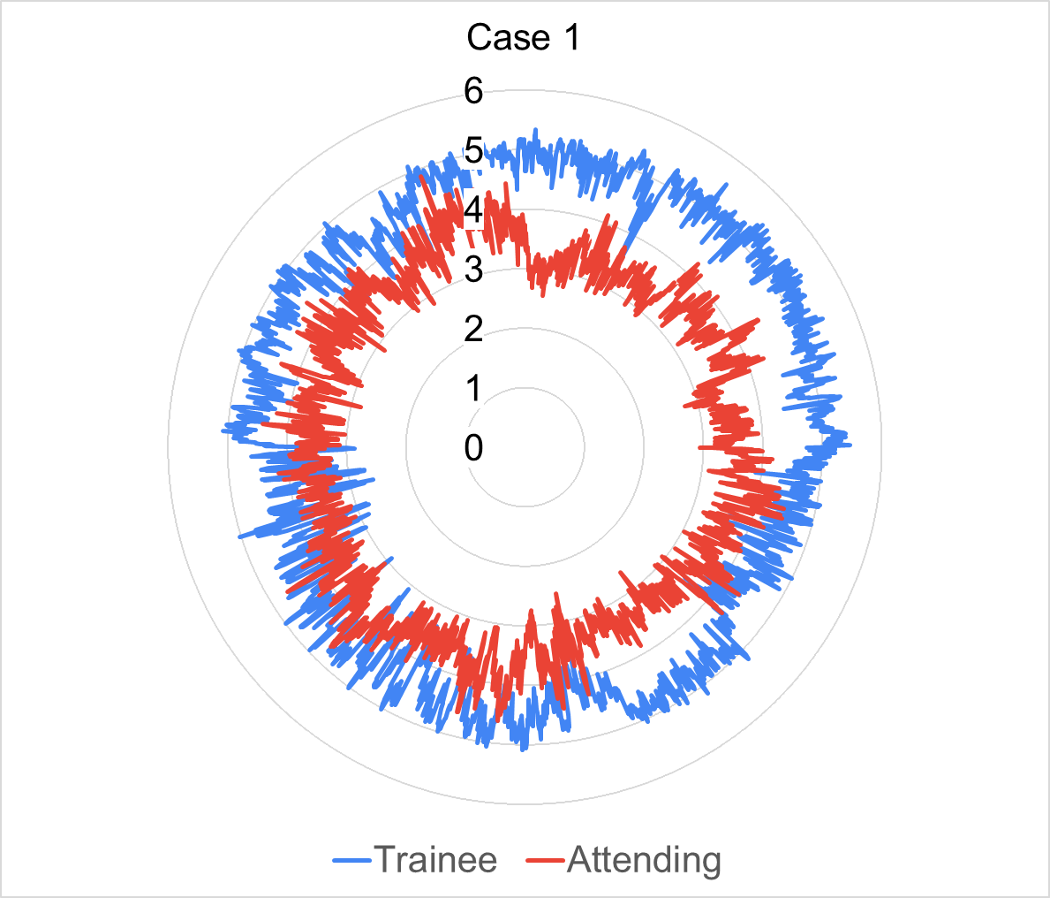
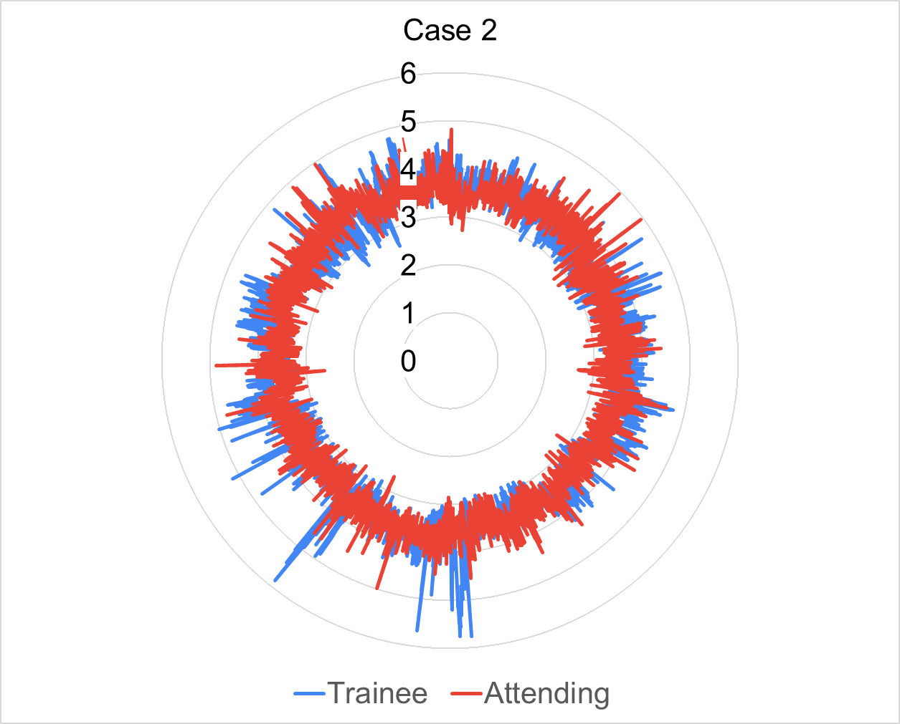
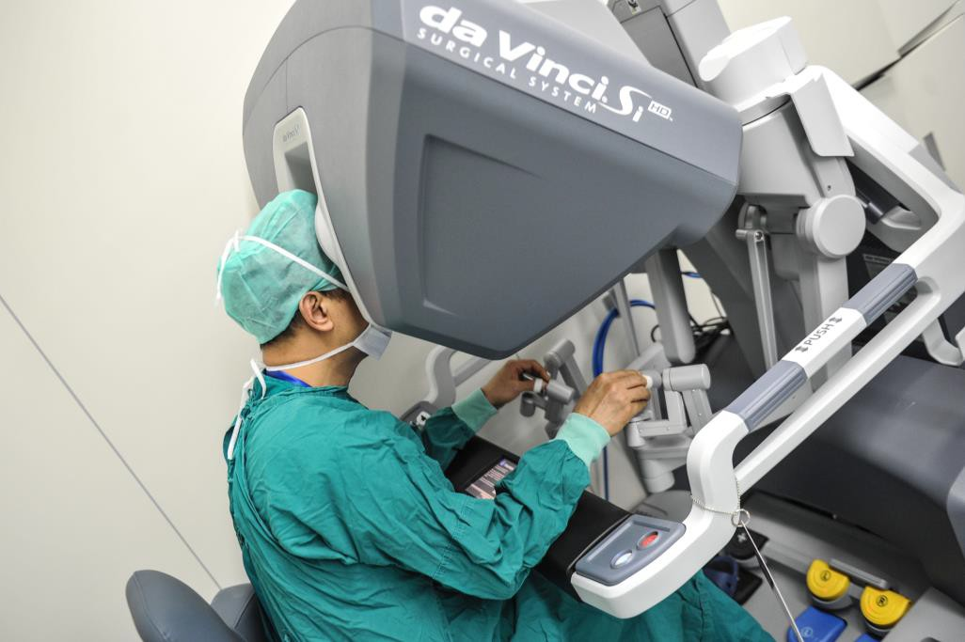

Intraoperative Cognitive Load Differences between Trainees and Attending Surgeons: A Pilot Study
Alex Nelson, BA,¹ Nicholas Anton, MS,² Mohammed Kalantar, MD, MPH,² Ryan Toy,³ Denny Yu, PhD, CPE,³
Dimitrios Stefanidis, MD, PhD,²
Indiana University School of Medicine
Indiana University School of Medicine, Department of Surgery
Purdue University, School of Industrial Engineering
Introduction
Cognitive load (CL) is the mental effort and resources required to process information in working memory to complete a task¹
High CL decreases attention to critical details and slows decision-making, increasing errors which can compromise patient safety²
Mobile eye-tracking (ET) is a novel method of assessing visual attention and CL³
Our aim was to determine if intraoperative CL differences exist between trainees and experienced attending surgeons
Results
Discussion
Lower AFD and F:S in trainees compared to experienced attending surgeons
  Trainees require more glances to compensate for their sub-optimal scanning strategy
  Novice console operators make more mistakes and require more movements to complete tasks⁵
  Trainees are constantly incorporating instructions from the attending surgeon
Larger Pupil Size in trainees compared to experienced attending surgeons
  Increased cognitive load during procedure
 | Trainee (n=1) | Attending (n=1) | Mean Difference | Paired T-test P-Value
Mean Pupil Size Case 1 (mm) | 4.594 (0.47) | 3.584 (0.35) | 1.010 (0.60) | < 0.001
Mean Pupil Size Case 2 (mm) | 3.615 (0.37) | 3.576 (0.27) | 0.039 (0.045 | < 0.001
 | - | Attending (n=1) | - | - | Trainee (n=1) | -
 | Median | 25th | 75th | Median | 25th | 75th | Mann-Whitney U Test P- Value
AFD Case 1 | 210 | 140 | 380 | 281 | 160 | 521 | <0.001
AFD Case 2 | 130 | 90 | 230 | 130 | 80 | 240 | <0.001
Intraoperative Pupil Size Change
Materials & Methods
Trainees and attending participants performed robotic gastrointestinal procedures while wearing a mobile eye- tracker (Tobii Glasses 2)
Analyzed metrics included:
  Average Fixation Duration (AFD): Average time during which the eyes purposefully focus on a gaze point
  Fixation to Saccade Ratio (F:S): Ratio of purposeful fixations to non-purposeful “scanning” saccades
  Average pupil diameter: A measure of sympathetic arousal⁴
Conclusions
ET is an effective method to detect intraoperative CL differences between trainees and attending surgeons
Intraoperative CL is higher in trainees compared to experienced attending surgeons
Replication with larger sample is needed
Further research to determine methods to decrease intraoperative CL is needed
Decreasing trainee CL may create a more effective learning environment for aspiring surgeons
Mean AFD While Operating
Mean F:S While Operating
_{0.6} 0.592
0.86
0.842
 |  | Attending
 |  | Trainee
 |  | 0.775
0.58
References
Sweller J., Cognitive Science 1988.
Sullivan ME., Journal of Surgical Onc. 2020.
Wu et al., HFES 2019.
Sege et al., Biological Psychology 2020.
Khan et al., Surgical Endoscopy 2012.
0.84
0.56
Attending
AFD
0.82
F:S
0.54
Trainee
0.8
0.52
0.497
0.78
0.5
0.76
0.48
0.74
0.46
Attending
Trainee
0.44
Attending
Trainee
 | Attending (n=3) | Trainee (n=3) | Mean Difference
Mean AFD while operating | 0.842 (0.15) | 0.775 (0.09) | 0.067
Mean F:S while operating | 0.592 (0.24) | 0.497 (0.10) | 0.095
INDIANA UNIVERSITY SCHOOL OF MEDICINE
DEPARTMENT OF SURGERY

Slide 2
 | Attending (n=3) | Trainee (n=3) | Mean Difference
Mean AFD while operating | 0.842 (0.15) | 0.775 (0.09) | 0.067
Mean F:S while operating | 0.592 (0.24) | 0.497 (0.10) | 0.095
 | Trainee (n=1) | Attending (n=1) | Mean Difference | Paired T-test P-Value
Mean Pupil Size Case 1 (mm) | 4.594 (0.47) | 3.584 (0.35) | 1.010 (0.60) | < 0.001
Mean Pupil Size Case 2 (mm) | 3.615 (0.37) | 3.576 (0.27) | 0.039 (0.045 | < 0.001
 | - | Attending (n=1) | - | - | Trainee (n=1) | -
 | Median | 25th | 75th | Median | 25th | 75th | Mann-Whitney U Test P- Value
AFD Case 1 | 210 | 140 | 380 | 281 | 160 | 521 | <0.001
AFD Case 2 | 130 | 90 | 230 | 130 | 80 | 240 | <0.001
Variable | Attending | Trainee | P-Val
Mean AFD while operating (all cases) | 0.842 (0.15) | 0.775 (0.09) | Not calculated
Mean F:S while operating (all cases) | 0.592 (0.24) | 0 0.497 (0.10) | Not calculated
Mean Pupil Size Case 1 | 4.594 (0.47) | 3.584 (0.35) | < 0.001
Mean Pupil Size Case 2 | 3.615 (0.37) | 3.576 (0.27) | < 0.001
Median AFD Case 1 | 210 | 281 | < 0.001
Median AFD Case 2 | 130 | 130 | < 0.001

