Slide 1

Indiana Clinical and Translational Sciences Institute
2023 Annual Meeting
Diagnostic Accuracy of Primary Care Clinicians Across a Statewide System of Autism Evaluation
Rebecca McNally Keehn, PhD
Assistant Professor of Pediatrics
Department of Pediatrics, Indiana University School of Medicine

Slide 2
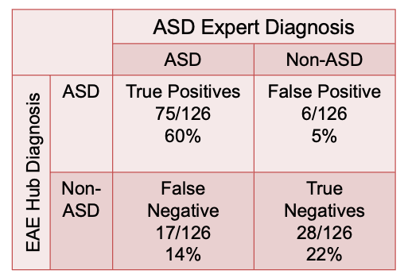
Here’s what we found
Diagnostic agreement between primary care practitioners (PCP) who received specialty training in autism diagnosis and autism diagnostic specialists is high
Overall agreement was 82%
Sensitivity: 82%; Specificity: 82%; PPV: 93%; NPV: 62%
Autism was missed by PCPs in 14% of cases
    Lower PCP diagnostic certainty
    Higher rate of PCP referral for specialist evaluation
    Higher child developmental skills

Slide 3
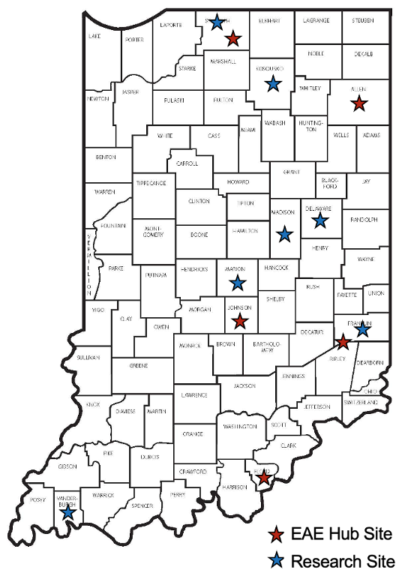
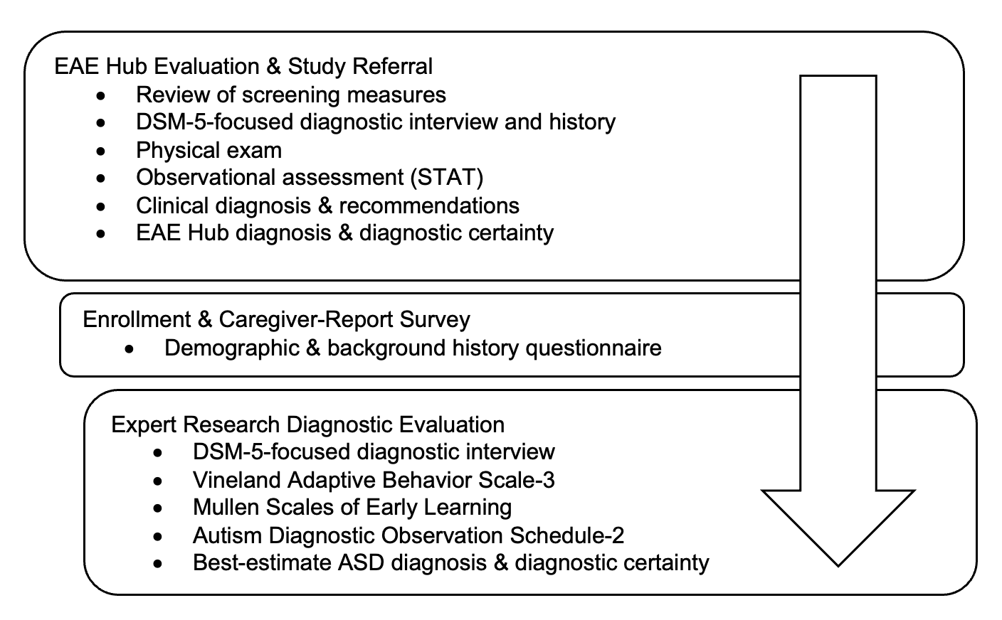
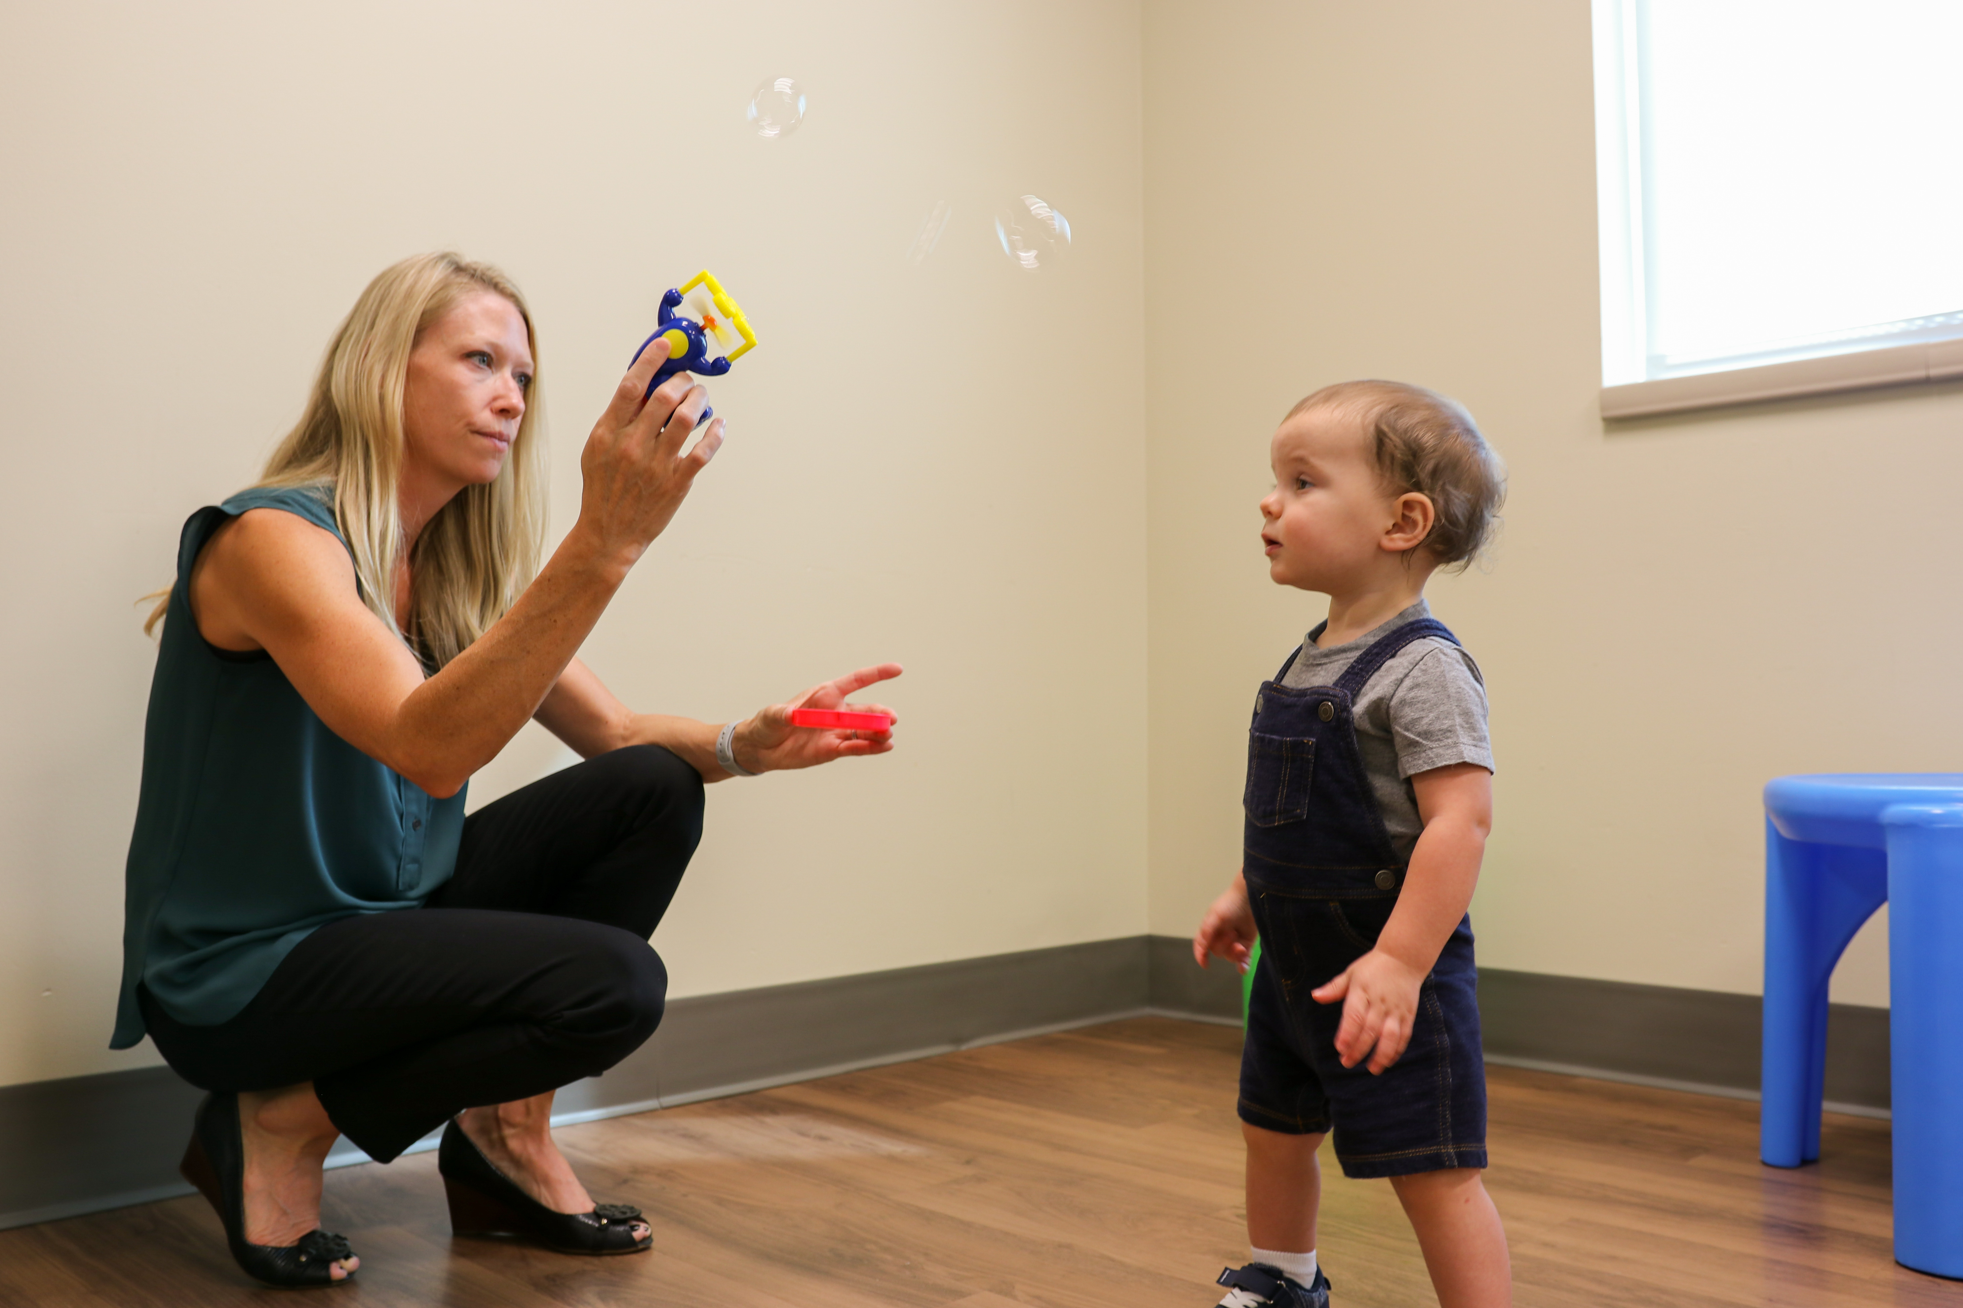
Here’s how we did it
This study evaluated the diagnostic accuracy of the Early Autism Evaluation(EAE) Hub system, a statewide model of early ASD evaluation in the primary care setting
  Diagnostic accuracy between PCPs and expert ASD evaluation
  Diagnostic, demographic, and phenotypic characteristics associated with diagnostic accuracy
Children who participated
  Mean age: 30 months
  Diverse backgrounds

Slide 4
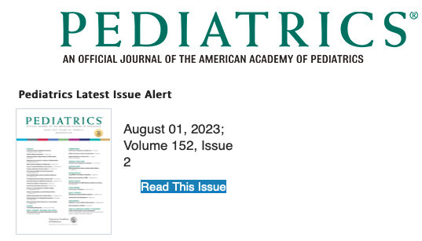
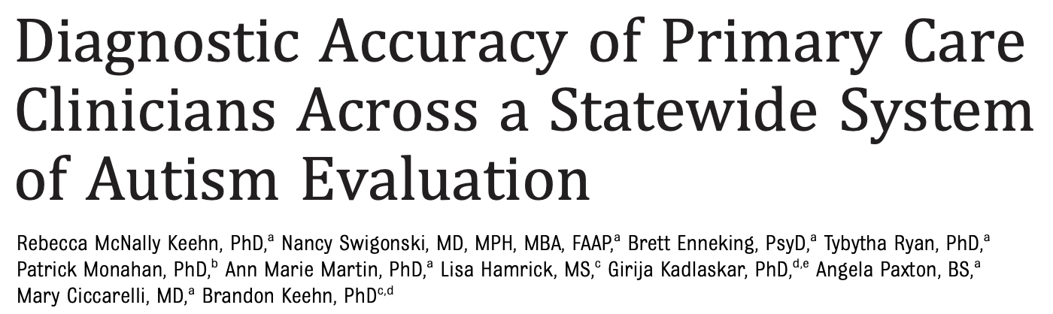
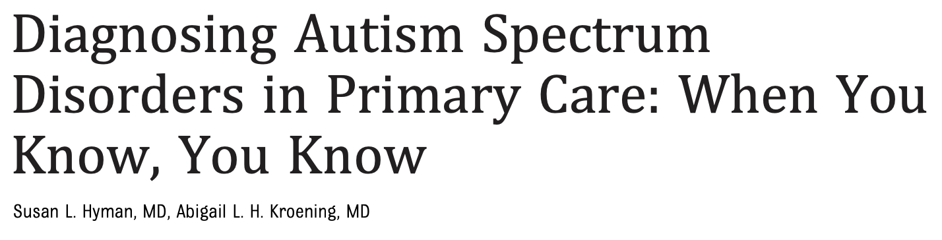
Future implications
Strong empirical support for tiered community-based models of ASD diagnosis
  Tiered models have the potential to relieve burden on specialty care
Disseminated via
  Oral session at International Society for Autism Research
  Peer-reviewed publication in Pediatrics with linked Commentary highlighting the impact of the research
Next steps
  Engage stakeholder in refining a more scalable model of PCP training (K12)

Slide 5

Grant Acknowledgement
This project was funded with support from the Indiana Clinical and Translational Sciences Institute which is funded in part by Award Number K12TR004415 from the National Institutes of Health, National Center for Advancing Translational Sciences, Clinical and Translational Sciences Award. The content is solely the responsibility of the authors and does not necessarily represent the official views of the National Institutes of Health.
Additional sources of funding
  National Institute of Mental Health (R21MH121747)
  Purdue Big Ideas Challenge 2.0
  Indiana CTSI (UL1TR002529)
  Riley Children’s Foundation
  Kiwanis Indiana
  Haddad Family Foundation

