Slide 1
Community drug checking in a restrictive regulatory environment: recovery of drugs from used fentanyl test strips (FTS)
Gap analysis
Identify resources and needs
Modify Narcan training, wound care kits
Situational awareness
learn what is going on in the drug supply
Presence of xylazine
Identify threats
Increase capacity
Heather Whitehead,¹ Warnakulasuriya Thilini Hirudini Fernando,¹ Joanne Cogdell,² and Marya Lieberman¹ (mlieberm@nd.edu)
1 Department of Chemistry and Biochemistry, University of Notre Dame, Notre Dame IN
2 Naxos Neighbors LLC, South Bend, IN
Harm reduction
Inform participants about dangers
Overdose & wound risks
Reduce harm

Slide 2
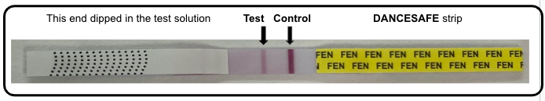
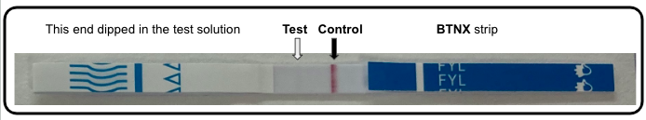
FTS are used to generate actionable info for opioid harm reduction
Negative
Positive
After use, the strips are normally thrown away in the trash.
→ We can get extra information from the used FTS with mass spectroscopy

Slide 3
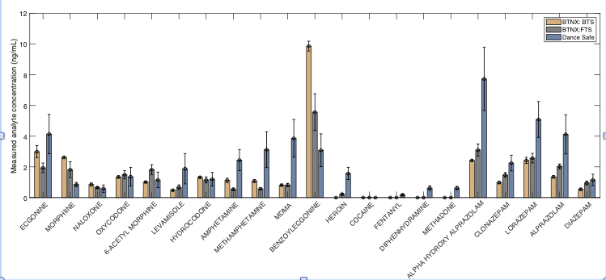
Tandem MS identifies other drugs “archived” in used FTS

