Slide 1
Indiana Clinical and Translational Sciences Institute
2023 Annual Meeting
Associations of GFAP, NfL, Aβ42/40, and pTau231 with global cognition in LEADS
Ralitsa Kostadinova, B.A.
This study is generously supported by R56 AG057195,
U01 AG057195,
NIA P30 AG010133,
U24 AG021886,
U01 AG016976,
and the Blennow/Zetterberg lab. Additional thanks to the Apostolova lab and all co-authors.

Slide 2
Background and Methods
Background:
Alzheimer’s disease (AD) biomarkers have been a growing hallmark to accurately measure the presence of the disease. Previous research has concentrated on testing the reliability of plasma pTau231 but little to none of it has focused on early-onset AD (EOAD) populations. Data retrieved was from the Longitudinal Early-Onset Alzheimer’s Disease Study (LEADS).
Methods:
We focused on 367 LEADS participants aged 41 to 65, categorized as amyloid PET-positive EOAD, amyloid PET-negative EOnonAD, or cognitively normal CN.
Partial correlations were conducted between cognitive measures (MMSE, MoCA, CDR-SB, and ADAS-Cog13) and biomarkers (Aβ42:40, pTau231, NfL, and GFAP), and accounted for demographic variables (age, gender, and education).

Slide 3
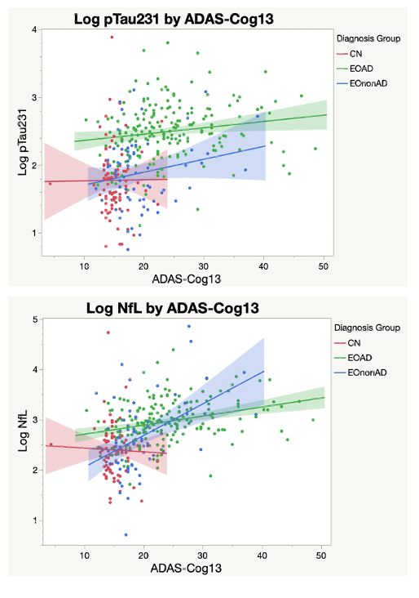
Results and Conclusions
Results:
Moderate associations between the cognitive variables and plasma pTau231, GFAP and NfL. Weaker associations with Aβ42:40.
All correlations significant in the pooled sample.
NfL and GFAP correlations with global cognition were significant in EOAD and EOnonAD. Aβ42:40 correlations were generally not significant. The pTau231 correlations were significant in EOAD.
Conclusions:
The biomarkers pTau231 and NfL showed stronger association with cognition compared to Aβ42:40.

