Slide 1



Early Changes In Porcine Larynges Following Injection Of Motor-Endplate Expressing Muscle Cells For The Treatment Of Unilateral Vocal Fold Paralysis
Samuel Kaefer, Lujuan Zhang MD, Rachel Morrison PhD, Sarah Brookes DVM PhD, Oluwaseyi Awonusi MD, Elizabeth Shay MD, Orlando Hoilett PhD, Jennifer Anderson PhD, Craig Goergen PhD, Sherry Voytik-Harbin PhD, Stacey Halum MD FACS
Presented at the American Broncho-Esophageal Association’s Annual Meeting - May 6th, 2023
CTSI 2023 Annual Meeting Poster Consideration
Notes:
Hello my name is Sam Kaefer, I am a medical student from Indiana University, and today I am going to talk about the work I helped conduct in Dr. Halum’s laboratory this past year regarding Early Change in Porcine Larynges Following Injection of Motor-Endplate Expressing muscle cells for the treatment of unilateral vocal fold paralysis.
8

Slide 2


Background
  There is an unwavering need for a simple, cost-effective, and permanent treatment for UVFP secondary to RLN injury.
  AMDCs have shown promise in OTO-HNS pathologies,¹ and within the Halum lab we have taken this biotherapeutic a step further with Motor Endplate-Expressing Muscle Cells (MEEs):
    Vector-free, autologous-derived, neurotrophic secreting, generated in therapeutic quantities in 3-4 weeks, still holding myogenic benefits.²
Purpose of Study
  Do MEEs injected into denervated laryngeal muscle positively impact the molecular microenvironment to promote RLN reinnervation?
Abbreviations:
UVFP = Unilateral vocal fold paralysis
AMDCs = Autologous muscle-derived cells
OTO-HNS = Otolaryngology-Head and Neck Surgery
MEE = Motor endplate-expressing muscle cells
RLN = Recurrent Laryngeal Nerve
Notes:
There is an unwavering need for a simple, cost-effective, and permanent treatment for UVFP.
Autologous muscle derived cells have shown promise in treating ENT pathologies, and we have taken this concept a step further to develop MEEs which are autologous derived, vector free, neurotrophic secreting muscle cells that can be generated in therapeutic quantities over the course of a couple weeks and still hold the myogenic benefits of muscle progenitor cells
A prior collaborative study with Wash U has revealed the long-term benefits of injectable MEEs for laryngeal reinnervation in large animals
8

Slide 3
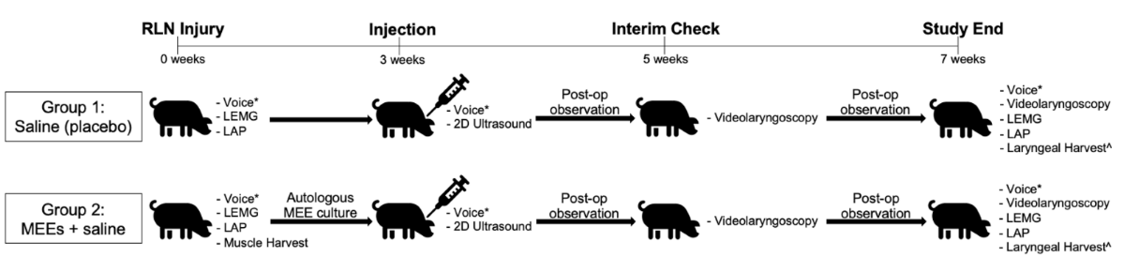
Methods
Muscle Harvest = 1 to 2 grams from laryngeal strap muscles
Voice = voice recording, LEMG = laryngeal electromyography, LAP = laryngeal adductor pressure
= data collected prior to anesthesia.
^ = further analysis through 3D ultrasound, quantitative polymerase chain reaction, and immunohistochemistry were performed.
Notes:
This displays our study methods. In summary, pigs were subjected to full transection injury and strap muscle biopsies were harvested. Following the completion of MEE culture 3 weeks later, saline or cells in saline were injected targeting the thyroarytenoid muscle. One month later, pigs were further analyzed and full larynges were harvested for further analysis.
I just want to emphasize the following as this pertained to our study goals of molecular analysis the most.
8

Slide 4
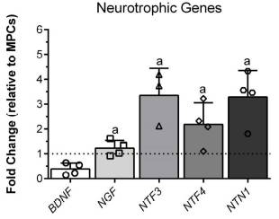
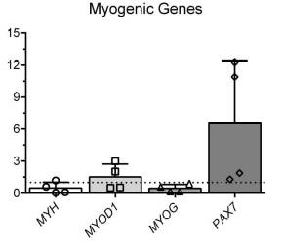
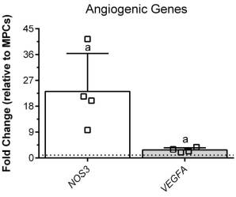
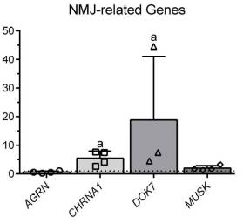
Increased Expression of Neurotrophic, Angiogenic, and NMJ-related Genes in MEEs Compared to MPCs
  MEEs also retaining pool of satellite (regenerative) cells (PAX7).³
  Average viability of injected MEEs was 97.64% (s.d. 1.86).
Abbreviations:
NMJ = Neuromuscular junction
MEE = Motor endplate-expressing muscle cells
MPC = Muscle progenitor cell (harvested muscle)
Stats:
a = ≤ 0.05
2-tailed T-test MEE vs. MPC
Notes:
Injected MEE aliquots display increased expression of neurotrophic and NMJ-related factors compared to MPCs.
Of note, MEE retained a regenerative capacity of MPCs as seen by expression of PAX7. And our culture yields were consistently high.
8

Slide 5

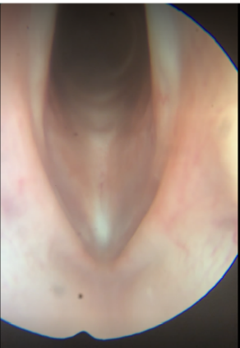
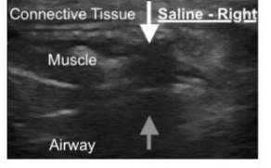
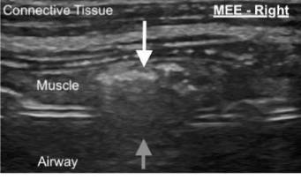
Injection
(3 weeks)
Study End
(7 weeks)
2D Ultrasound
Notes:
The following video shows our injection approach, making sure to go past the false vocal fold and aiming for the TA muscle.
Directly after, proper injection placement was confirmed at the bedside with 2D ultrasound. Injected material is localized by its created shadow denoted by grey arrow. Injected material was distinguishable given saline is hypoechoic and MEEs were hyperechoic.
One can also appreciate the lack of gross inflammation (no erythema, induration, or mucosal irregularity) in MEE-pigs at 4 weeks post-injection.
8

Slide 6
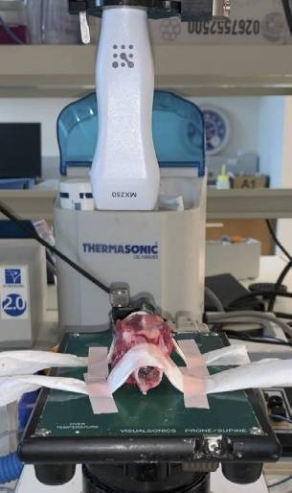
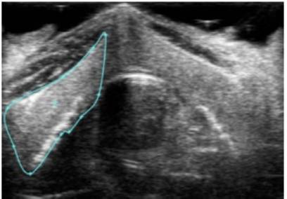
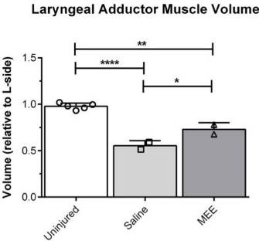
MEE Injected Larynges Showed Greater Adductor Volume compared to Saline
Ellipsoid
Stats:
* = p ≤ 0.05
** = p ≤ 0.01
**** = p ≤ 0.0001
Tukey’s Multiple Comparisons
Notes:
The following shows our set up for analyzing laryngeal volume via 3D ultrasound.
We then outline adductor muscle regions using Vevo software.
Utilizing the equation of ellipsoid and normalizing to non-injured left sides to account for biological variation, we could compare groups (as well as to normal larynges) to reveal the benefit of MEE injection compared to saline only.
8

Slide 7
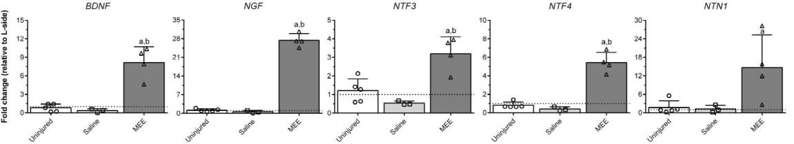
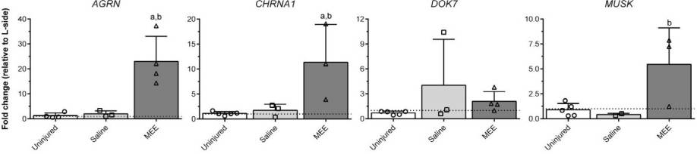
Retained neurotrophic and NMJ-related expression
Survival, differentiation of motor nerves.⁴
Survival, differentiation of sensory and autonomic nerves.⁴
Predominantly survival, differentiation of sensory nerves.⁴
Survival, differentiation of motor nerves.⁴
Axonal guidance.⁵
  Comparable expression of satellite pool marker, PAX7.
  Statistically higher angiogenic NOS3 expression.
Stats:
a = p ≤ 0.05 compared to Uninjured
b = p ≤ 0.05 compared to Saline
Tukey’s Multiple Comparisons
Notes:
TA muscle showed increased expression of all tested neurotrophic factor 1-month after injection. I would like like to draw your attention to NTN-1, a chief guider or the regenerating RLN axon, as well as to the fact that although some of these factors have been studied prior, they have not been all at once.
The majority of NMJ-related genes showed increased expression, and I just want to emphasize CHRNA1 as this gene’s protein product is what we targeted in histology staining.
Lastly, the TA muscles still show regenerative ability through PAX7, and heightened angiogenic expression.
<number>

Slide 8
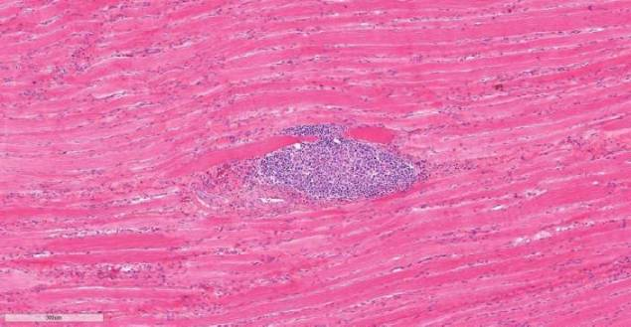
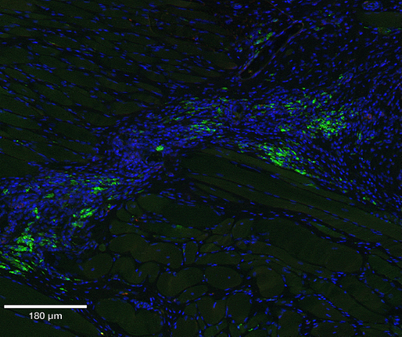
Areas of Hypercellularity
on H&E Histology
NMJ-related Protein Expression Detected by Immunofluorescence
DAPI
CHRNA1
Lack of fibrotic capsule on H&E, positive expression on IF, and autologous cells
→ Likely due to dosing and not rejection.⁶
Notes:
Naturally, we wanted to try and localize where MEEs were injected. We saw areas of hypercellularity on H&E slides and used these to concentrate IF analysis.
This ultimately revealed evidence of continued viability and MEE-related protein expression 1-month after injection.
Taken together and with review of the literature, this hypercellularity is likely a result of high dosing density leading to nutrient starvation, a phenomenon described in cellular therapeutics but not widely studied in skeletal muscle therapy at this point. Additionally, this may self-resolve given we did not see this in the aforementioned long-term pilot study.
<number>

