Slide 1

Indiana Clinical and Translational Sciences Institute
2023 Annual Meeting
Agent based model of latent and naïve in vitro M. Tuberculosis early infection dynamics shows synergistic interactions between CD4+ T cell and macrophage activation
Alexis Hoerter
PhD Candidate | CTSI TL1 Fellow
Pienaar Computational Systems Pharmacology Lab

Slide 2
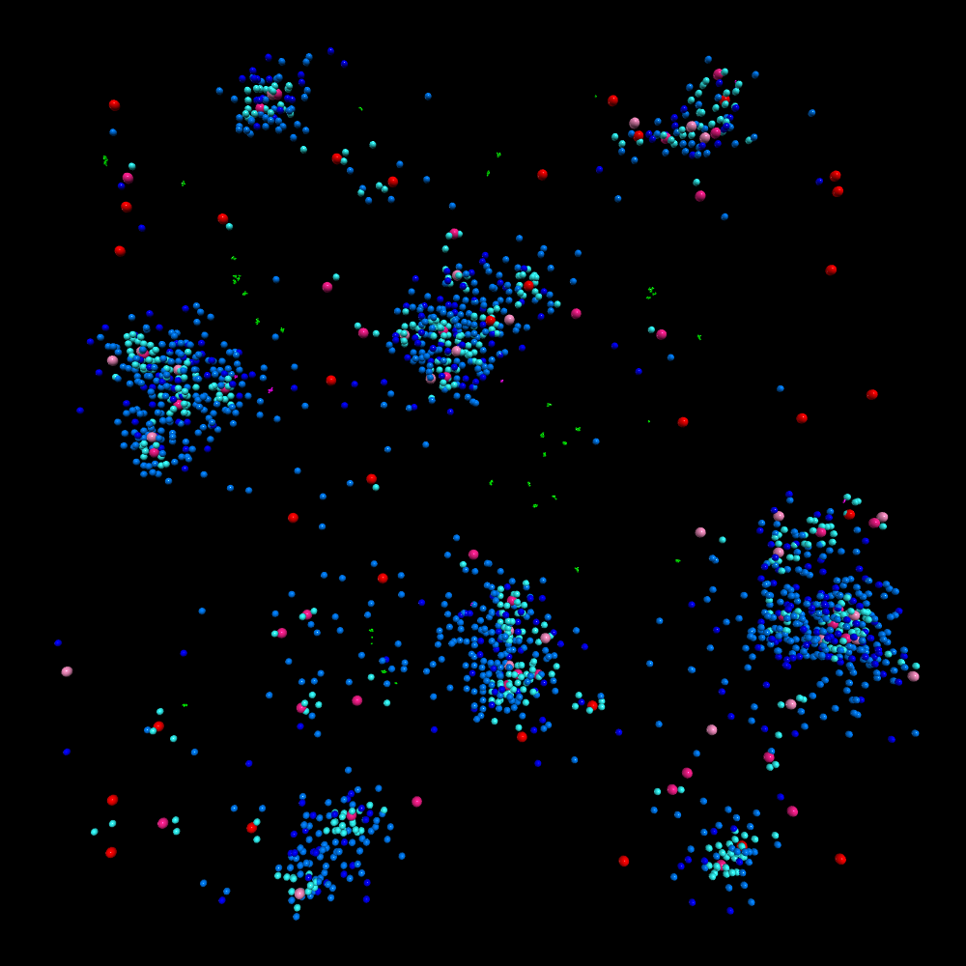
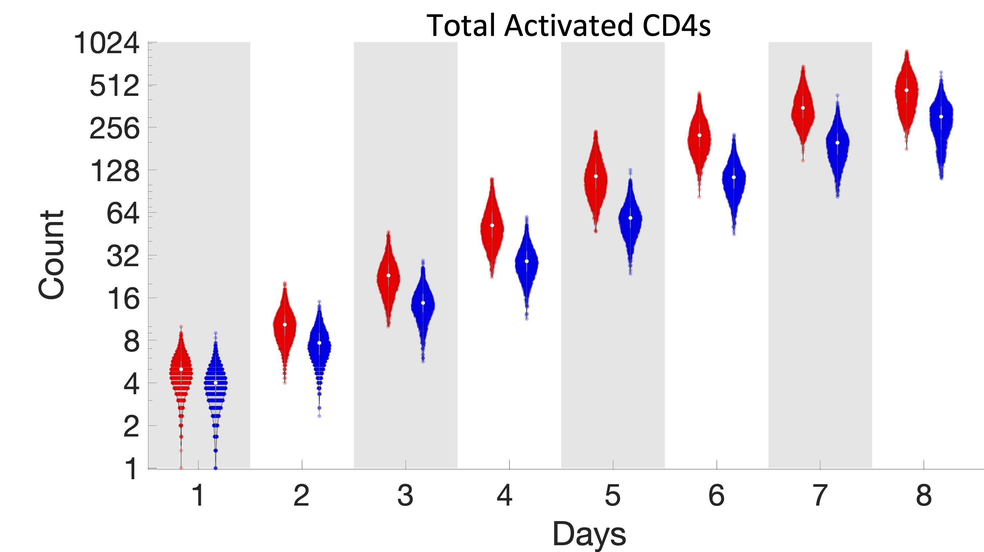
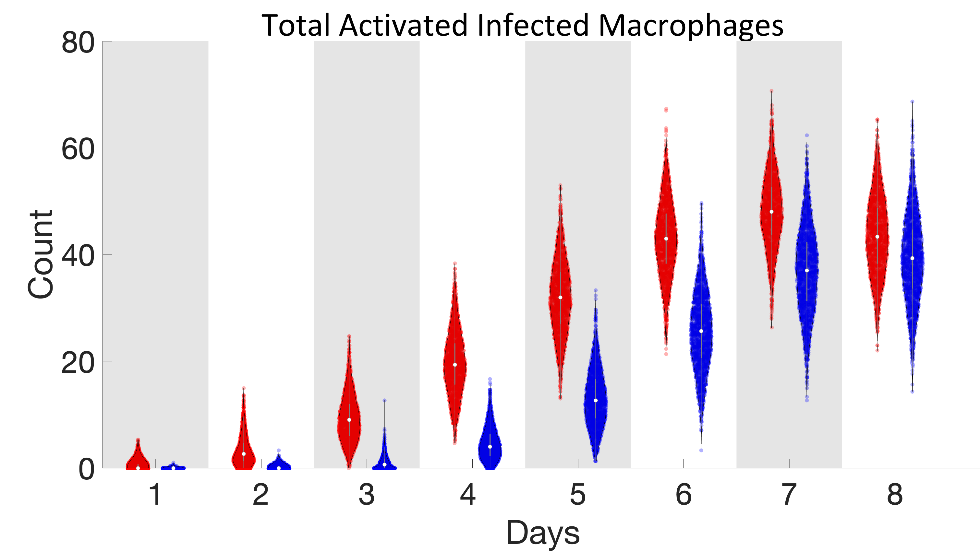
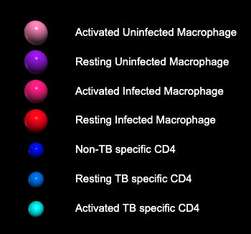
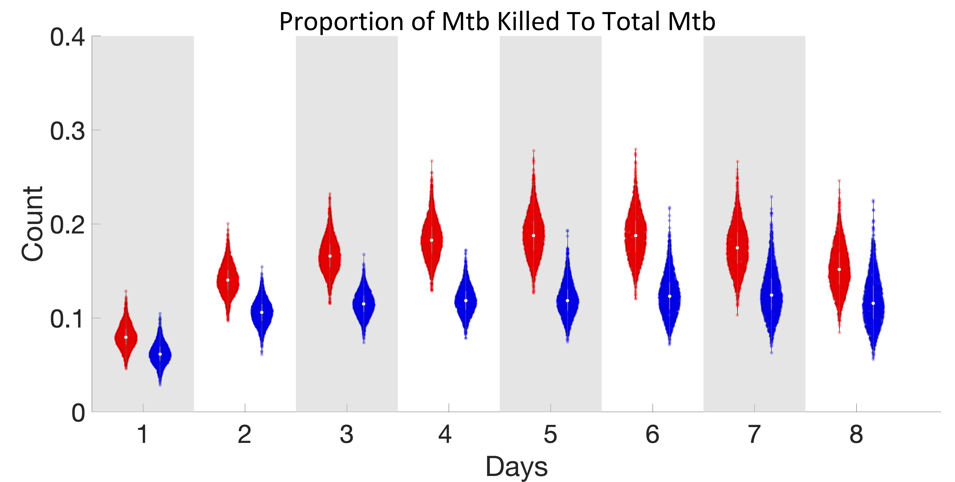
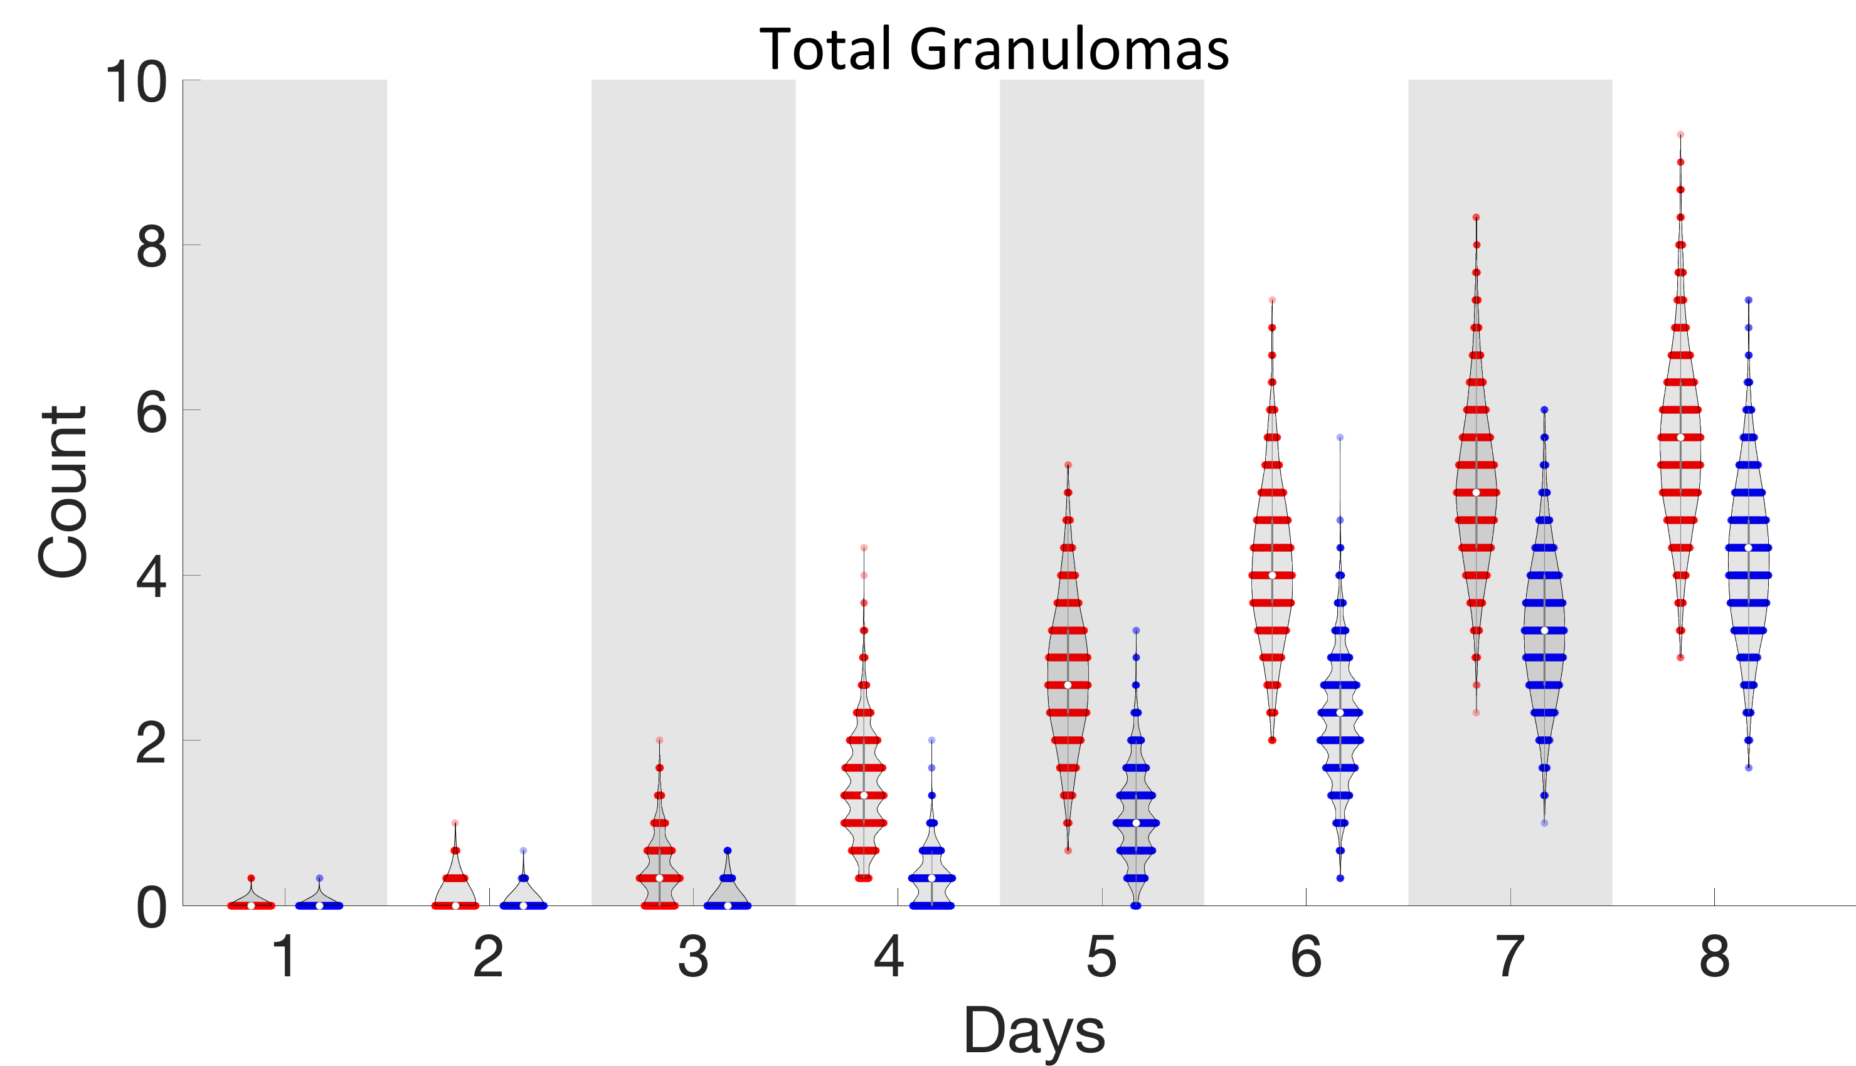
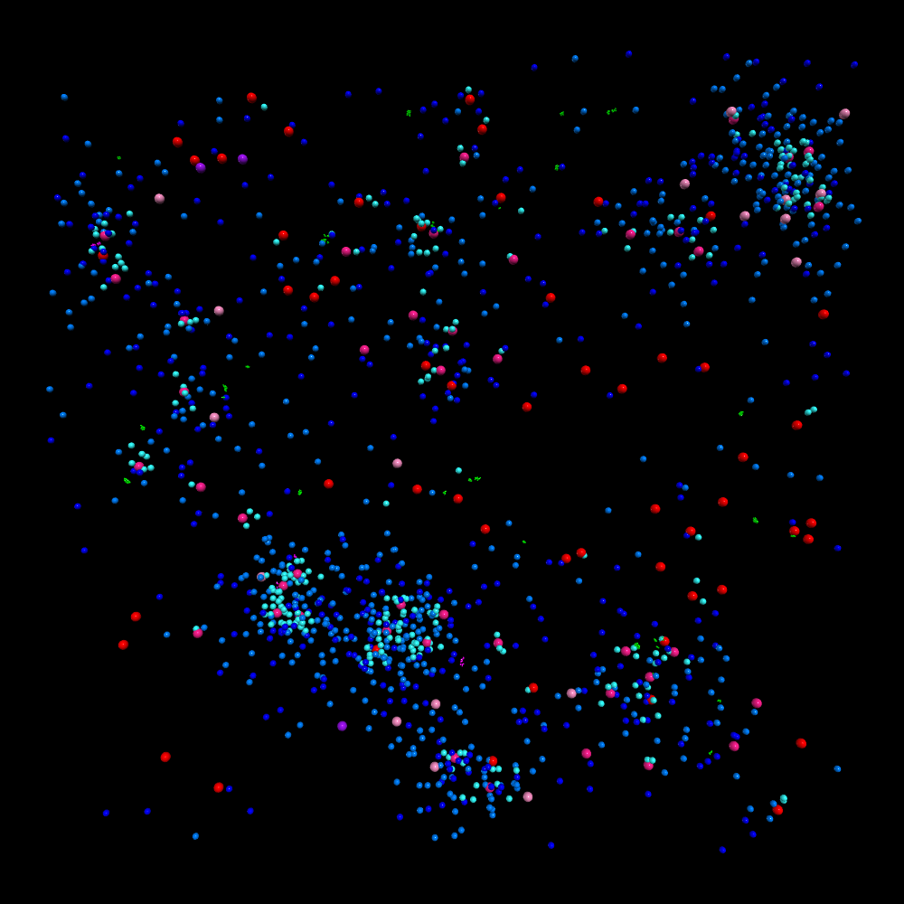
LTBI controls bacteria through macrophage activation
Early activation of CD4+ T cells and macrophages in LTBI
LTBI kills more bacteria
LTBI has more and larger granulomas
Granulomas promote activation of macrophages
LTBI
Naïve
Day 8 Post Infection
LTBI: Red, n =2223
Naïve: Blue, n =2099
Notes:
Begin by stating the Super Big Results (state them in 3 key points, like an outline)

Slide 3
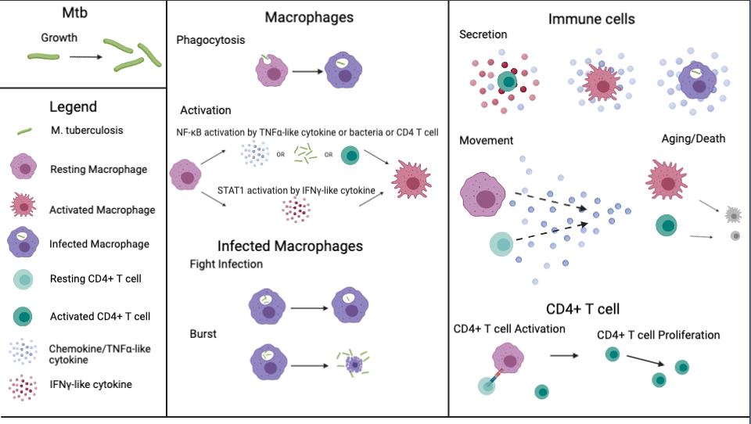
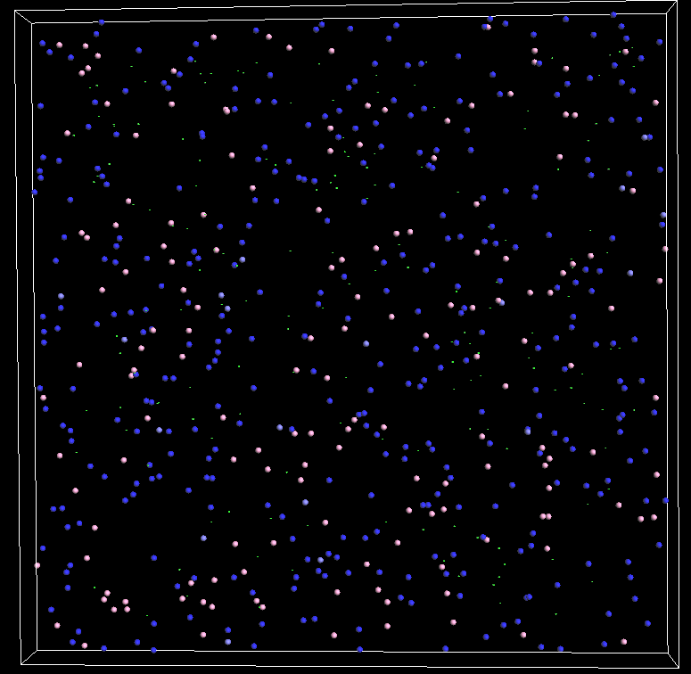
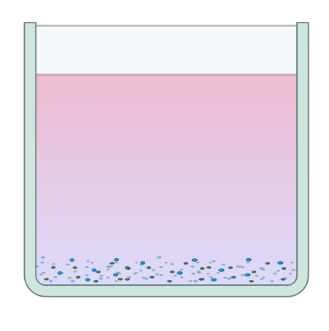

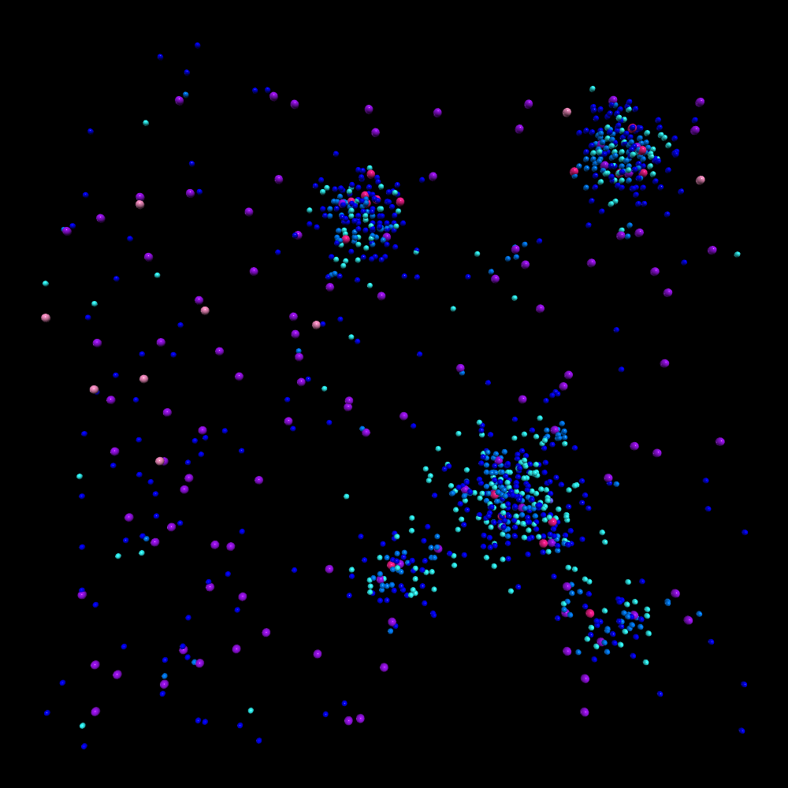
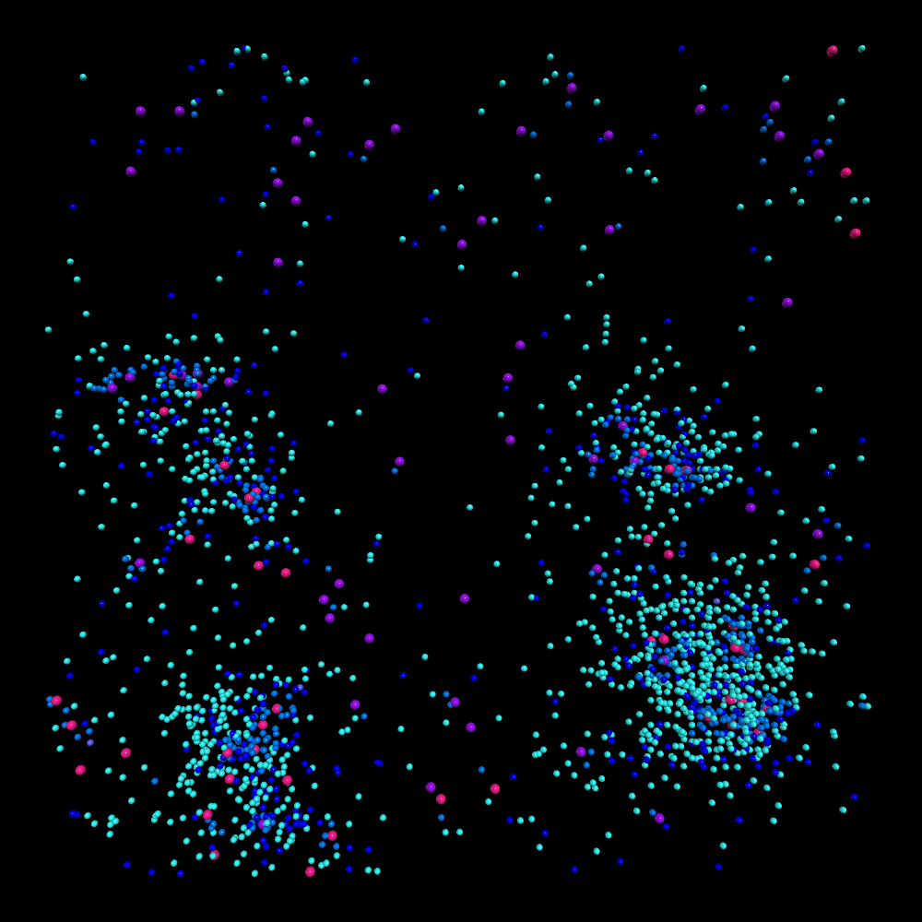
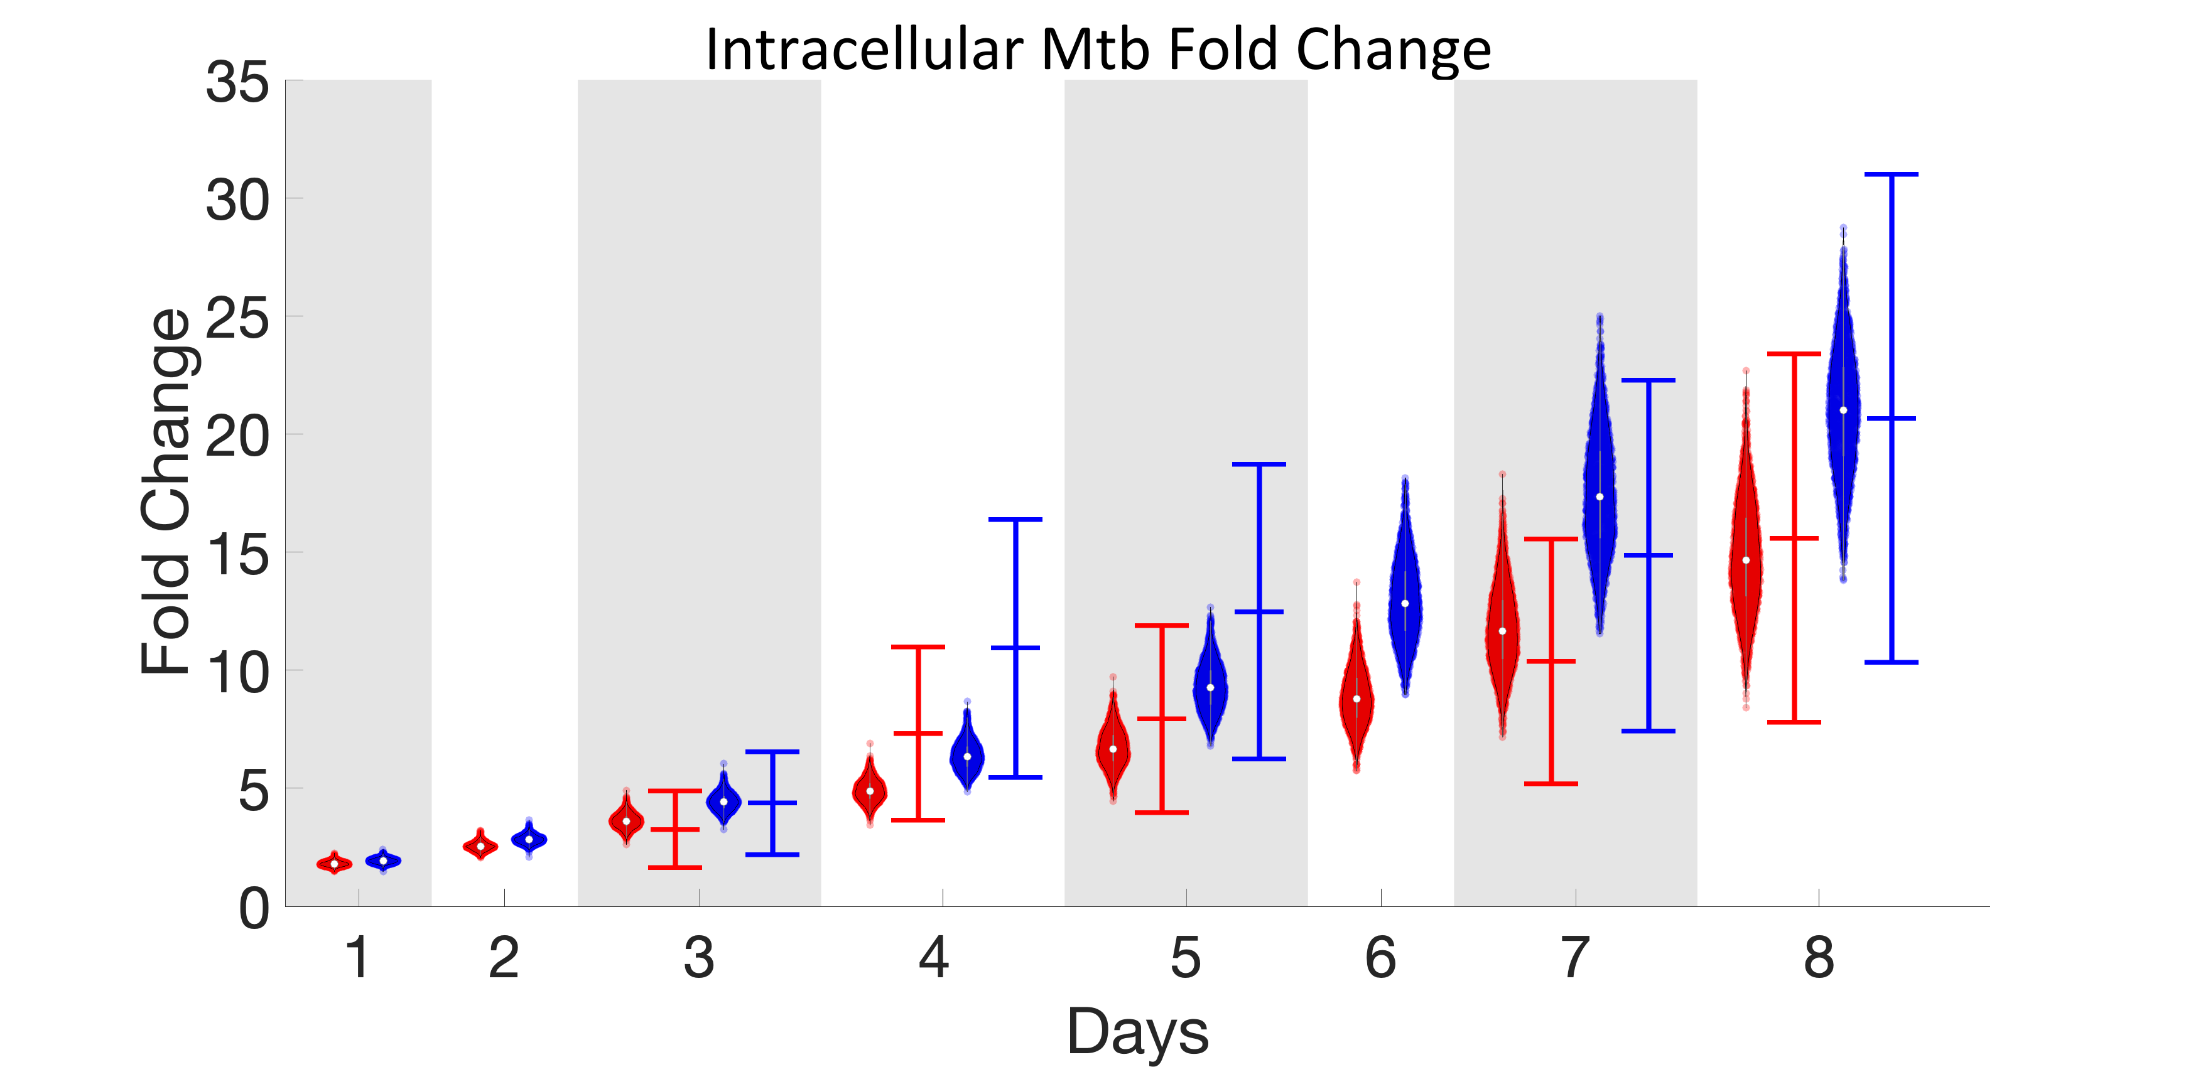
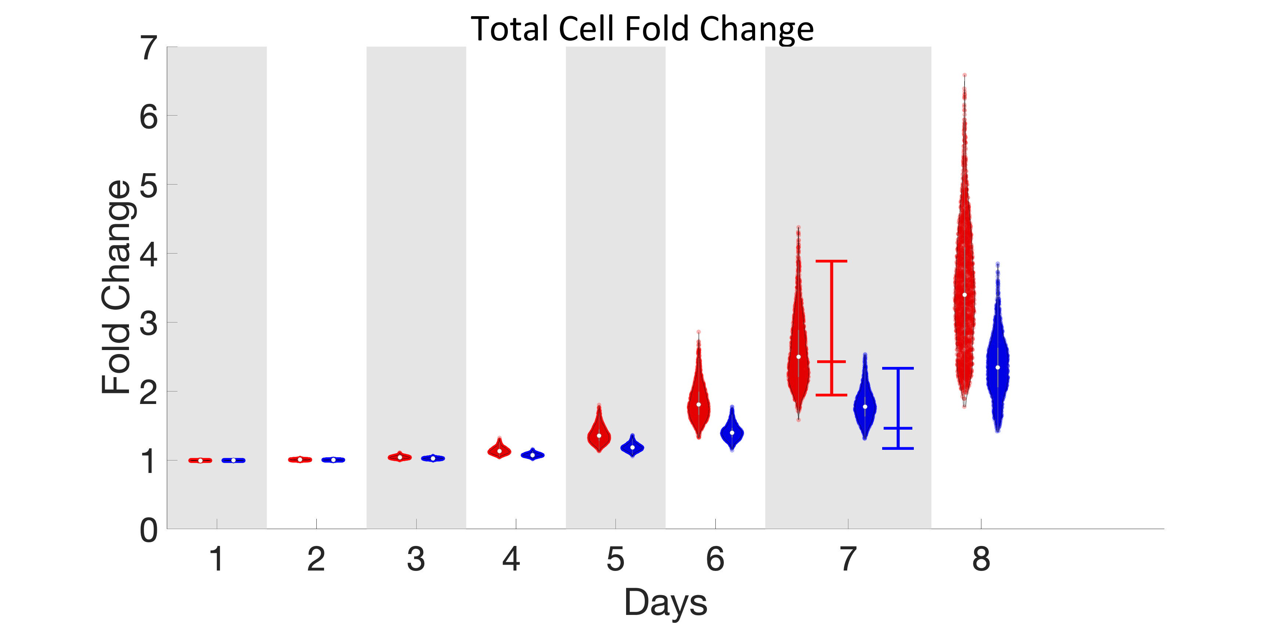

Mechanistic Agent Based Model Calibrated to Experimental Data Data
1 well
Infected Macrophage
Uninfected Macrophage
Activated and Uninfected Macrophage
Non-TB specific CD4+ T cell
TB specific CD4+ T cell
TB specific and Activated CD4+ T cell
TB specific, activated and proliferated CD4+ T cell
Bacteria
LTBI: Red, n =2223
Naïve: Blue, n =2099
Experimental: ⎯
Simulation: ●

Slide 4
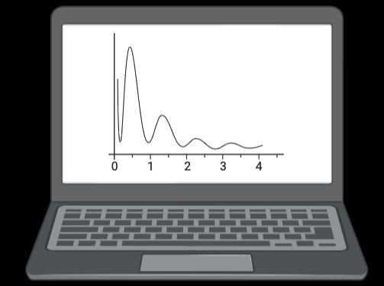
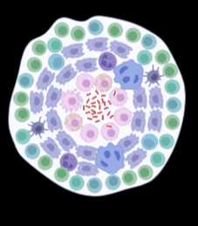
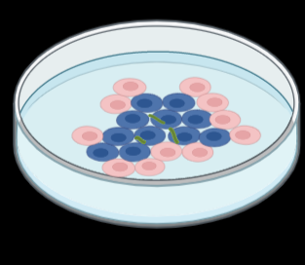
Future implications for patients or the community/ or next steps
  In vitro model
  Donor specific
  Flexible
  Mimics granuloma structure
  Agent based model
  Stochastic – cell-cell interactions
  Spatiotemporal – granuloma formation
  Allow for heterogeneity – variability in model
Host directed therapies to increase macrophage activation such as IFNγ
Trained immunity in TB infection
Notes:
Before creating your 3 slides that will form your 2-minute video, think about how you would present your slides in a TWEET, and use that brief format to guide your points. Provide key takeaways for the most impact.

Slide 5
Grant Acknowledgement
For TL1 Predoctoral and Post-Doctoral Awardees: “This project was funded with support from the Indiana Clinical and Translational Sciences Institute which is funded in part by Award Number TL1TR002531 from the National Institutes of Health, National Center for Advancing Translational Sciences, Clinical and Translational Sciences Award. The content is solely the responsibility of the authors and does not necessarily represent the official views of the National Institutes of Health.”
Notes:
If your project or training has been supported by the Indiana CTSI, your poster and PowerPoint presentation should include acknowledgement of the appropriate Indiana CTSI grant.
For your convenience, we have added this list of award sources to the last slide of the PowerPoint template. Please review the list of award sources and delete those that did not contribute to the conduct of the research reported in your presentation.
If your project or training was supported by other grants, please remember to acknowledge those grants as well.

