Slide 1


Indiana Clinical and Translational Sciences Institute
2023 Annual Meeting
Central Apnea Severity is Related to Changes in Natriuretic Peptide Levels During Decongestive Treatment of Acute Decompensated Heart Failure.
Nicholas Harrison MD, MSc
Assistant Professor of Emergency Medicine, IUSM
KL2 Scholar, Indiana CTSI 2022-2024

Slide 2
Here’s what we found
Despite a high prevalence (>50%) and morbidity/mortality associated with CS-CA in heart failure patients, effective treatment modalities for CS-CA has remained elusive in clinical trials
We discovered – for the first time ever – evidence that the severity of Cheyne-Stokes central apnea (CS-CA) is correlated with a treatment-responsive biomarker of congestion severity in real patients with acute decompensated heart failure (B-type natriuretic peptide, BNP).
The association through time between central apnea index (CAI) and BNP remained significant after adjusting for other hypothesized physiologic drivers of CS-CA in heart failure (pulmonary edema severity, metabolic alkalosis, etc.) which were found to not be significant.
These findings suggest that CS-CA is related to the physiology of congestive myocardial dysfunction and elevated cardiac pressures on their own (possibly via cardiovascular stretch receptors or cardiac myocyte signaling under stress)
Notes:
Begin by stating the Super Big Results (state them in 3 key points, like an outline)

Slide 3
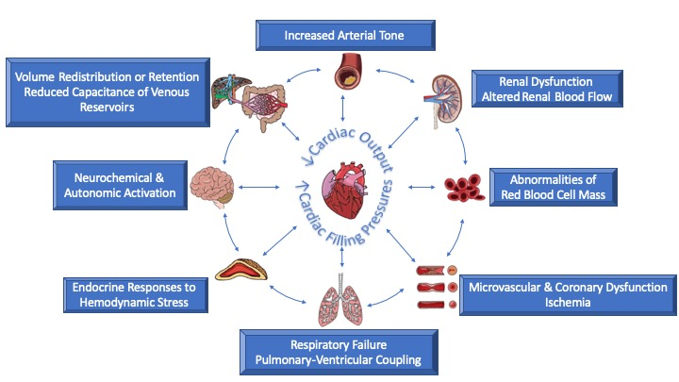

Here’s we did it
83 daily observations of 30 patients hospitalized for acute heart failure (AHF) were obtained, each including:
  Serum biomarkers (BNP, high-sensitivity troponin I, renal and hepatic function, electrolytes)
  Lung ultrasonography (LUS) to quantify severity of pulmonary edema
  Physical exams and patient questionnaires of congestion severity
  Central apnea monitoring using a portable sleep monitoring device, read by a blinded Sleep Medicine Specialist.
The time-adjusted correlation of Central Apnea Index (CAI) with hypothesized contributors to CS-CA was modeled via a repeated measures linear mixed model (LMM).
Pulmonary edema severity by LUS, BNP, and multiple other treatment-responsive biomarkers significantly improved during each day of hospital heart failure treatment (primarily IV diuresis)
Adjusted for daily LUS severity, serum chemistries, demographics, level of oxygen support, and vital signs, only changes in BNP were significantly associated with changing CAI during treatment.
Myocyte specific biomarkers
(BNP, cTn)
CAI
+
Biomarkers of Extra-cardiac pathophysiology in AHF
…Adjusted for….

Slide 4
Future implications for patients or the community/ or next steps
These findings suggest that the etiology of CS-CA in heart failure is directly related to cardiomyocyte dysfunction in congestion, via unknown means.
Furthermore, this casts doubt on previously hypothesized pathophysiologic mechanisms of CS-CA including the effects of chronic pulmonary congestion on gas-exchange, metabolic acid-base disturbances, and others.
This explains why treatment strategies for CS-CA in heart failure based on ventilatory modulation (adaptive servoventilation, CPAP) have not been found useful in prior clinical trials.
Treatment of the underlying heart failure, with aggressive diuresis for acute congestion and optimization of guideline-directed medical therapy, may be the key to solving CS-CA in heart failure patients.
Notes:
Before creating your 3 slides that will form your 2-minute video, think about how you would present your slides in a TWEET, and use that brief format to guide your points. Provide key takeaways for the most impact.

Slide 5
Grant Acknowledgement
“This project was funded with support from the Indiana Clinical and Translational Sciences Institute which is funded in part by Award Number KL2TR002530 from the National Institutes of Health, National Center for Advancing Translational Sciences, Clinical and Translational Sciences Award. The content is solely the responsibility of the authors and does not necessarily represent the official views of the National Institutes of Health.”
“This project was funded with support from the Indiana Clinical and Translational Sciences Institute which is funded in part by Award Number UL1TR002529 from the National Institutes of Health, National Center for Advancing Translational Sciences, Clinical and Translational Sciences Award. The content is solely the responsibility of the authors and does not necessarily represent the official views of the National Institutes of Health.”
This project was supported by an award from the Indiana University School of Medicine. The content is solely the responsibility of the authors and does not necessarily represent the official views of the Indiana University School of Medicine.
"This work was supported by Grant 2021258 from the Doris Duke Charitable Foundation through the COVID-19 Fund to Retain Clinical Scientists collaborative grant program and support from the IU School of Medicine Department of Emergency Medicine. The opinions expressed in this publication are those of the author(s) and do not necessarily reflect the view of the John Templeton Foundation."
Notes:
If your project or training has been supported by the Indiana CTSI, your poster and PowerPoint presentation should include acknowledgement of the appropriate Indiana CTSI grant.
For your convenience, we have added this list of award sources to the last slide of the PowerPoint template. Please review the list of award sources and delete those that did not contribute to the conduct of the research reported in your presentation.
If your project or training was supported by other grants, please remember to acknowledge those grants as well.

