Slide 1

Indiana Clinical and Translational Sciences Institute
2023 Annual Meeting
Out of Sight, Out of Mind: Using visual perception to probe subtle effects of mild traumatic brain injury on cortical physiology.
Elizabeth Frazier
PhD Student: Purdue University, Weldon School of Biomedical Engineering
Co-Authors: Anne Sereno, PhD; Maria Dadarlat, PhD

Slide 2


Results | A behavioral task to probe post-mTBI visual deficits
Traumatic brain injury (TBI) is a leading cause of death and disability.
Mild TBI (mTBI) is particularly diverse in functional deficits and patient prognosis.
Many mTBI patients suffer from
visual dysfunctions and visual acuity loss.
Neuropathology of mTBI disrupts cortical circuitry.
Developed a novel two alternative forced choice (2AFC) task to probe perception of complex global motion stimuli in mice, compatible with head-fixation for in vivo electrophysiology
Validated parameters to reliably generate mTBI in mice using a controlled cortical impact (CCI)
Established framework to bridge visual deficits and cortical circuitry changes following mTBI.

Slide 3
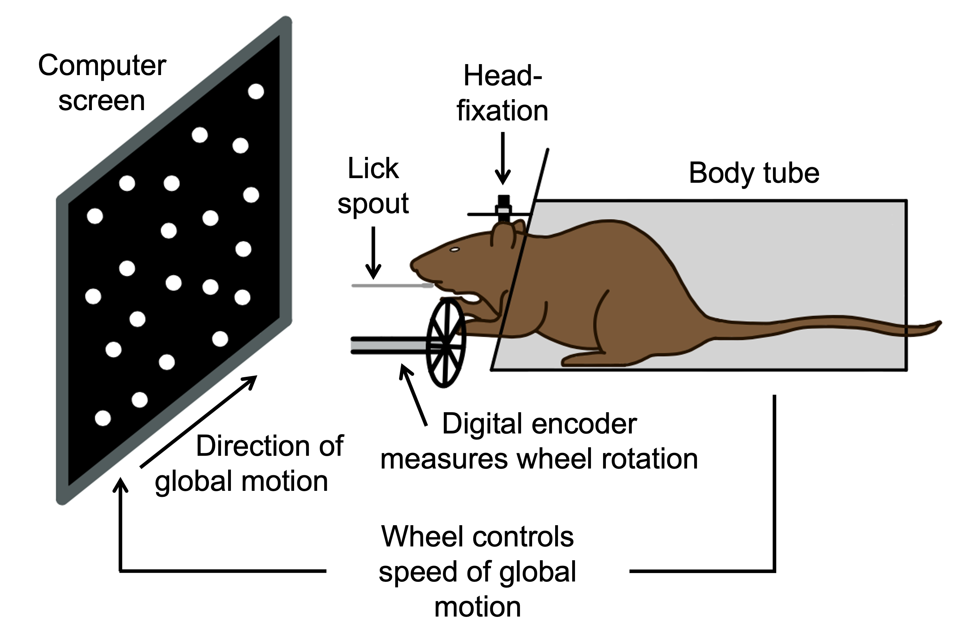
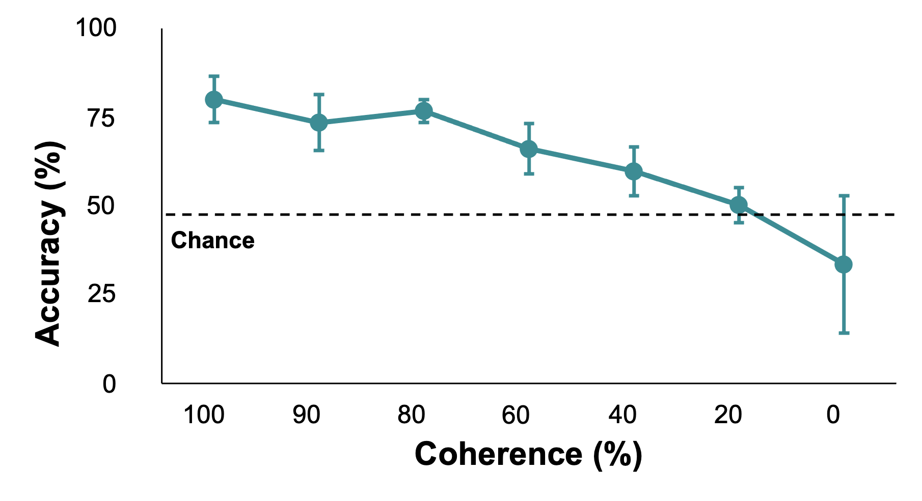
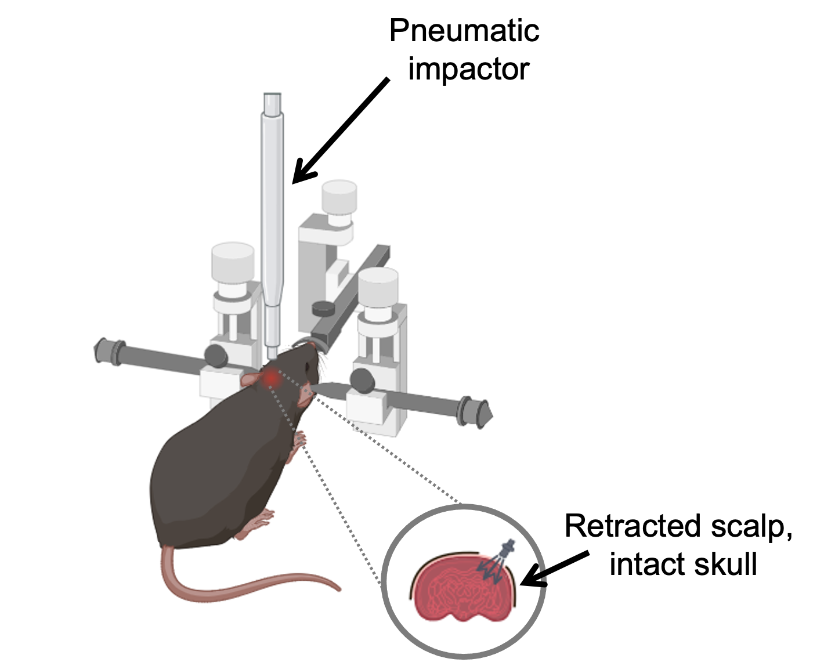
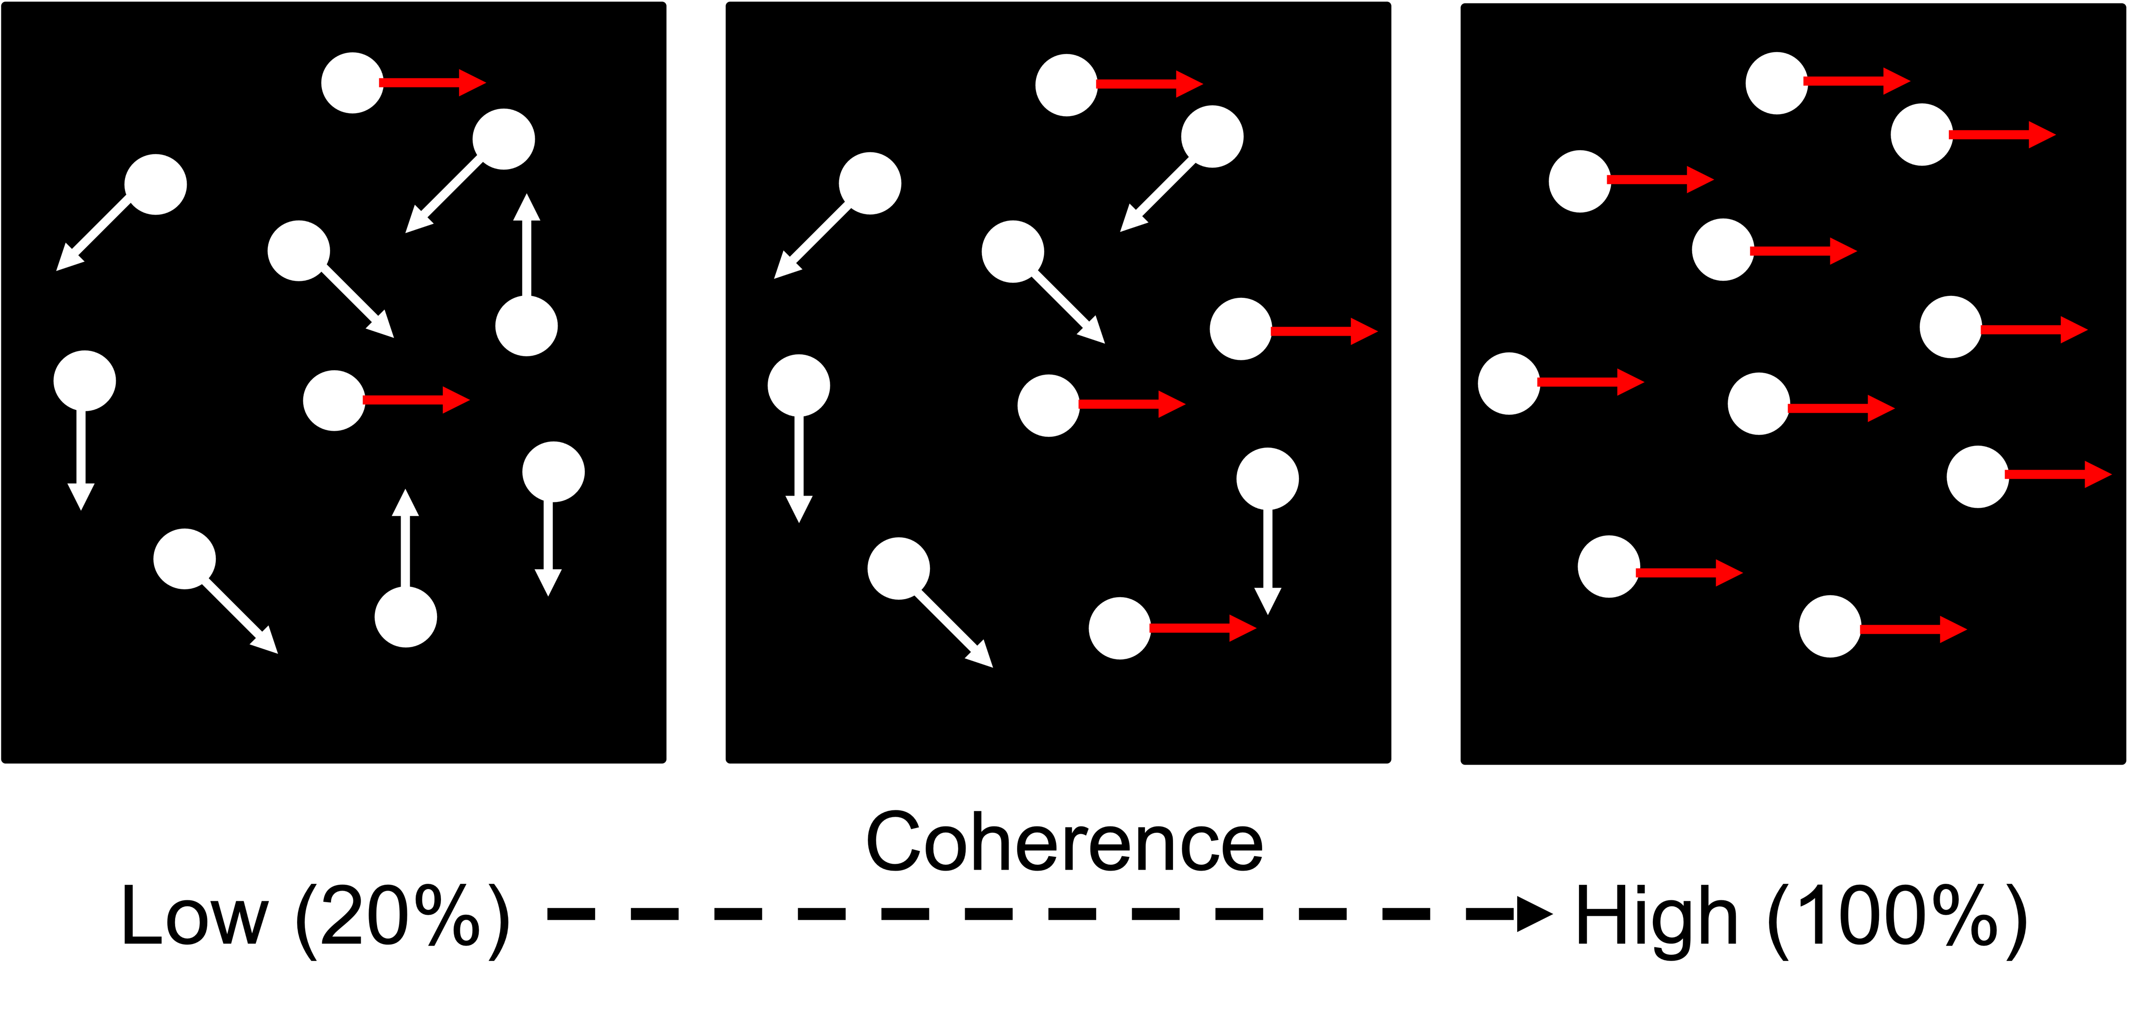
Methods | 2AFC task overview and mTBI validation
2AFC Task: Mice report global motion of a random dot kinematogram (RDK) with a wheel turn
mTBI: Mice receive a mild impact to skull over primary visual cortex
2AFC Task Setup
Sample Psychometric Data
Controlled Cortical Impact Setup
Impactor Parameters:
3 m/s tip velocity
0.8 mm depth
180 ms dwell time
3mm plastic tip
RDK Coherence
Created using Biorender.

Slide 4
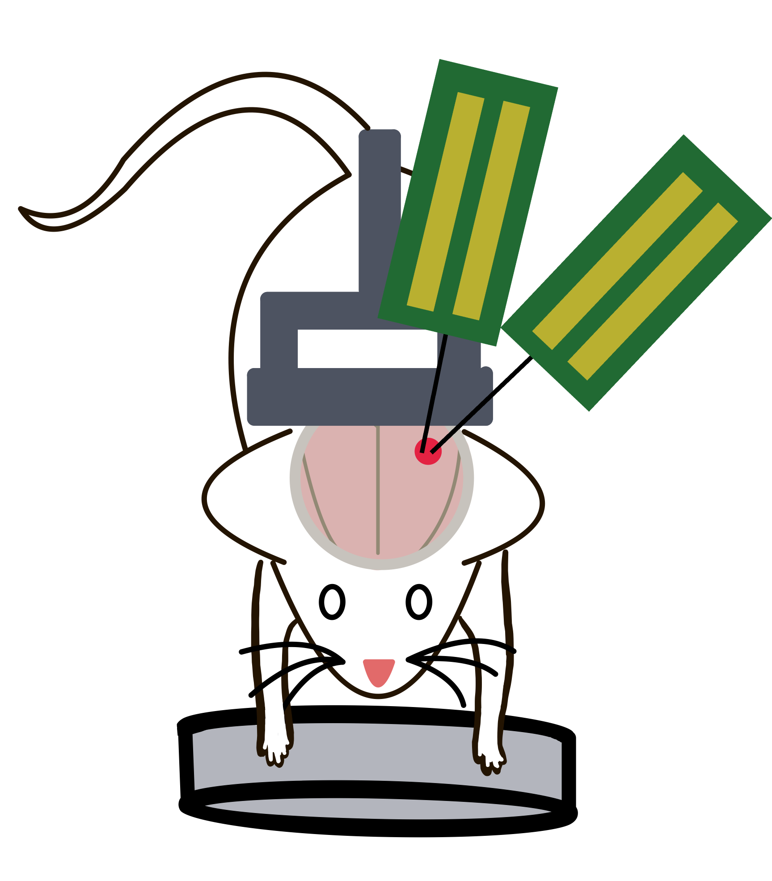
Future Work | Next steps and patient implications
Overall Objective | Correlate physiological outcomes post-mTBI to simple, visual behavior outcomes.
Acute, in vivo electrophysiology
Immediate Next Steps | Bridge behavior with electrophysiology
Acutely implant recording electrodes into the cortex of awake, behaving mice performing 2AFC task
Assess changes in behavior (speed/accuracy) and physiology (RDK-evoked responses/functional connectivity) following mTBI
Human Translation | Improve mTBI diagnosis and monitoring
Facilitate estimation of latent physiological changes after mTBI using performance on simple behavioral tasks
Improve prediction of mTBI prognosis
Translate 2AFC task to an easily administered, cost-effective tool to improve diagnosis and rehabilitation of mTBI patients

Slide 5
Grant Acknowledgement
Thank you for your attention!
“This project was funded with support from the Indiana Clinical and Translational Sciences Institute which is funded in part by Award Number UL1TR002529 from the National Institutes of Health, National Center for Advancing Translational Sciences, Clinical and Translational Sciences Award. The content is solely the responsibility of the authors and does not necessarily represent the official views of the National Institutes of Health.”

