Slide 1
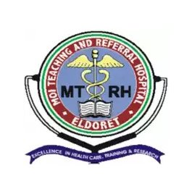
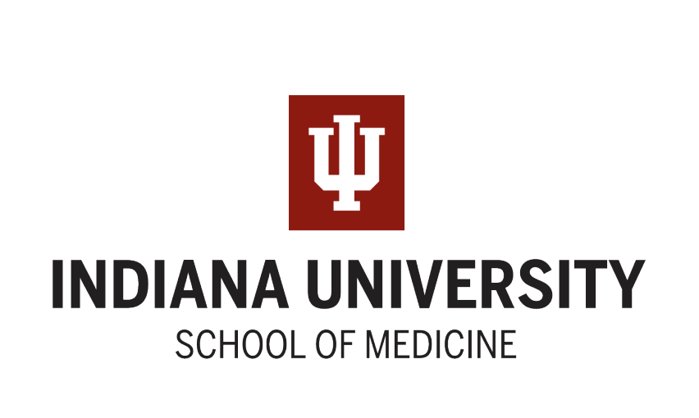


Neonatal Outcomes of Children who are HIV Exposed and Uninfected Compared with HIV Unexposed in Western Kenya
Mary Ann Etling^{1,2}, Eren Oyungu^{3,4}, Ziyi Yang¹, Emily Abuonji³, Carolyne Jerop³, Roselyne Ombitsa³, Cleophas Cherop³, Wanzhu Tu¹, Megan S. McHenry^{1,3}
¹Indiana University School of Medicine, Indianapolis, Indiana. ²Richard M. Fairbanks School of Public Health, Indianapolis, Indiana. ³Academic Model Providing Access to Healthcare (AMPATH), Eldoret, Kenya. ⁴Department of Child Health, College of Health Sciences,
Moi University School of Medicine, Eldoret, Kenya.

Slide 2
Background
Nearly 16 million children are born to mothers with HIV globally each year.
In Kenya, an estimated 840,000 children are born to mothers with HIV.
Emerging literature suggests this population has increased risk for adverse neonatal outcomes compared to their HIV unexposed peers.
This study is among the first to further investigate whether maternal HIV exposure is associated with newborn unit (NBU) admission in Kenya.

Slide 3
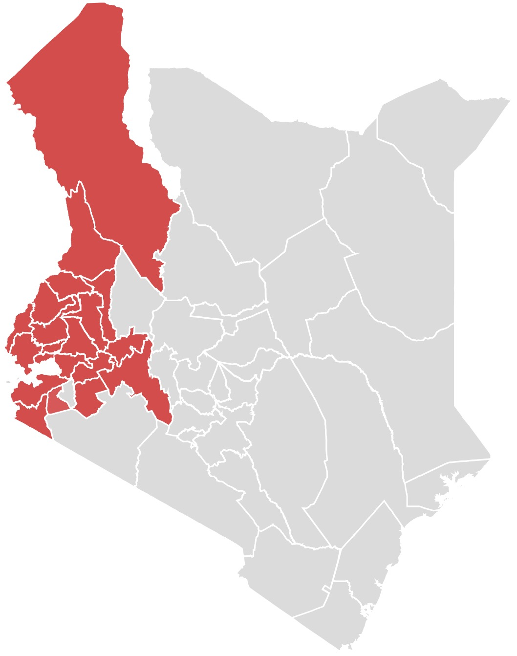
Methodology
Interim analysis of a longitudinal, cohort study of infants born to women living with HIV who are maternally age-matched to those born unexposed to HIV in western Kenya.
Setting: Moi Teaching and Referral Hospital in Eldoret, Kenya within the Academic Model for Providing Access to Healthcare (AMPATH) Partnership.
Maternal and infant characteristics were prospectively collected, and infants were followed for the first 28 days of life.

Slide 4
Results and Conclusion
A total of 511 infants and their mothers were included for analysis (253 HEU infants, 258 HUU infants).
Infants born to mothers with HIV had higher rates of NBU admission compared to their HIV unexposed peers (13.0% vs. 2.7%, p<0.001), as well as higher rates of low birthweight (<2500 g), preterm birth (<37 weeks gestation), supportive care in 24 hours, and respiratory distress (21.3% vs. 10.9%, p=0.002; 23.7% vs. 13.2%, p<0.001; 10.3% vs. 3.9%, p<0.001; 6.7% vs. 1.2%, p=0.003).
When adjusting for birth weight, odds of NBU admission remained significantly higher for infants who were born to mothers living with HIV (aOR=4.55, 95% CI 2.06-11.5, p<0.001).

