Slide 1
Indiana Clinical and Translational Sciences Institute
2023 Annual Meeting
Gene Co-Expression Network Analyses in Mild Cognitive Impairment
Valerie Dorsant-Ardon
Titles: MD, MS

Slide 2
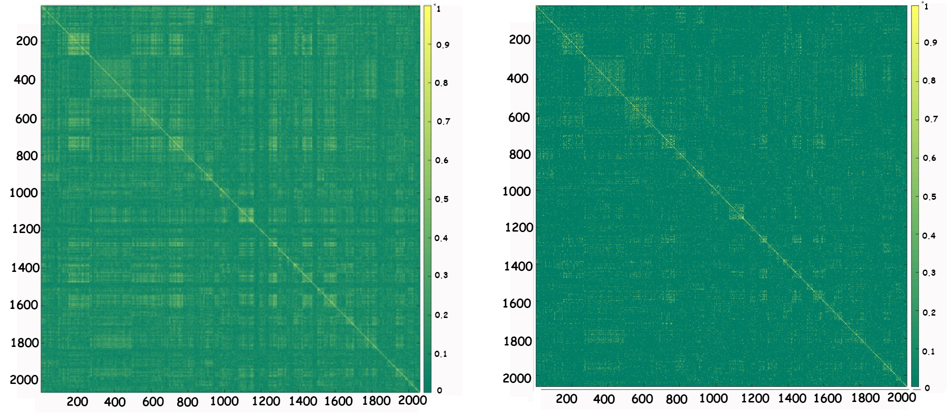
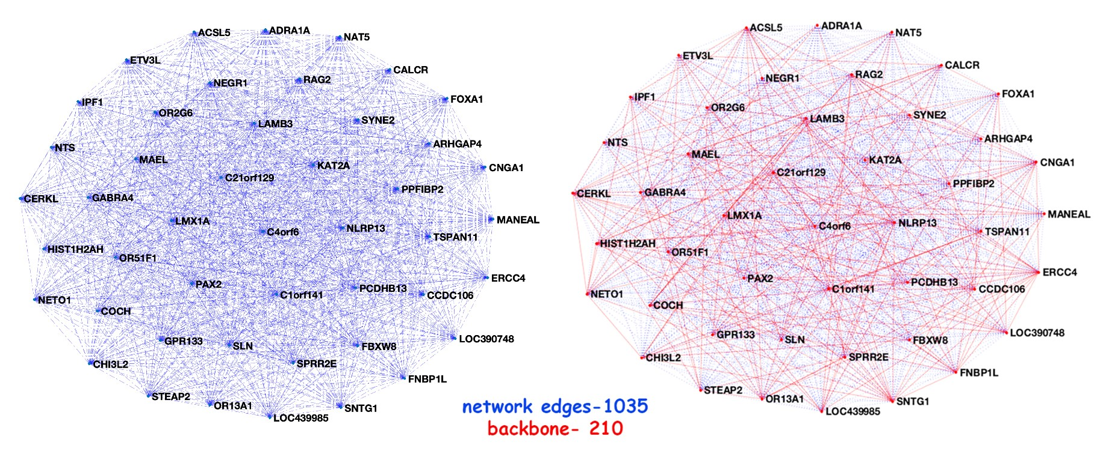
Here’s what we found
Figure 1: WGCNA Correlation matrix of gene expression organized by cluster assignment: a) network b) backbone
Figure 2. Gene expression network and backbone
Notes:
Begin by stating the Super Big Results (state them in 3 key points, like an outline)

Slide 3
Here’s how I we did it

Slide 4
Future implications for patients or the community
There is an identifiable difference in peripheral blood gene expression in MCI individuals compared to normal controls.
Our backbone approach allowed us to reduce the number of genes of interest.
This approach can help elucidate important biological interactions, potential therapeutic targets and could eventually be used for individual risk ascertainment for the development of MCI and AD.
Notes:
Before creating your 3 slides that will form your 2-minute video, think about how you would present your slides in a TWEET, and use that brief format to guide your points. Provide key takeaways for the most impact.

Slide 5
Grant Acknowledgement
This work was supported by R01 AG040770, K02 AG048240, the Easton Consortium for Alzheimer’s Drug Discovery and Biomarker Development, NIA P50 AG16570, NIA P30 AG010133, and NIA U01AG024904.
Notes:
If your project or training has been supported by the Indiana CTSI, your poster and PowerPoint presentation should include acknowledgement of the appropriate Indiana CTSI grant.
For your convenience, we have added this list of award sources to the last slide of the PowerPoint template. Please review the list of award sources and delete those that did not contribute to the conduct of the research reported in your presentation.
If your project or training was supported by other grants, please remember to acknowledge those grants as well.

