Slide 1

Indiana Clinical and Translational Sciences Institute
2023 Annual Meeting
Sex-dependent effects of alcohol and oxycodone polysubstance use
Yueyi Chen

Slide 2
Sex-dependent effects of drug used and associated with withdrawal
Male mice increased oxycodone self-administration during alcohol withdrawal; Female mice did not show same effect
Female mice increased alcohol drinking during oxycodone withdrawal; Male mice did not show same effect
Notes:
Begin by stating the Super Big Results (state them in 3 key points, like an outline)

Slide 3
Two preclinical models studying alcohol and oxycodone
Animals: male and female C57BL/6J mice; Alcohol-dependent (CIE, n = 16/sex), control (n = 16/sex)
Alcohol dependence: chronic intermittent ethanol vapor exposure (CIE; 16 hours/day, 5 days/week)
Oxycodone self-administration: intravenous oxycodone self-administration (IVSA; 0.25 mg/kg/infusion)
Animals: male and female C57BL/6J mice; Oxycodone-dependent (OXY, n = 10/sex), control (n = 10/sex)
Oxycodone dependence: oxycodone i.p. injection (OXY; 2x/day, 12 h apart, 5 days/week, 5, 5, 7.5, 10, 20 mg/kg)
Alcohol drinking: two-bottle choice of 15% alcohol and water for 2 hours (2BC; 5 days/week)
CIE
Air
CIE
Air
CIE
BSL
BSL
OXY
2BC
OXY
2BC
Week1
Week2
Week3
Week4
Week5
Week1
Week2
Week3
Week4
Week5
Week6
IV Surgery
CIE
IVSA
CIE
IVSA
OXY
2BC
OXY
2BC
OXY
2BC
Week6
Week7
Week8
Week9
Week10
Week7
Week8
Week9
Week10
Week11
Week12

Slide 4


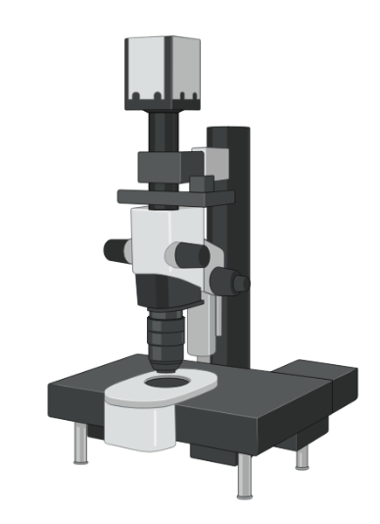
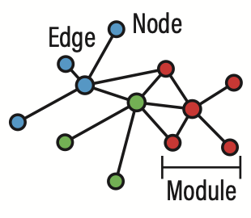
Future directions: network analysis
iDISCO+ clearing & staining with c-Fos
ClearMap2 cell detection & registration
Light-sheet imaging
Activated brain regions network analysis
Notes:
Before creating your 3 slides that will form your 2-minute video, think about how you would present your slides in a TWEET, and use that brief format to guide your points. Provide key takeaways for the most impact.

