Slide 1

Indiana Clinical and Translational Sciences Institute
2023 Annual Meeting
Imaging fine structures of the human trabecular meshwork in vivo using a custom design goniolens and OCT gonioscopy
Alessandra Carmichael-Martins (PhD), Thomas J. Gast, Brett J. King, Brittany R. Walker, Marcelina Sobczak, Stephen A. Burns
Indiana University, Bloomington
*The Authors have no conflict of interest

Slide 2
Here’s what we found
We have successfully used a commercial Heidelberg™ Spectralis OCT device and a custom goniolens to image the human trabecular meshwork (TM) – for the first time – with sufficient resolution to depict fine structural features.
The optimized goniolens was designed to reduce optical aberrations and increase optical resolution allowing to image structures down to 11.05 µm (45.25 cy/mm).
The custom lens can be 3D printed, making it very cost efficient, and uses a commercial contact lens to couple to the corneal surface.
This high-resolution gonioscopic OCT allows imaging of fine collagenous structures within the TM using a clinically feasible approach, allowing to study structural changes within the TM with age and disease.
Notes:
Begin by stating the Super Big Results (state them in 3 key points, like an outline)

Slide 3
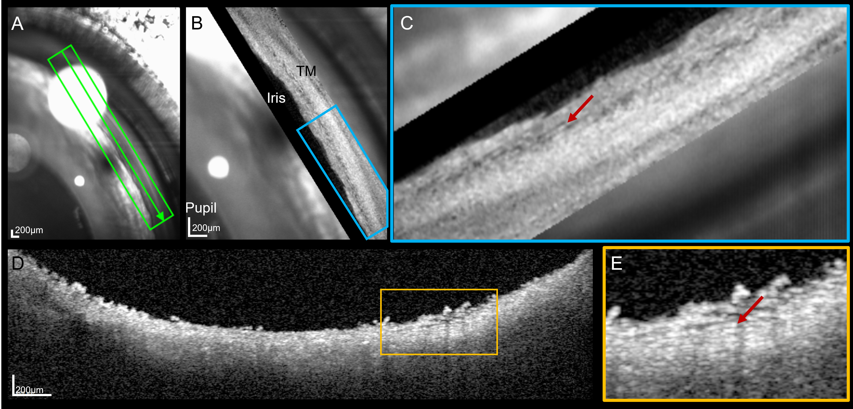
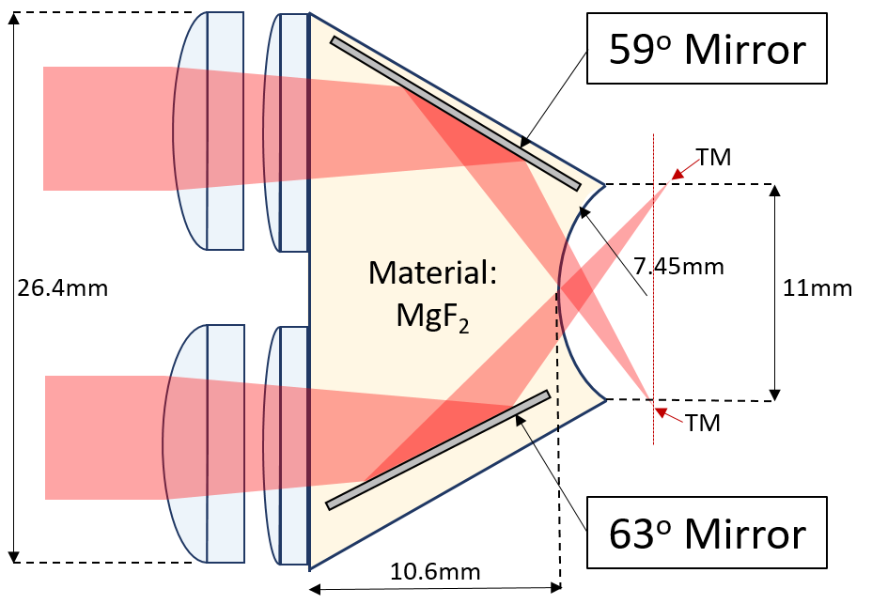
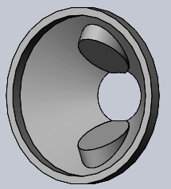
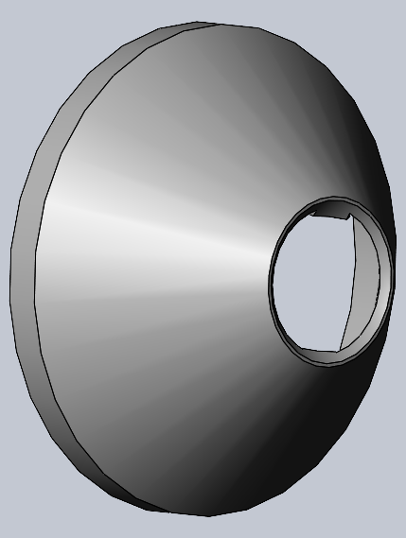
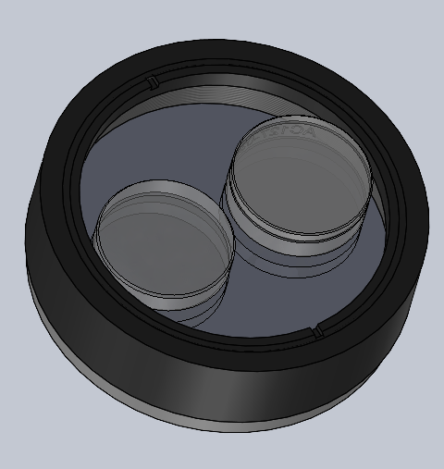
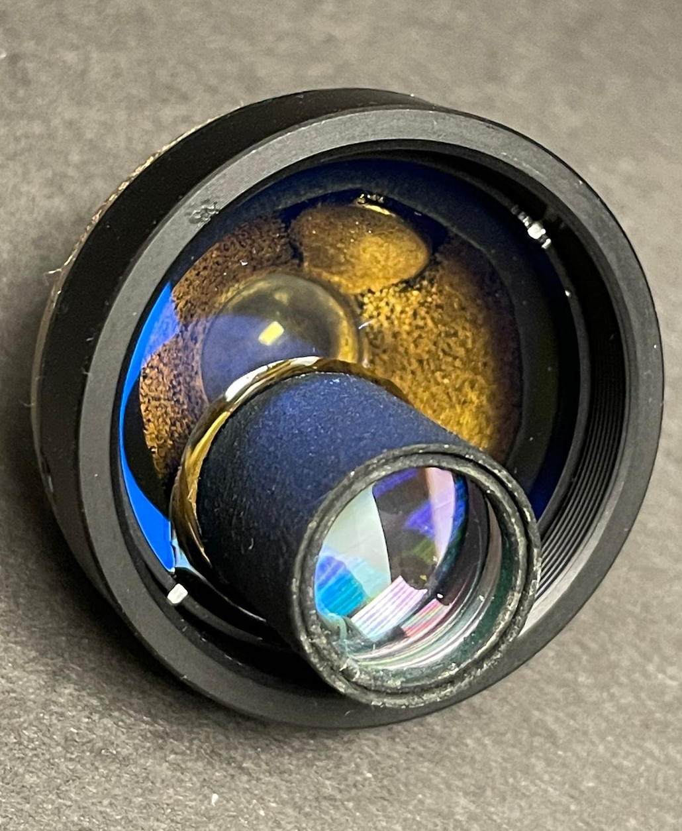
Here’s how we did it
The goniolens has been redesigned to improve its optical resolution by index matching its refractive index to that of the human cornea.
The goniolens was placed on the anesthetized eye, coupled with goniogel, and OCT dense volumes were acquired for 7 healthy subjects.
Carmichael-Martins et al. “Imaging fine structures of the human trabecular meshwork in vivo using a custom design goniolens and OCT gonioscopy” Biomedical Optics Express, (2023, In Review)

Slide 4
Future implications for patients and next steps
The TM is one of the main sites for increased resistance to aqueous outflow, causing the intraocular pressure (IOP) to increase.
Most surgical glaucoma treatments are aimed at decreasing the intraocular pressure by targeting the TM, but assessment of the structural changes within the TM in vivo are currently not possible.
Our clinically feasible approach high-resolution imaging provides imaging of the lamellar-like structures known to be present the TM, but not observable in living humans using other techniques.
We will use this approach to quantify and compare TM structures in healthy controls and glaucoma patients to further understand changes with age, IOP and glaucoma in order to improve non-surgical treatments.
Notes:
Before creating your 3 slides that will form your 2-minute video, think about how you would present your slides in a TWEET, and use that brief format to guide your points. Provide key takeaways for the most impact.

Slide 5
Grant Acknowledgement
This project was funded with support from the Indiana Clinical and Translational Sciences Institute which is funded in part by Award Number TL1TR002531 from the National Institutes of Health, National Center for Advancing Translational Sciences, Clinical and Translational Sciences Award. The content is solely the responsibility of the authors and does not necessarily represent the official views of the National Institutes of Health.
BrightFocus National Glaucoma Research Fellowship – G2022001F
NIH National Eye Institute – R01EY024315-09
Alcon Research Institute
Notes:
If your project or training has been supported by the Indiana CTSI, your poster and PowerPoint presentation should include acknowledgement of the appropriate Indiana CTSI grant.
For your convenience, we have added this list of award sources to the last slide of the PowerPoint template. Please review the list of award sources and delete those that did not contribute to the conduct of the research reported in your presentation.
If your project or training was supported by other grants, please remember to acknowledge those grants as well.

