Slide 1

Indiana Clinical and Translational Sciences Institute
2022 Annual Meeting
The effects of dietary fiber based on fermentability and viscosity on mineral balance and the gut microbiome in a rat model of CKD
Annabel Biruete, PhD, RD
Department of Nutrition Science
Purdue University

Slide 2
Here’s what we found so far
Study is ongoing with ~70% of animals done
Psyllium seems to be increasing the length of the small intestine and the colon
Weight trajectories were not different between groups
Survival was similar between groups

Slide 3
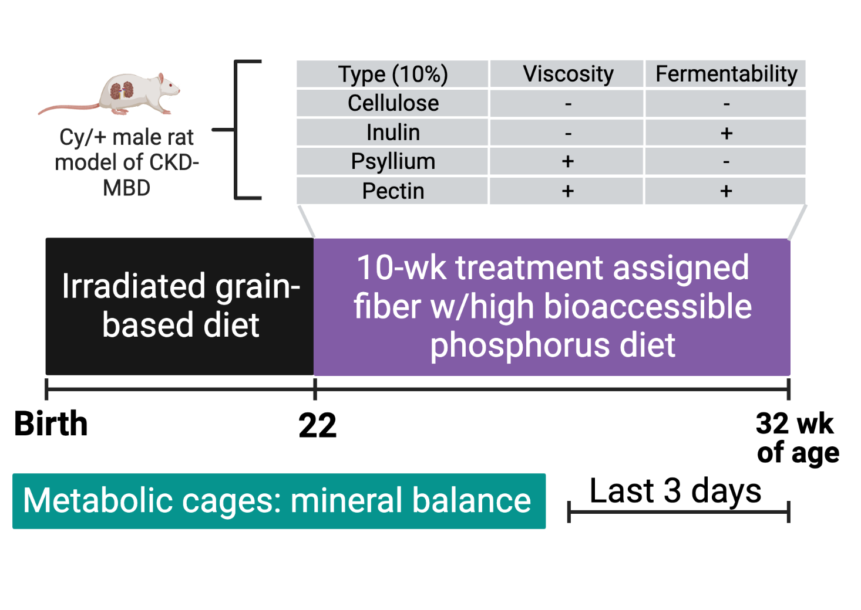
Here’s how we are doing it

Slide 4
Next steps
Goals of my KL2 project is to expand on the effects of dietary fiber based on their viscosity and fermentability profile on:
Mineral balance
Other CKD-MBD outcomes
The microbial metagenome and microbially-derived metabolites

Slide 5
Grant Acknowledgement
This project was funded with support from the Indiana Clinical and Translational Sciences Institute which is funded in part by Award Number KL2TR002530 from the National Institutes of Health, National Center for Advancing Translational Sciences, Clinical and Translational Sciences Award. The content is solely the responsibility of the authors and does not necessarily represent the official views of the National Institutes of Health.

