Slide 1

Indiana Clinical and Translational Sciences Institute
2023 Annual Meeting
The profibrotic phenotype in COL4A3 mouse model of Alport Syndrome
Ameya Belamkar
Indiana University Bloomington

Slide 2
Methods
Sections were stained for the collagen (IV) α3 protein to evaluate its distribution in wild-type mouse eyes
Sections were stained for the inflammatory markers TGF-ß2, ß-catenin, and CTGF
All sections were counterstained with DAPI and photomicrographs visualizing protein distribution were taken under a confocal microscope
mRNA levels of the pro-fibrotic genes FSP1, αSMA, Col1a1, SNAIL, SLUG, TWIST1, and HE4 were assessed using real-time quantitative PCR

Slide 3
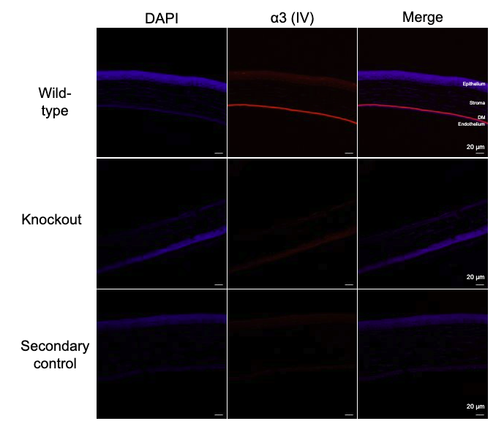
Results
There was no positive staining of the α3 (IV) protein in the retina, while there was a clear positive staining in the Descemet’s membrane of the cornea.
An upregulation of TGF-ß2 was observed in both the retina and cornea. While there was an increase in CTGF and ß-catenin in the cornea, there was no observable difference in the retina.
qPCR showed a significant increase in the levels of FSP1, αSMA, Col1a1, SNAIL, and SLUG in KO retinas. There was a moderate increase in FSP1 and SLUG in the corneas of KO mice, but the trend was less clear.
Notes:
Begin by stating the Super Big Results (state them in 3 key points, like an outline)

Slide 4
Future Implications
The ocular pathogenesis of Alport syndrome is not well-characterized
These findings indicate that inflammatory and fibrotic changes induced by the absence of the α3 (IV) protein may lead to the ocular abnormalities observed in patients with Alport syndrome
Future work with increased sample size is needed to corroborate these initial findings
Notes:
Before creating your 3 slides that will form your 2-minute video, think about how you would present your slides in a TWEET, and use that brief format to guide your points. Provide key takeaways for the most impact.

Slide 5
Grant Acknowledgement
This project was funded by NIH- NEI R01: R01EY027779, R01EY027779-S1 and R01EY032080 and Research to Prevent Blindness.
Notes:
If your project or training has been supported by the Indiana CTSI, your poster and PowerPoint presentation should include acknowledgement of the appropriate Indiana CTSI grant.
For your convenience, we have added this list of award sources to the last slide of the PowerPoint template. Please review the list of award sources and delete those that did not contribute to the conduct of the research reported in your presentation.
If your project or training was supported by other grants, please remember to acknowledge those grants as well.

