Slide 1
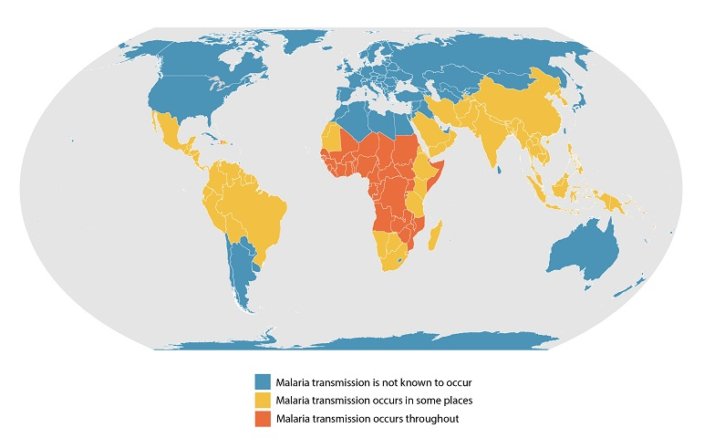
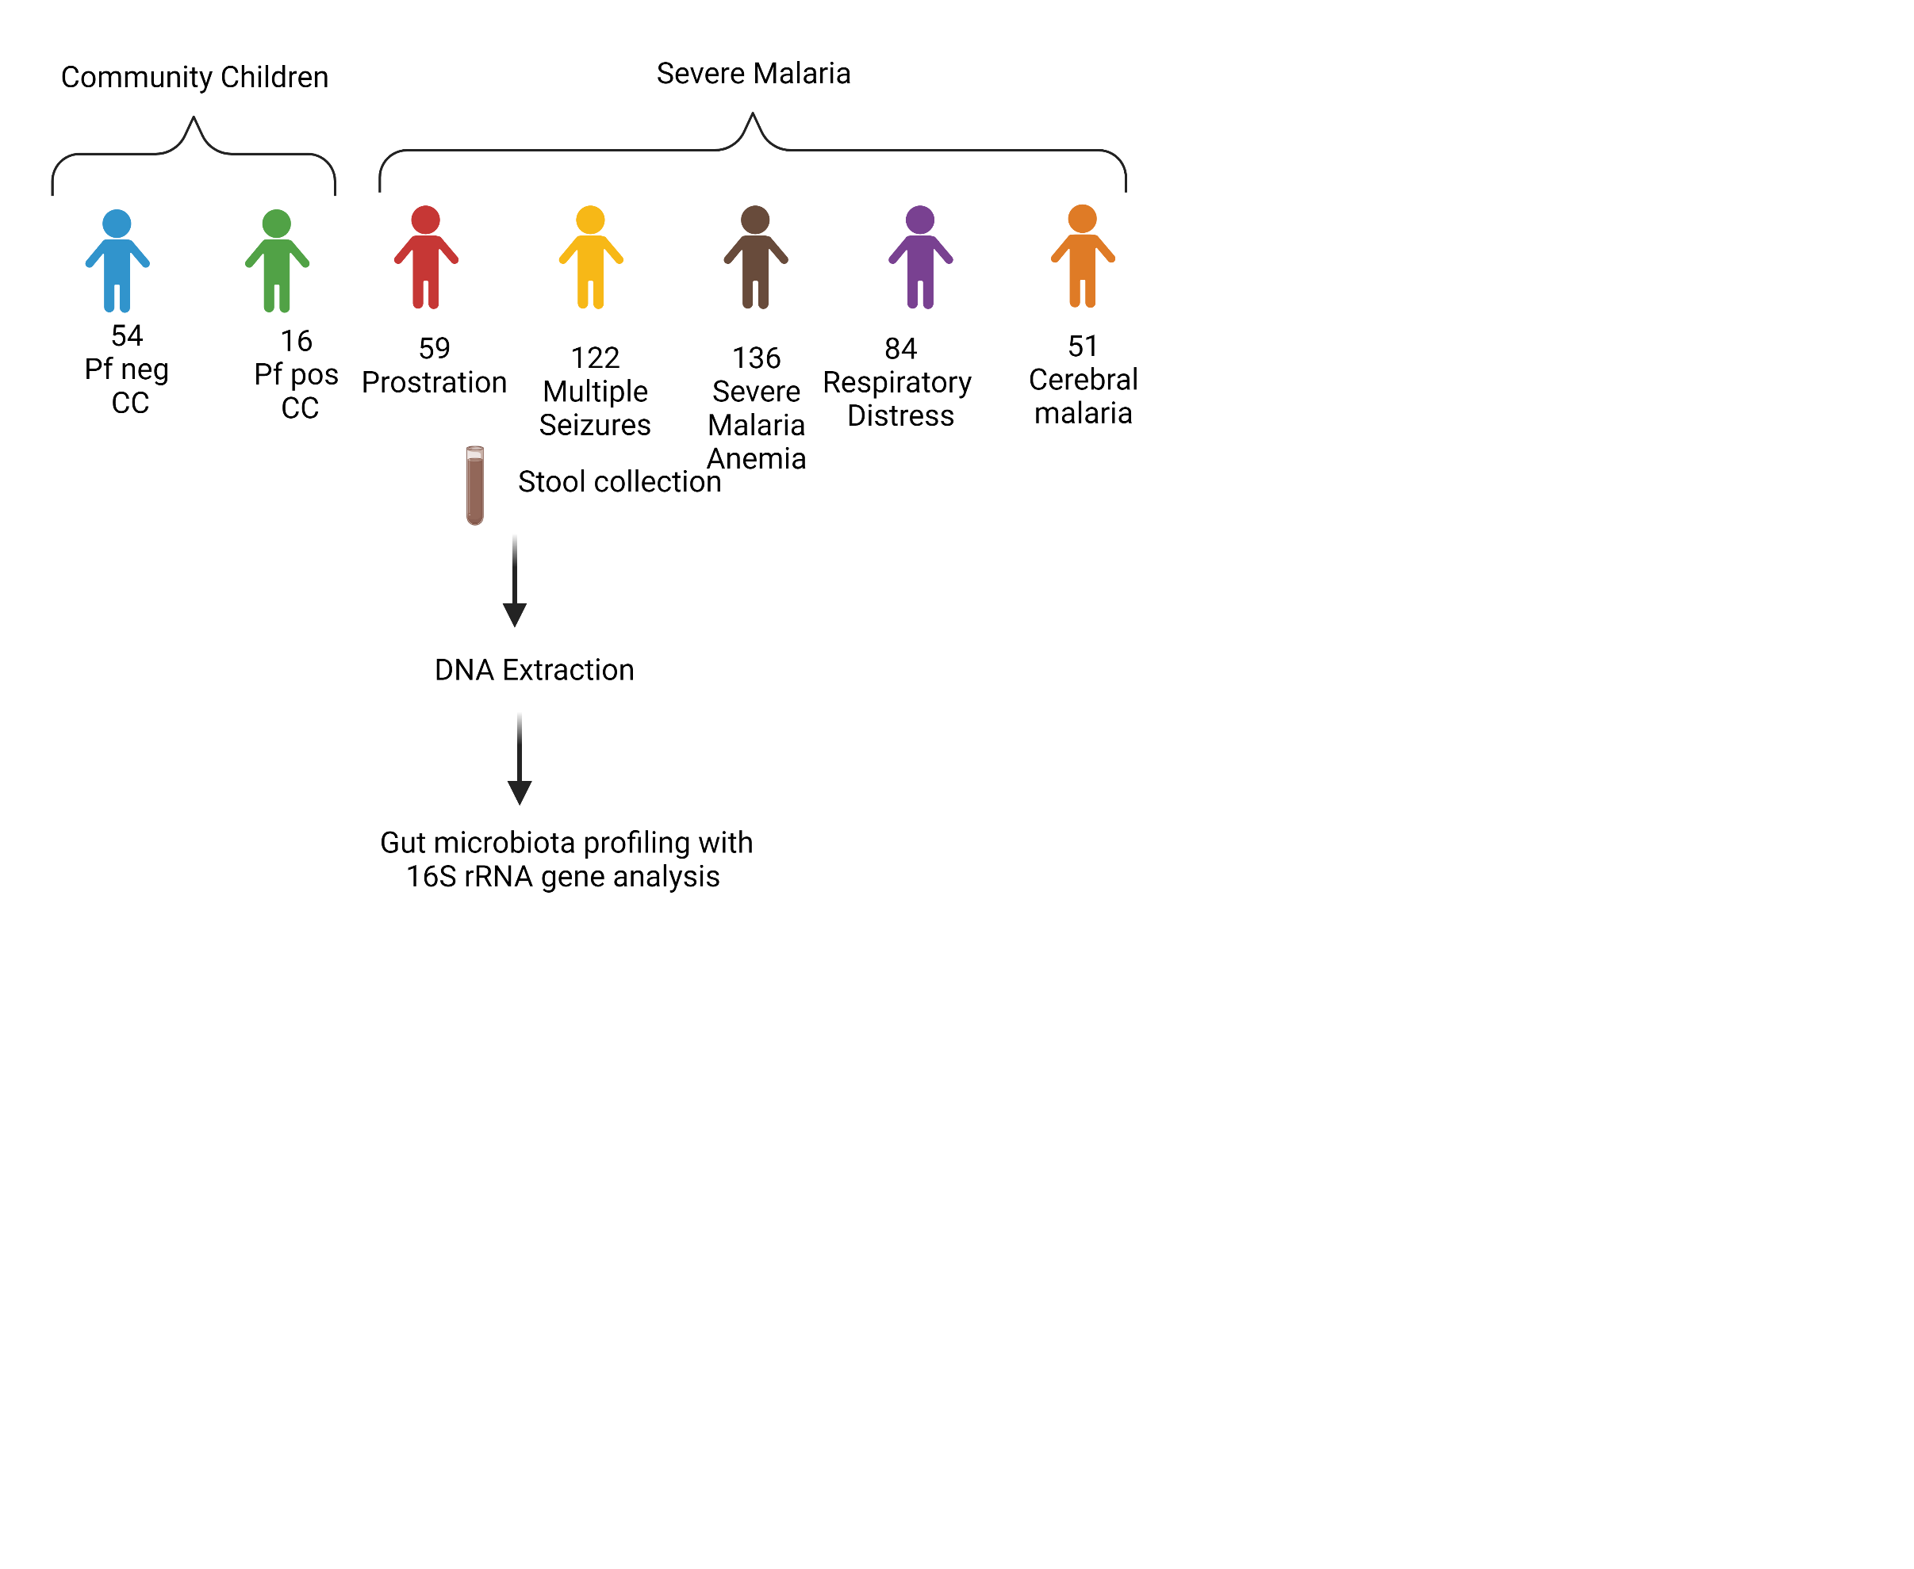
Malaria burden in sub-Saharan Africa
247 million malaria cases in 2021
619,000 deaths from malaria

Slide 2
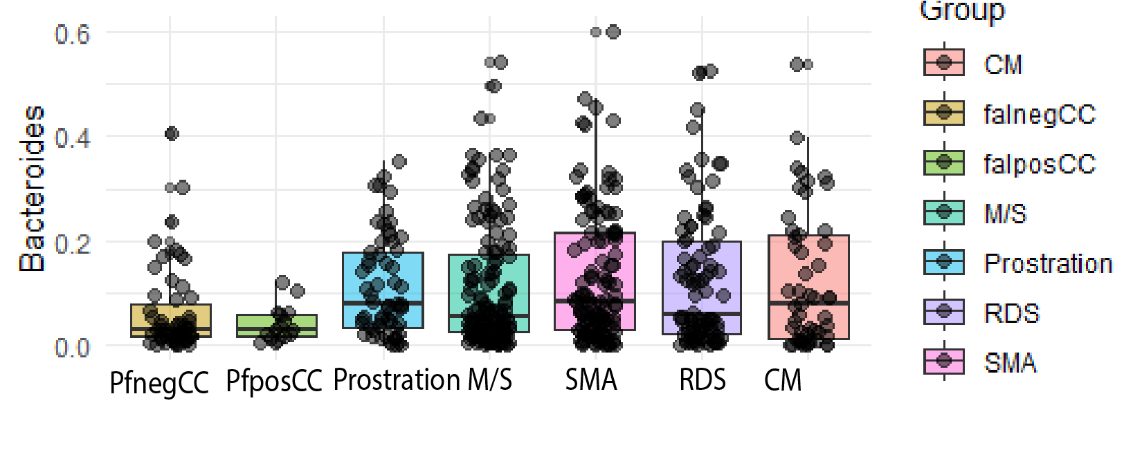
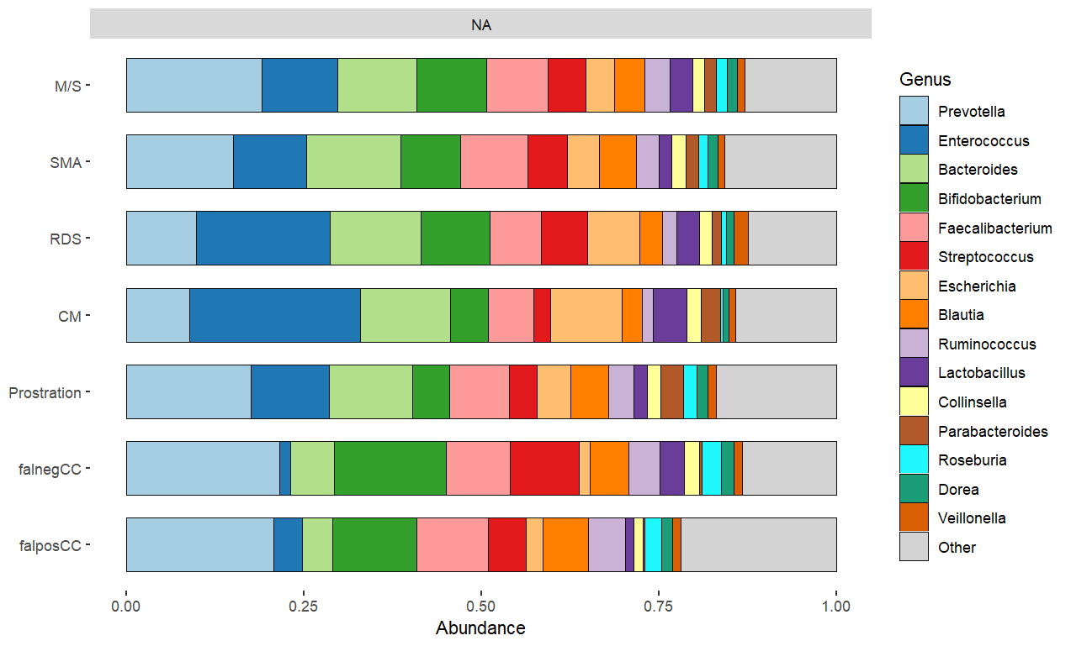
Differential abundance of bacteria in the stool sample of Ugandan children with severe malaria

Slide 3
Functional assessment of microbiome in mouse model
Mouse experiment results

