Slide 1

Indiana Clinical and Translational Sciences Institute
2023 Annual Meeting
Using an end-to-end deep learning model in older adults with MCI to identify AD risk factors in chromosome 19 that exacerbate cognitive decline
Jinhyeong Bae
3rd-year Ph.D. Candidate
Indiana University School of Medicine

Slide 2
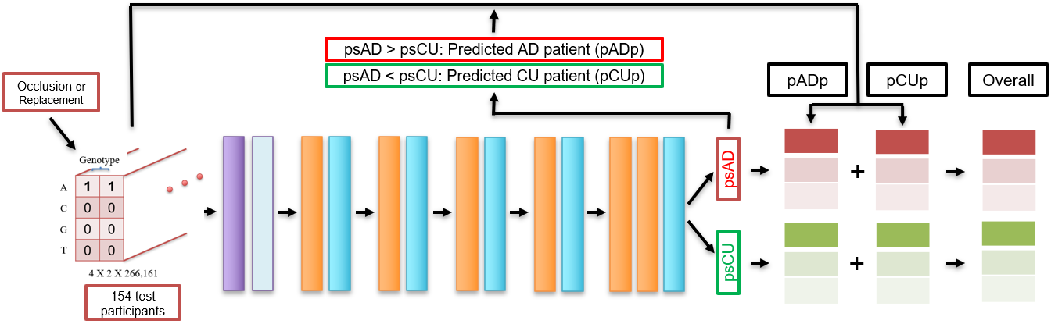
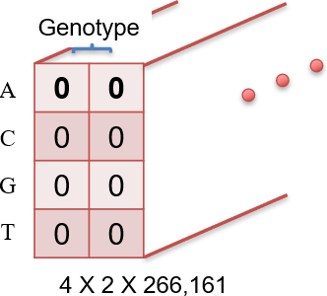

Summary of chromosome 19 research
• psAD: prediction score for AD
• psCU: prediction score for CU
• CRIS: Chromosomal Risk Impact
Score
Occlusion or Replacement for each SNP
pMCI-Cp
pMCI-NCp
ΔpsAD↑
Chromosome 19
CRIS
ΔpsCU↑
154 test participants
Fully Trained Deep learning model
203 Mild Cognitive Impairment-Converter (MCI-C) participants
213 Mild Cognitive Impairment-Non converter (MCI-NC) participants
61 Alzheimer’s disease (AD) participants
93 Cognitively unimpaired (CU) participants
~ The rate of Cognitive decline
Reference: Bae et al., 2023, A simulative deep learning model of SNP interactions on chromosome 19 for predicting AD risk …

Slide 3
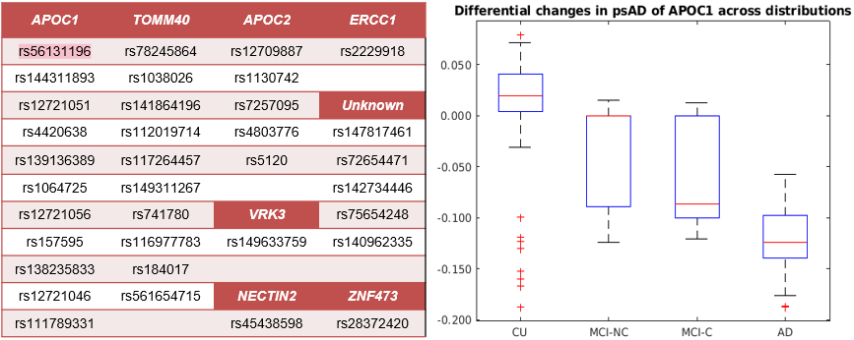
Differential contribution of AD-risk SNPs on diagnostic groups

Slide 4
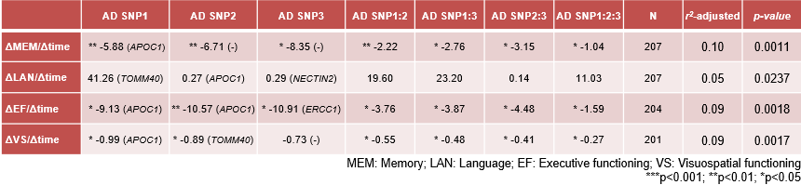
Predicting the rate of cognitive decline
Many SNPs were mapped to APOC1 gene.
  5 SNPs from APOC1, 2 SNPs from TOMM40, and 1 SNP each from ERCC1 and NECTIN2.
Predicting the rate of cognitive decline with a greater number of AD-risk SNPs
  5 SNPs: 0.279, 0.163, 0.098, 0.178 for the rate of MEM, LAN, EF, and VS, respectively (p<0.001).
  7 SNPs: 0.372, 0.387, 0.276, 0.461 for the rate of MEM, LAN, EF, and VS, respectively (p<0.001).
CRIS can be used to predict the rate of predicted MCI-C participants’ cognitive decline.

Slide 5
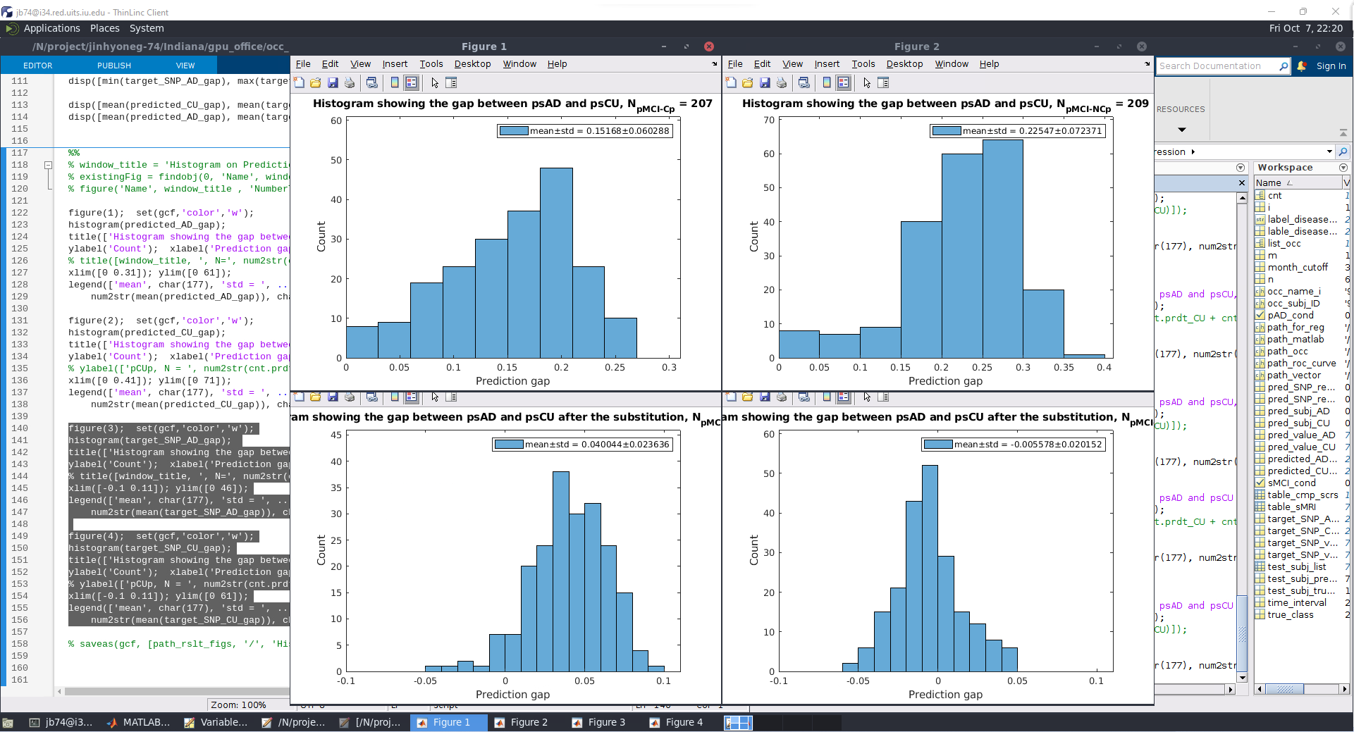
Computational CRISPR simulation
AA: 27.54.% (57/207)
AG: 72.46% (150/207)
Predicted MCI-C participants
AA or AG → GG
Predicted MCI-C participants
5.8% (12/207)
Replacing rs56131196 (APOC1) from AA/AG to GG for MCI-C participants.
  AA: Homozygous mutation; AG: Heterozygous mutation; GG: Reference Genome
Left-side vs. Right-side histogram
  Left: The prediction gap of predicted MCI-C participants before the genotype replacement
  Right: The prediction gap of predicted MCI-C participants after the genotype replacement
Our deep learning model can provide a group of personalized SNPs that can expectedly stop the AD progression

