Slide 1

Indiana Clinical and Translational Sciences Institute
2023 Annual Meeting
Up and down Regulation of Aldehyde Expression by External and Internal Mechanisms and their Therapeutic Value in EAE Mice
Anna Alford

Slide 2
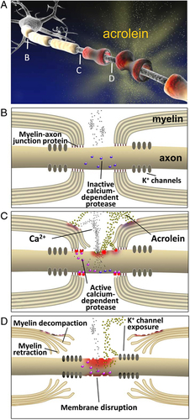
Here’s what we found
We are the first to use mice genetically deficient in ALDH2 to examine the impact of endogenous acrolein scavenging on EAE symptom severity.
We have shown that up- and down-regulation of ALDH2 in ALDH2*2 mice has significant effects on disease severity, bolstering previous findings marking acrolein as a key pathological hallmark of the disease.
These findings are expected to reinforce and expand the possible therapeutic targets of anti-aldehyde treatments to achieve neuroprotection for diseases such as Multiple Sclerosis.
https://www.ncbi.nlm.nih.gov/pmc/articles/PMC3517031/

Slide 3
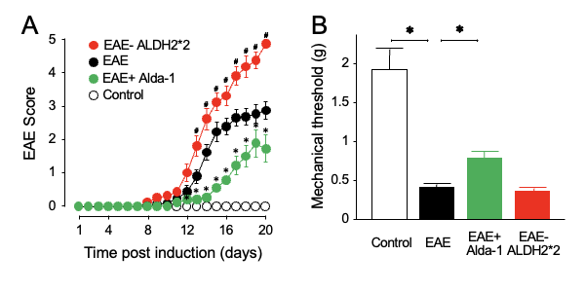
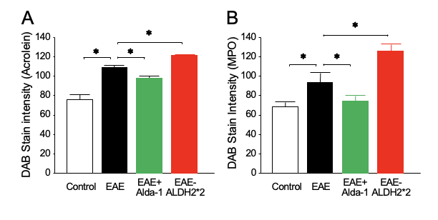
Here’s how we did it
We used three acrolein scavengers to mitigate behavioral deficits in EAE mice. Their levels of acrolein and myeloperoxidase (MPO) were measured by immunohistochemistry.
To assess behavioral deficits, motor function was determined using a 5-point system. Mechanical hyperreflexia indicating neuropathic pain was evaluated using on Frey filaments.
ALDH2 was down-regulated through a genetically modified mouse model (ALDH2*2), a clinically-relevant genotype prevalent in East Asian populations. Finally, alda-1 was employed as an ALDH2-activator
Fig 1: Modulation of ALDH2 activity results in correspondent changes in motor and sensory behavioral deficits
Fig 2: The effect of functional regulation of ALDH2 on levels of acrolein and MPO in spinal cord white matter

Slide 4
Future implications for patients or the community/next steps
While acrolein-scavenging has shown great success in decreasing symptom severity in EAE mice, there has been hesitation bringing this approach to human trials due to the potential side effects of known acrolein-scavenging drugs such as hydralazine.
Our study represents a novel and safer approach to scavenging acrolein through endogenous mechanisms – the enzyme ALDH2.
It is our hope that this research underscores the critical role of acrolein in MS pathogenesis and offers a novel therapeutic treatment that could be translated to clinical trials as well as for other neurodegenerative diseases.
Further research is being conducted to better understand the extent by which ALDH2 modulation effects the key pathological hallmarks of MS such as neuronal death and demyelination in EAE mice.

Slide 5
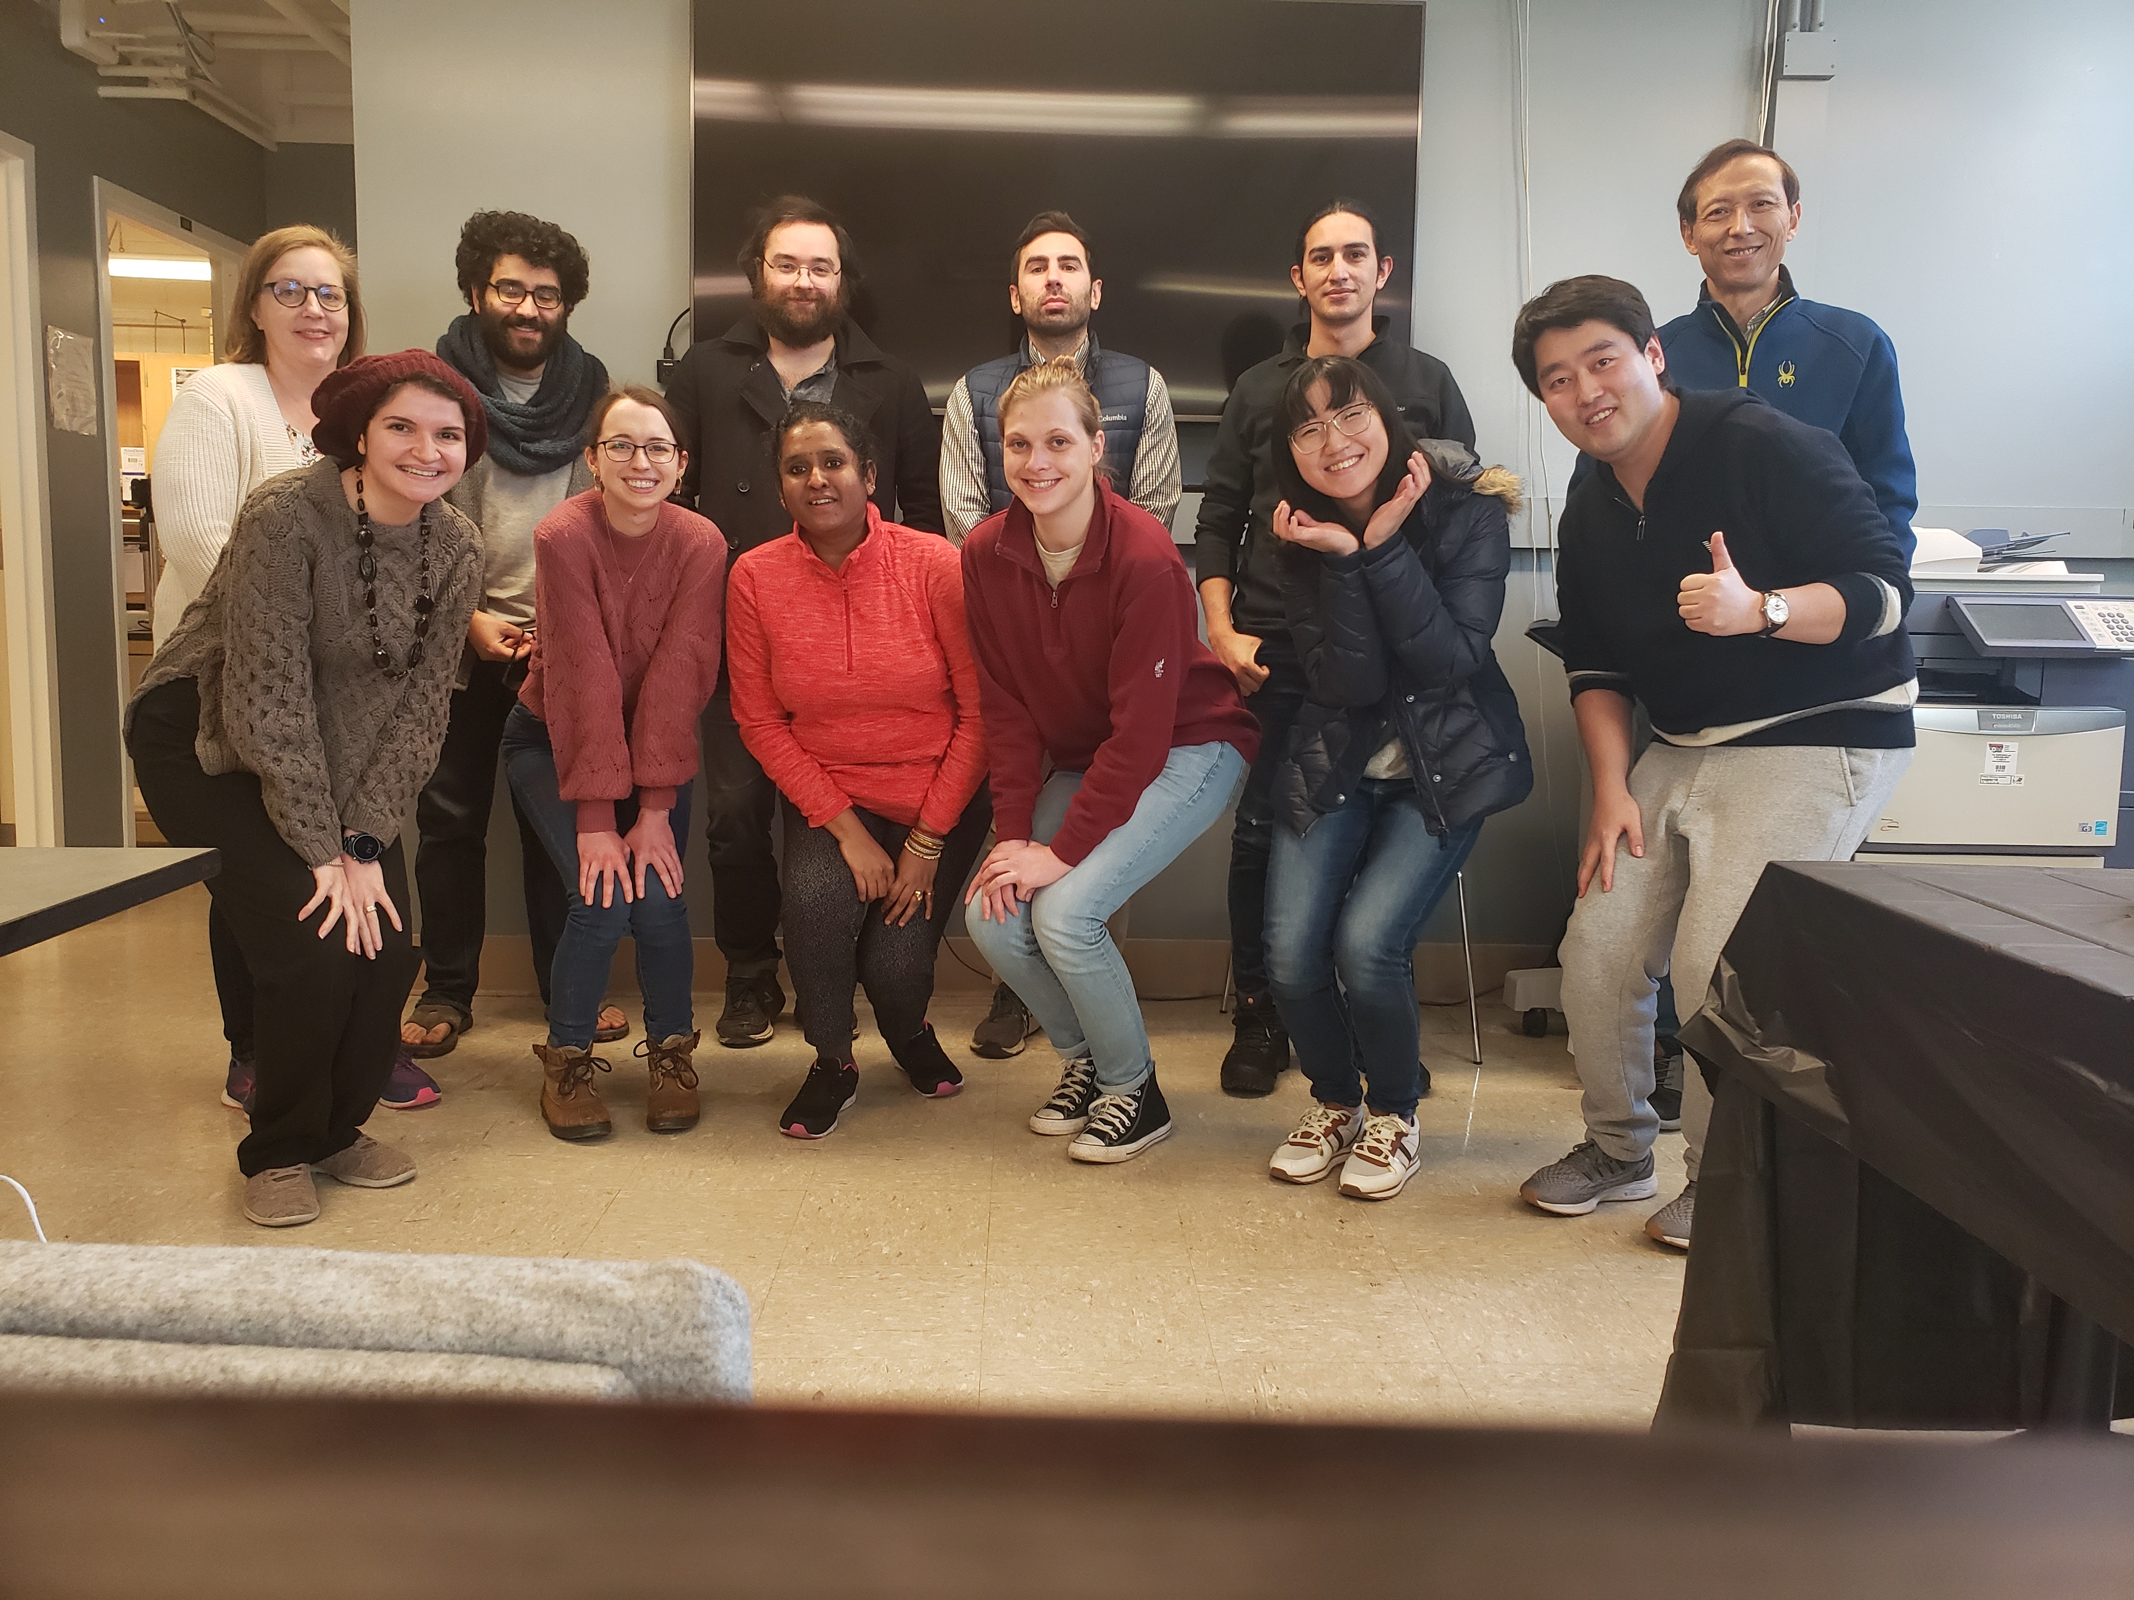
Grant Acknowledgement
This project was funded by the State of Indiana (PHS NCCR # TL1RR025759) and with support from the Indiana Clinical and Translational Sciences Institute which is funded in part by Award Number RR025761 from the National Institutes of Health, National Center for Advancing Translational Sciences, Clinical and Translational Sciences Award. The content is solely the responsibility of the authors and does not necessarily represent the official views of the National Institutes of Health.”
I would also like to thank Purdue’s Weldon School of Biomedical
Engineering and acknowledge everyone at the Center for
Paralysis Research for their support and contribution to this
project!

