Slide 1

Indiana Clinical and Translational Sciences Institute
2024 Annual Meeting
A pilot study to explore the effects of red meat intake on gut-derived uremic toxins in people with chronic kidney disease following a low protein diet
Brandon Kistler, PhD, RD
Department of Nutrition Science
Purdue University

Slide 2
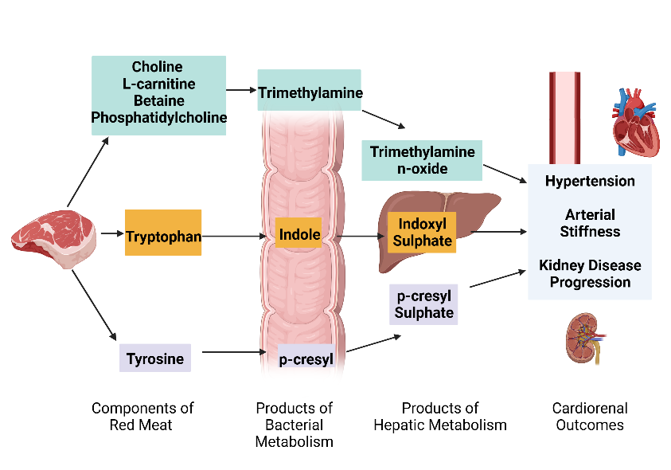
Here’s why we are doing this project
Chronic Kidney Disease (CKD) affects 14% of US adults
Cardiovascular Disease (CVD) is the leading cause of death
  Traditional risk factors do not fully explain CVD risk
Uremic toxins are one non-traditional risk factor for CVD and CKD progression
  Derived from diet and the gut microbiome
  Elevated in CKD
Red meat is associated with worse CVD outcomes
  Changes in the microbiome
  Increased uremic toxin production
The purpose of this pilot study will be to examine the effects of red meat intake on the gut microbiome
Modified from Lim et al. Toxins. 2021; 13(2): 142.

Slide 3
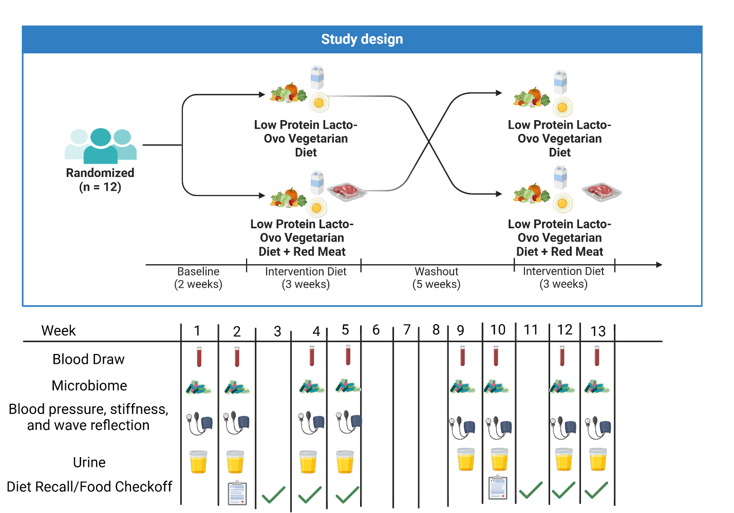
Here’s how we plan to do it

Slide 4
Next steps
This project will:
Provide pilot data on inter- and intraindividual variability
Feasibility data
Insight into the effects of red meat on:
  Uremic toxins
  Gut microbiome
  Cardiovascular disease risk factors
Initial information on food based (as opposed to nutrient based) recommendations for people with CKD

Slide 5
Grant Acknowledgement
The project described was supported by the National Center for Advancing Translational Sciences (NCATS) of the National Institutes of Health under award number K12TR004415. The content is solely the responsibility of the authors and does not necessarily represent the official views of the NIH.

