Slide 1
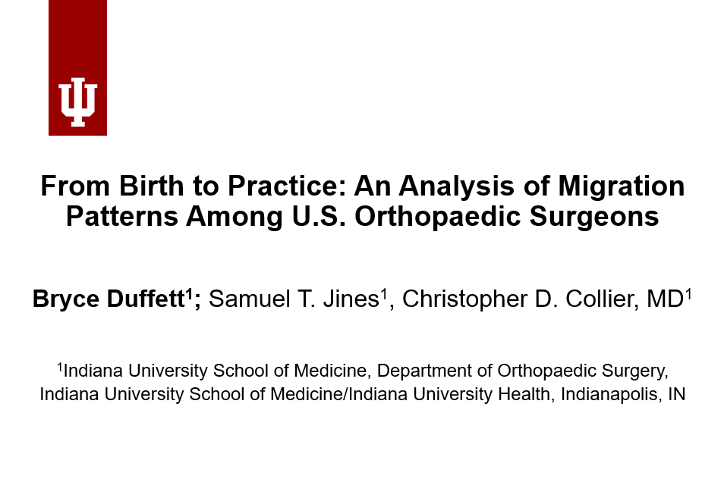



Study Questions
Study Questions
Study Methods
Birth Location
Medical School
Primary Specialty
What best predicts where orthopaedic surgeons practice in the US?
If residency location has a strong association with attending location, are residency spots appropriately allocated?
What best predicts where orthopaedic surgeons practice in the US?
If residency location has a strong association with attending location, are residency spots appropriately allocated?
Retrospective Observational Study
(N=8676)
Residency
Fellowship
Practice Demographics
Attending Location
Sex
MD vs DO
Notes:
Before I begin, I would like to thank CTSI for the opportunity to present my data today. I also want to thank my mentor, Dr. Christopher Collier, for his invaluable support in advancing this research.
My name is Bryce Duffett, and I’m a second-year medical student at IU School of Medicine. Today, I’ll provide an overview of my current research, which analyzes the migration patterns of orthopedic surgeons across the United States.*
As seen in our first question, this study highlights how birth and medical training locations predict where attending surgeons ultimately practice, shedding light on a potential cause of the unequal distribution of specialists nationwide.*
Due to time constraints, I won’t delve into the second part of my research on residency allocation. However, this analysis is complete and available for presentation.
Our study is a retrospective observational analysis, examining the geodemographic data of 8,676 orthopedic surgeons who completed residency between 2004 and 2017. We recorded their practice locations five years post-training.*
Although today's focus is on location, our dataset also includes various demographic factors such as primary specialty, practice type, gender, and degree.

Slide 2

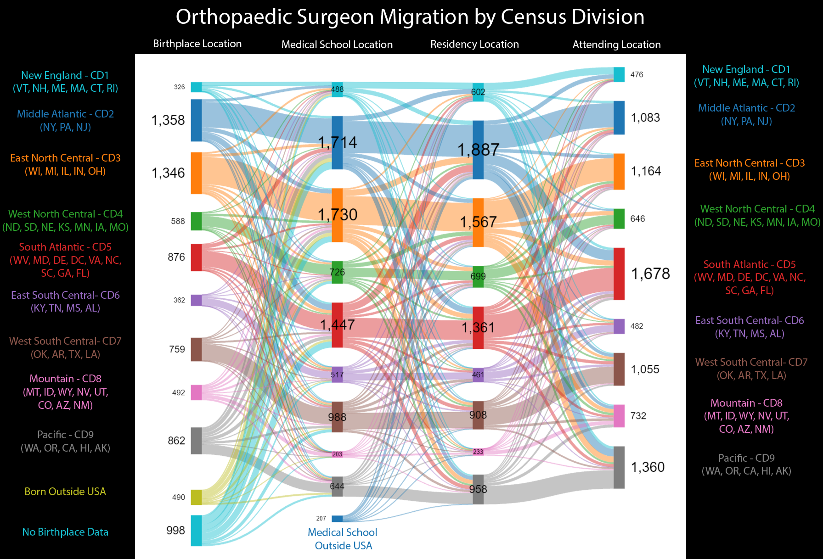
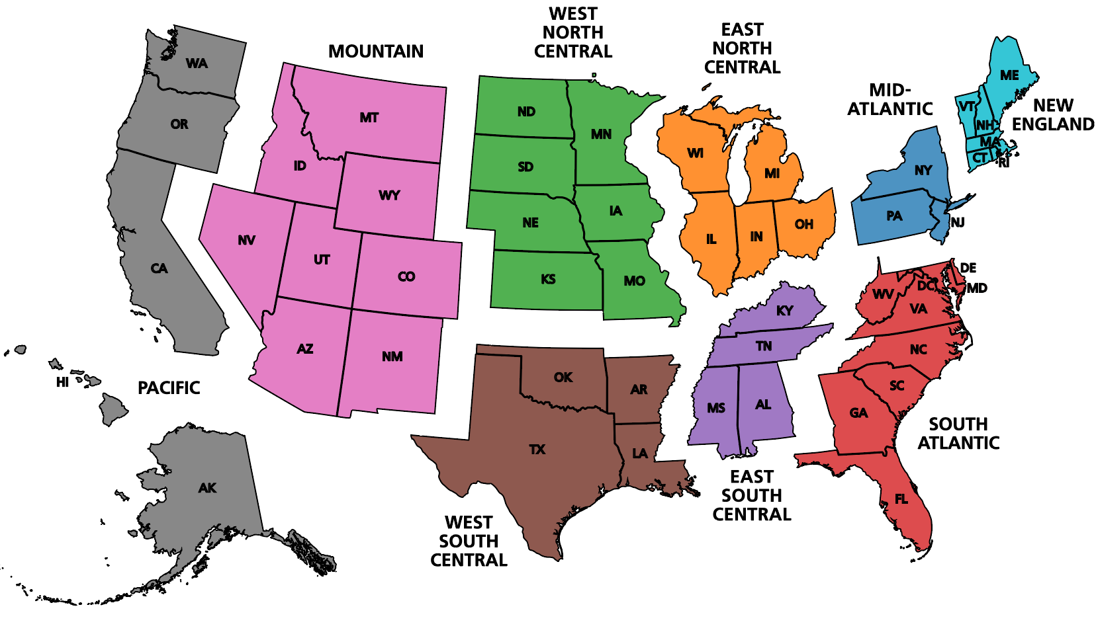
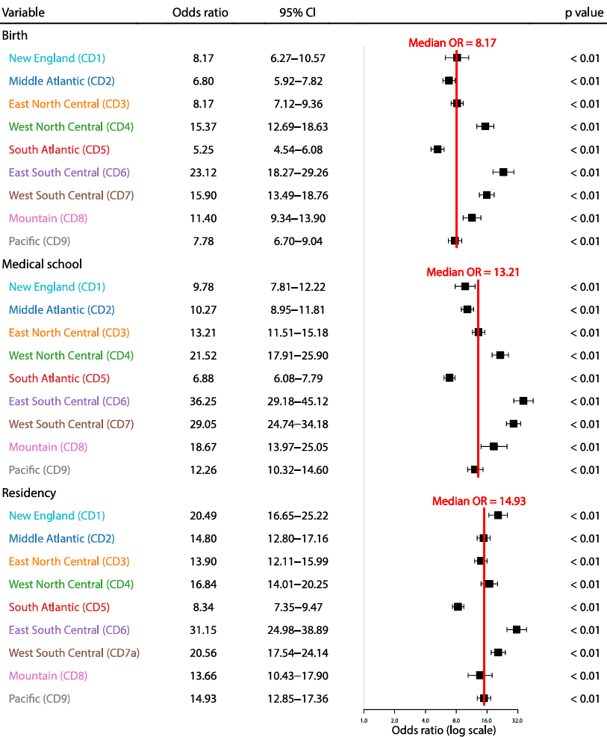

Determining the Drivers of Attending Location
U.S. Census Divisions
Notes:
Throughout this presentation, I'll refer to U.S. Census Divisions, as defined by the U.S. Department of Commerce, which groups states into clusters. For instance, Indiana is in Census Division 3, the East North Central Division, within the Midwest Region.*
To address our primary question—what predicts practice location—we ran a univariate logistic regression to establish odds ratios for those in the cohort who practice in the same Census Division where they were born, attended medical school, or completed residency. Our results showed with strong significance that residency location is the most powerful predictor.*
By visualizing our entire cohort with a Sankey plot, we can clearly demonstrate that as orthopedic surgeons advance through their training, a significant number tend to stay within their original Census Division. This trend is consistent across nearly all divisions, further reinforcing that birth and training locations are strong determinants of where orthopedic surgeons eventually practice.

Slide 3


The Implications
Residency training location is a key determining factor of practice location
Addressing inequitable specialist access nationwide requires an understanding of the factors driving the current distribution
Empowers congressional policy makers to make informed decisions on where additional orthopaedic residency spots would have the highest impact
Notes:
Throughout this presentation, I'll refer to U.S. Census Divisions, as defined by the U.S. Department of Commerce, which groups states into clusters. For instance, Indiana is in Census Division 3, the East North Central Division, within the Midwest Region.
To address our primary question—what predicts practice location—we ran a univariate logistic regression to establish odds ratios for those in the cohort who practice in the same Census Division where they were born, attended medical school, or completed residency. Our results showed with strong significance that residency location is the most powerful predictor.
By visualizing our entire cohort with a Sankey plot, we can clearly demonstrate that as orthopedic surgeons advance through their training, a significant number tend to stay within their original Census Division. This trend is consistent across nearly all divisions, further reinforcing that birth and training locations are strong determinants of where orthopedic surgeons eventually practice.

