Slide 1
Proteomic Analysis of Cytoplasmic Lipid Droplets and Whole Cell Lysates Reveal Ferroptosis Regulation by Fatty Acid Synthase-Derived Lipid Droplets in Metastatic Breast Cancer x Chaylen Andolino¹, Kimberly K. Buhman¹, Michael F. Coleman², Stephen D. Hursting², Marjorie Layosa¹, Michael K. Wendt³, Dorothy Teegarden¹ ^{m}
¹Department of Nutrition Science, Purdue University, West Lafayette, IN ²Department of Nutrition, University of North Carolina, Chapel Hill, NC ³Department of Medicinal Chemistry and Molecular Pharmacology, Purdue University, West Lafayette, IN

Slide 2
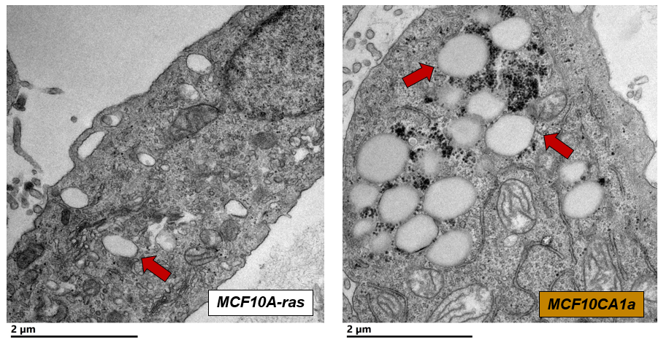
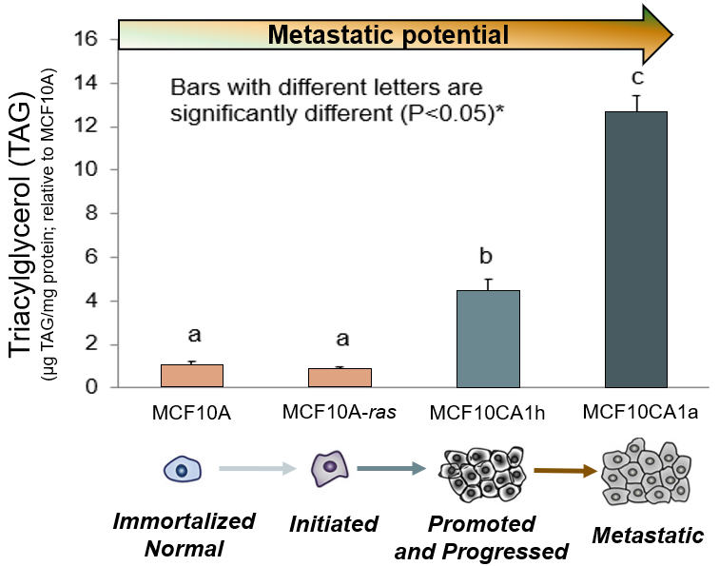
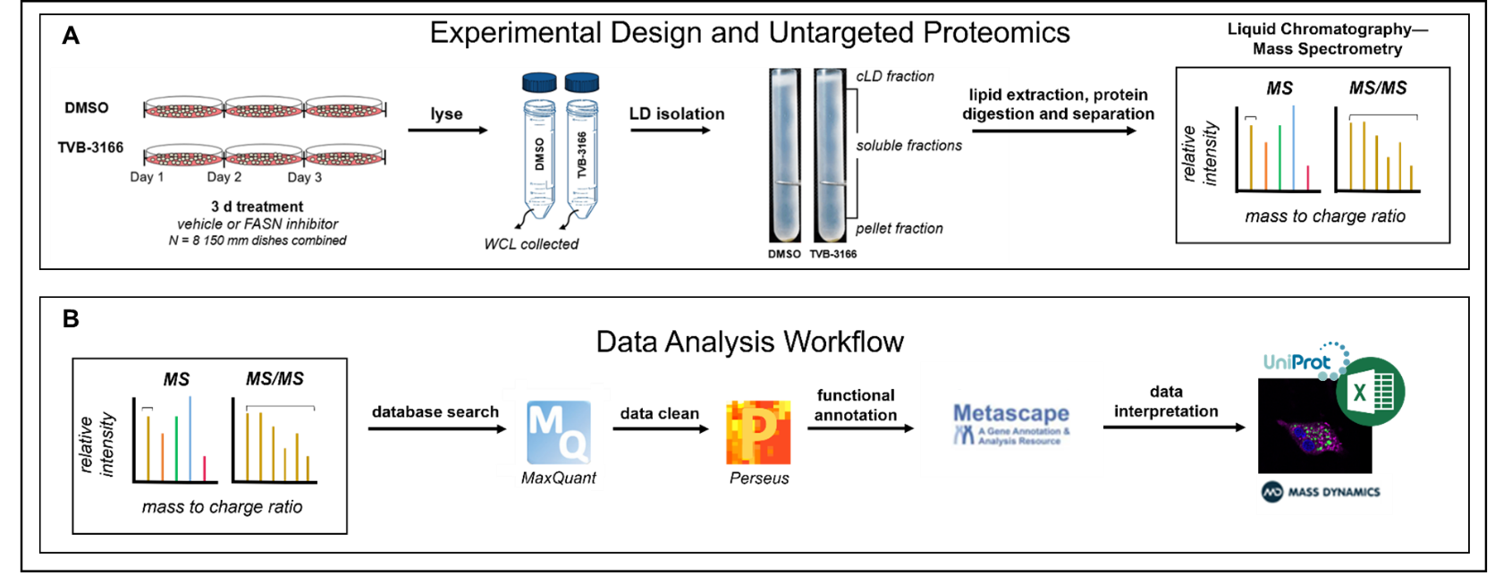
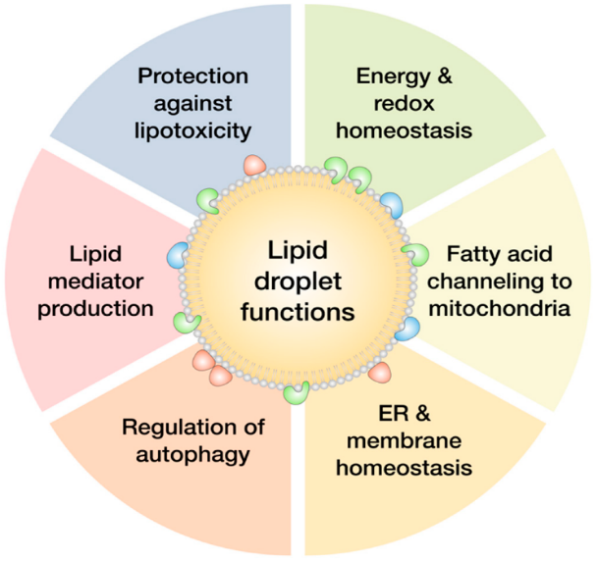
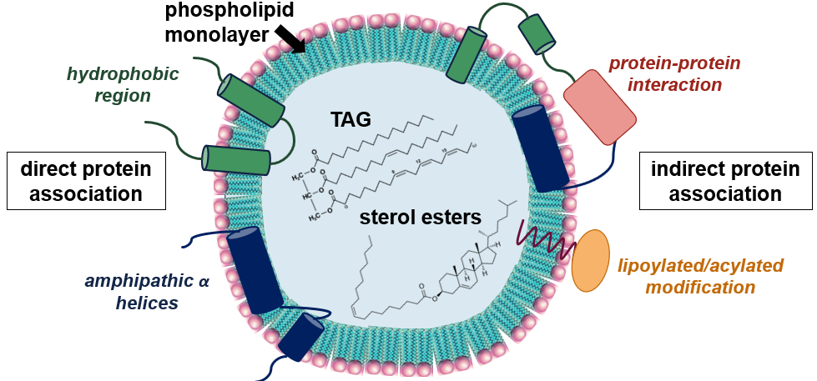
INTRODUCTION
HYPOTHESIS
Metastatic MCF10CA1a Cells Have More Triacylglycerol (TAG) and Cytoplasmic Lipid Droplets (CLD) Compared to Non-Metastatic Cells
Lipid droplet depletion by FASN-inhibition alters the CLD proteome in MCF10CA1a breast cancer cells, changing protein localization in a way that opposes metastasis.
Transmission Electron Micrographs
Vehicle-Treated MCF10CA1a More TAG, More CLDs
FASN-Inhibited MCF10CA1a Less TAG, Less CLDs
Triacylglycerol (TAG) Assay
CLD
CLD
MCF10A-ras
MCF10CA1a
nucleus
Fluorescence Microscopy
CLD
MCF10CA1h
MCF10CA1a
mito- chondria
EXPERIMENTAL WORKFLOW
DAPI = nuclei stain Bodipy = neutral lipid stain
Fatty Acid Synthase (FASN) and Fatty Acid Synthesis is Higher in Metastatic Compared to Non-Metastatic Cells
FASN Sustains TAG Accumulation and Subsequent Migration and Viability in Low Attachment in Metastatic Cells
RESULTS
Significant Differences in LD Proteomes of FASN-Inhibited MCF10CA1a Cells Compared to Vehicle-Treated Cells, Despite Similar Whole Cell Lysate (WCL) Proteomes
Asterisk indicates p < 0.05 by Student’s T-test; TVB-3166 = FASN-Inhibitor (20 µM)
Whole Cell Lysates
Lipid Droplet Fractions
The CLD Proteome Reflects the Organelle’s Functional Role Within the Cell^{1,2}
FASN-Inhibited
FASN-Inhibited
Vehicle
Vehicle

Slide 3
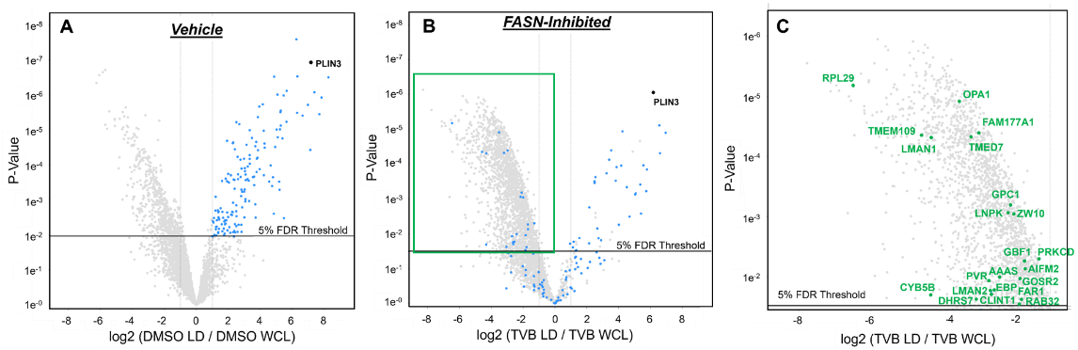
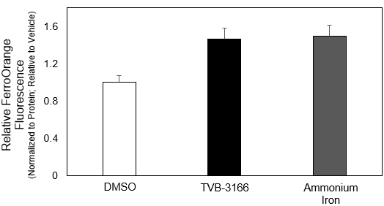
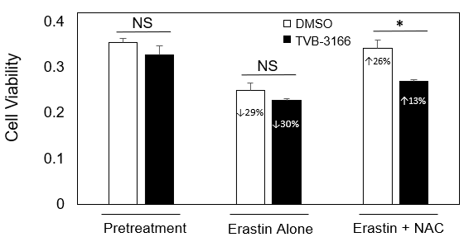
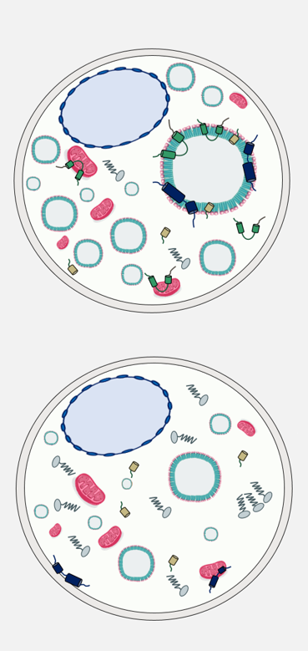
RESULTS
RESULTS
Proteins That Become Less Enriched on Lipid Droplets Following FASN Inhibition
Vehicle-Treated MCF10CA1a Cells Have Lower Levels of Ferroptosis than FASN-Inhibited, TAG-Depleted Cells
Vehicle
FASN-Inhibited
Zoomed in of overlay
*
*
Relative FerroOrange Fluorescence (Normalized to Protein; Relative to DMSO)
50 µm
50 µm
DMSO
TVB-3166
DAPI = nuclei stain Bodipy = neutral lipid stain FerroOrange = intracellular iron stain
Asterisk indicates p < 0.05 compared to DMSO by Student’s T-test; TVB-3166 = FASN-Inhibitor (20 µM) and Ammonium Iron (100 µM) = positive control
= proteins more enriched in vehicle LD fraction than WCL
= proteins more enriched in vehicle LD fraction than WCL that are less enriched in FASN-inhibited LD fraction than WCL
Ferroptosis-Stimulated MCF10CA1a Cells Have Enhanced Rescue in Cell Viability Following NAC Treatment Compared to FASN-Inhibited, TAG-Depleted Cells
Ferroptosis-Related Proteins are Less Abundant on LDs of FASN-Inhibited Cells Compared to Vehicle-Treated Cells
Pro-ferroptotic​ | t-test result between LFQ on LD | t-test result between LFQ in WCL​
ACSL4​ | higher in vehicle​ | same​
ACSL1​ | higher in vehicle​ | same​
STEAP3​ | only in vehicle​ | same​
FAR1​ | higher in vehicle​ | same​
POR​ | higher in vehicle​ | same​
TFRC​ | higher in vehicle​ | same​
CARS2​ | not present​ | higher in FASN​-inhibited
Anti-ferroptotic​ | t-test result between LFQ on LD​ | t-test result between LFQ in WCL​
SLC3A2 (system x_{c}⁻)​ | same​ | same​
GPX4​ | only in vehicle​ | only in vehicle​
AIFM2 (FSP1)​ | only in vehicle​ | same​
GCLM​ | same​ | same​
GSS​ | only in vehicle​ | same​
PROM2​ | not present ​ | only in vehicle​
FTH1​ | same​ | same​
CHMP6 (ESCRT-III)​ | only in vehicle​ | not present​
CHMP2B (ESCRT-III) ​ | only in vehicle​ | only in vehicle​
CHMP4B (ESCRT-III)​ | only in vehicle​ | same​
CHMP5 (ESCRT-III)​ | only in vehicle​ | only in vehicle​
IST1 (ESCRT-III)​ | only in vehicle​ | only in vehicle​
NEDD4L​ | only in vehicle​ | same​
PCBP1​ | same​ | higher in vehicle​
PCBP2​ | same​ | higher in vehicle​
ACSL3​ | same​ | same​
Hypothetical Model
Cell Viability
Vehicle-Treated MCF10CA1a More TAG in LDs
Ferroptosis Contributes to Reduced Migration of FASN-Inhibited, TAG-Depleted MCF10CA1a Cells
p = 0.03
FASN-Inhibited MCF10CA1a Less TAG in LDs
*
+19.8
TVB-3166 = FASN-Inhibitor (20 µM) Erastin = Ferroptosis-Activator (5 µM) NAC = N-Acetylcysteine (500 µM) Ferrostatin 1 (1 µM) Asterisk indicates p < 0.05 compared to respective pretreatments by Student’s T-test
-4.9
TVB-3166
DMSO
CONCLUSIONS
Anti-ferroptosis proteins are more abundant in migratory, vehicle-treated MCF10CA1a cells compared to FASN-inhibited cells d
Pro-ferroptotic, anti-cancer proteins are more abundant on the LDs of vehicle-treated cells compared to FASN-inhibited cells, despite similar protein levels within the whole cell
Such proteins liberated from LDs following TAG depletion may be free to function in their typical locations to exhibit anti-cancer effects d d
Our results suggest that LD accumulation may protect against lipid peroxidation-mediated cell death in metastatic breast cancer cells.
Schematic Model of Ferroptosis

