Slide 1

Indiana Clinical and Translational Sciences Institute
2024 Annual Meeting
Evaluation of Lead Screening in Indiana Populations
Sarah Doherty (IUSM MS4), Dr. Michelle Del Rio (IUB), Dr. Kara Garcia (IUSM), Dr. Alyson Alde (IUB)

Slide 2
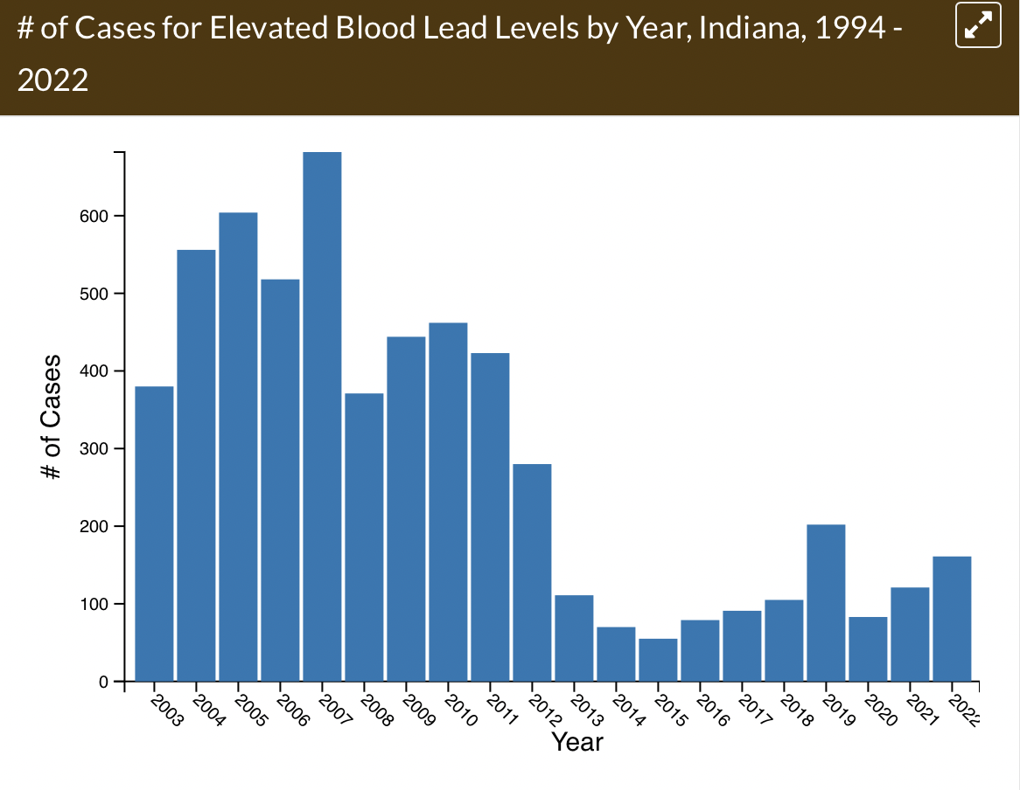
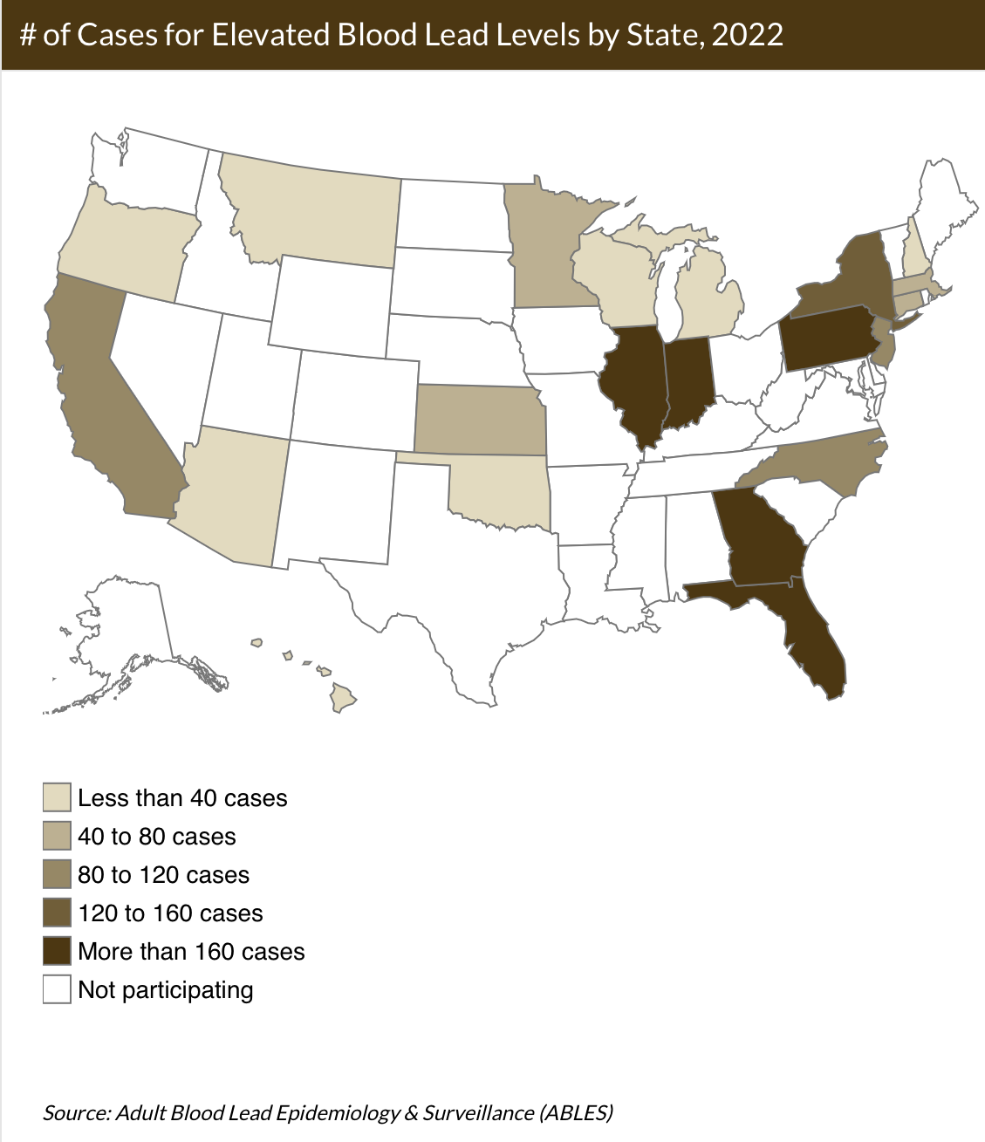
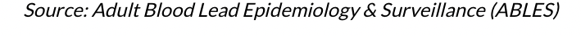
Lead Exposure in Adult and Pediatric Populations
Lead exposure is linked to devastating cognitive changes in children but is also associated with chronic health conditions in adults which often present with non-specific symptoms and are easily overlooked.
National reporting of Blood Lead Levels (BLL) conducted through ABLES and the CDC indicates reduction in elevated BLL (>25-30 ug/dL adults, 3.5 ug/dL in children) since 1944, but elevated levels in Indiana by state comparison which have increased since 2020¹.
Lead exposure risk is associated with occupational exposure, but these values may underestimate BLL and don’t account for home exposure. This is currently estimated by the age of the home and household income.
Number of Cases for BLL >=25 μg/dL by State by Year, Indiana, 1994 - 2022²
Number of Cases for BLL >=25 μg/dL by State in 2022³

Slide 3
PREDICT Healthy Homes Study
The PREDICT Healthy Homes Study collected soil, dust, and water samples from homes throughout Indiana and North Carolina to assess lead level, to develop a better predictive model of who may be at risk for household lead exposures.
Of the 8 Vanderburgh county participants, one tested for elevated levels above the screening limit for lead in the soil, and two tested for levels above the recommended level for pediatric exposure.
Action limit (400 PPM)
EPA and the Indiana Department of Health
Lead Screening Level (200 PPM)
EPA
Lead Screening Level + Known Exposure Source (100 PPM)
EPA
Federal Action Level (15 PPB)
EPA and the
Indiana Department of Environmental Management
Recommended maximum level
(1 PPB) American Academy of Pediatrics

Slide 4
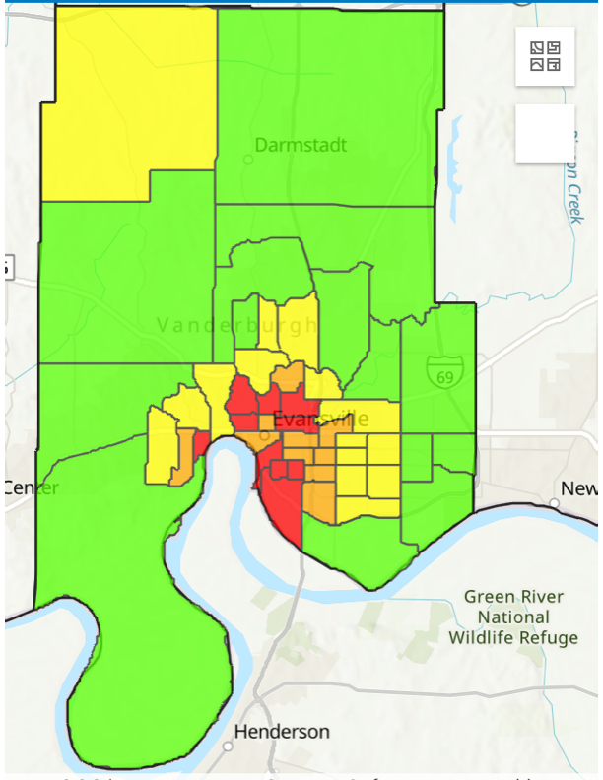
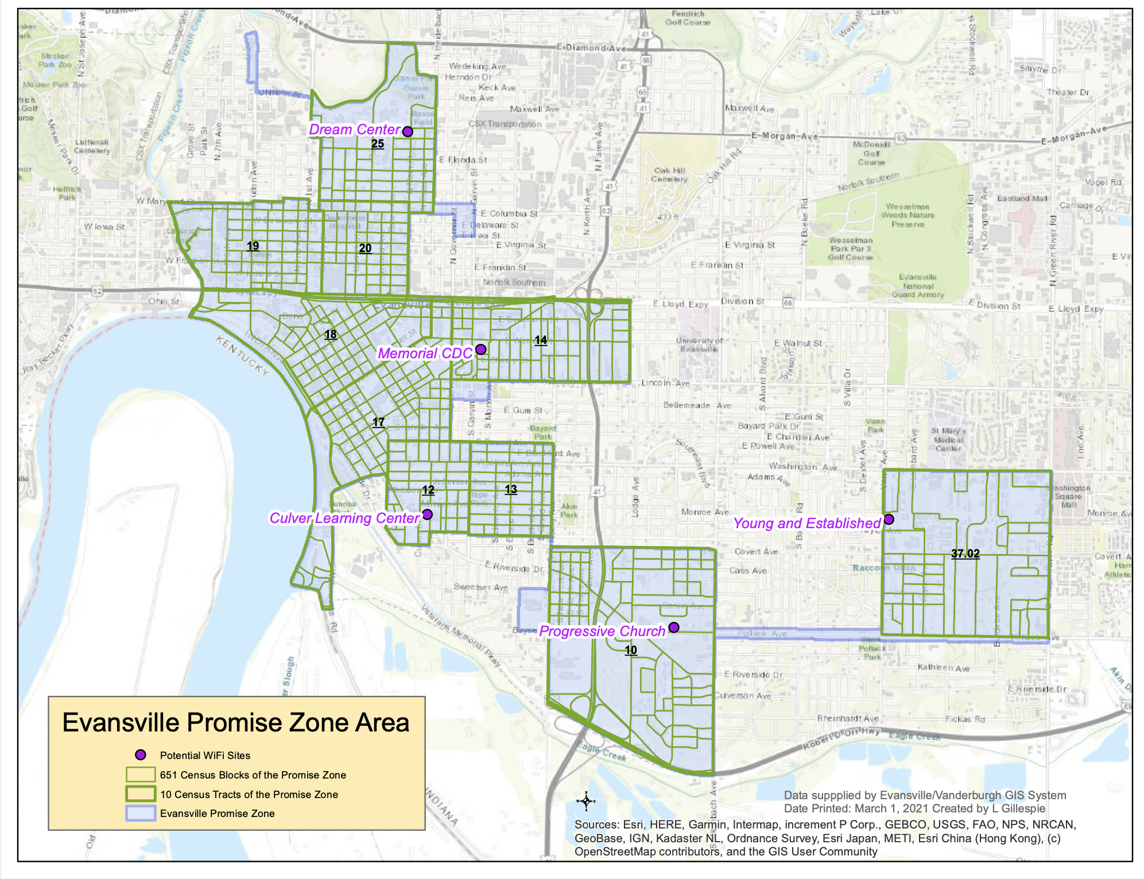
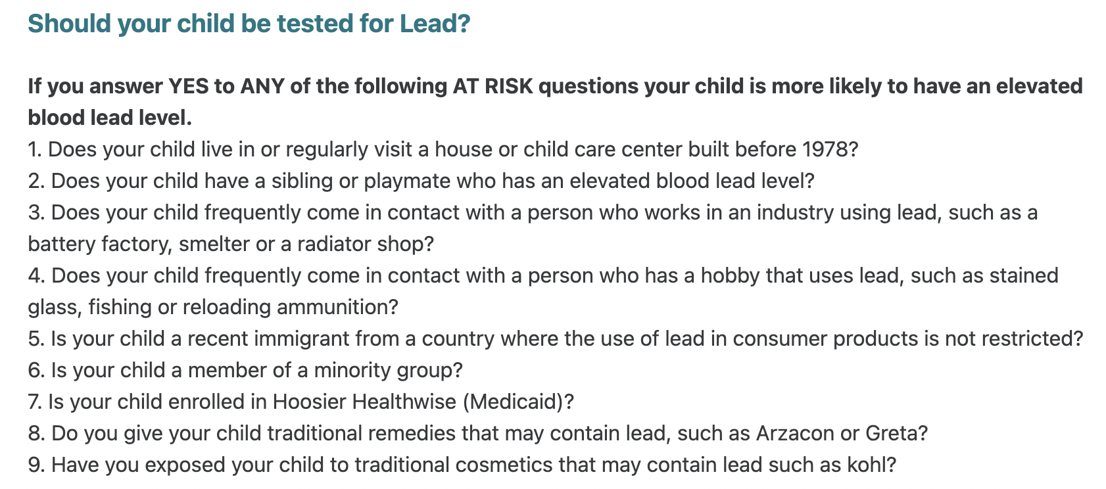
Future Implications for Patients and the Community
Lower socioeconomic and minority populations carry the highest burden of elevated BLL.
The PREDICT Healthy Homes Study data from Evansville may be useful to improve screening protocol within Vanderburgh County, improving testing in adult and pediatric populations.
Lowering the threshold to collect BLL in adult and pediatric populations can address unmet health concerns, and lead to local home remediation.
4.
5.

Slide 5
Grant Acknowledgement
For The Lead Technical Studies Grant Program: “The PREDICT healthy homes study was funded with support from the U.S. Department of Housing and Urban Development (HUD), Lead Technical Studies Grant Program. The content is solely the responsibility of the authors and does not necessarily represent the official views of the U.S. Department of Housing and Urban Development.”
Lead (PB) toxicity: What are U.S. standards for lead levels? [Internet]. Centers for Disease Control and Prevention; 2023 [cited 2024 Aug]. Available from: https://www.atsdr.cdc.gov/csem/leadtoxicity/safety_standards.html
Centers for Disease Control and Prevention (CDC), National Institute for Occupational Safety and Health (NIOSH). Adult Blood Lead Epidemiology & Surveillance (ABLES) Program. In: Worker Health Charts (WHC). # of Cases for Elevated Blood Lead Levels by Year, Indiana, 1994 - 2022, at https://wwwn.cdc.gov/NIOSH-WHC/chart/ables-ab?T=ZY&OU=L04&V=C&D=SINGLE&Y=2022&S=IN&chk_codes=False. Cincinnati, OH: US Department of Health and Human Services, CDC, NIOSH. Accessed August 16, 2024.
Centers for Disease Control and Prevention (CDC), National Institute for Occupational Safety and Health (NIOSH). Adult Blood Lead Epidemiology & Surveillance (ABLES) Program. In: Worker Health Charts (WHC). # of Cases for Elevated Blood Lead Levels by State, 2022, at https://wwwn.cdc.gov/NIOSH-WHC/chart/ables-ab?T=ZS&OU=L04&V=C&D=SINGLE&Y=2022&chk_codes=False. Cincinnati, OH: US Department of Health and Human Services, CDC, NIOSH. Accessed August 16, 2024.
The City of Evansville, Indiana [Internet]. [cited 2024 Aug]. Available from: https://www.evansvillegov.org/city/department/division.php?structureid=199
VCHD [Internet]. [cited 2024 Aug]. Available from: https://vanderburghhealth.org/lead-healthy-homes/
Bibliography
Notes:
If your project or training has been supported by the Indiana CTSI, your poster and PowerPoint presentation should include acknowledgement of the appropriate Indiana CTSI grant.
For your convenience, we have added this list of award sources to the last slide of the PowerPoint template. Please review the list of award sources and delete those that did not contribute to the conduct of the research reported in your presentation.
If your project or training was supported by other grants, please remember to acknowledge those grants as well.

