Slide 1
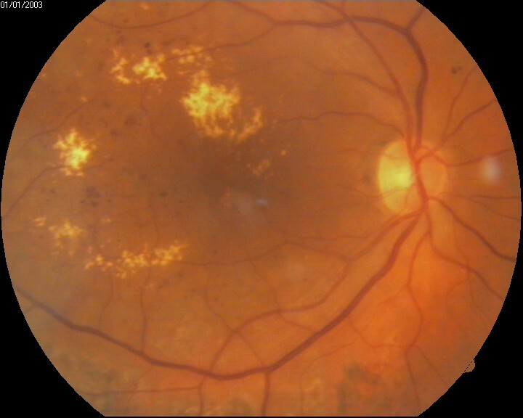
Circadian Rhythm Types in Individuals with Diabetic Macular Edema
Matthew T. Cory & Nikhil Davé MS, Janvi S. Patel, Denis Jusufbegovic MD , Ashay Bhatwadekar PhD RPh
Introduction
Diabetic retinopathy (DR) is a leading cause of vision loss in diabetic patients
Diabetic macular edema (DME) is a severe complication of DR associated with an increased level of fluid in the macula. The macula is the central portion of the retina responsible for seeing finer detail (Figure 1)
  Thickening and swelling associated
  with DME leads to poor visual acuity (1)
Circadian rhythm is our body’s natural
clock that governs physiological processes
and dictates our sleep-wake cycle
Potentially blinding effects of DR and DME
can impact the circadian rhythm adversely
The following changes to the circadian
rhythm have been implicated in the
pathogenesis of DR: retinal thickness rhythm,
pupillary diameter, a decrease in melatonin, and improper function of retinal cell clock genes (2)
Since circadian rhythms are implicated in DR/DME, we used the Morningness-Eveningness Questionnaire (MEQ) to characterize whether DME outcomes are affected by a circadian rhythm phenotype
Methods
Included Patients: >18 years of age; diagnosis of NPDR or PDR complicated by center involving DME (CI-DME), which was defined as a CFT of 305 µm or greater in women and 320 µm or greater in men on Heidelberg Spectralis, and 290 µm or greater in women and 305 µm or greater in men on Zeiss Cirrus; diagnosis of type 1 or type 2 diabetes (4)
Collected data: patient age, sex, ethnicity, race, HbA1c, blood pressure, type of diabetes, duration of diabetes diagnosis, type of diabetic retinopathy, visual acuity (logMAR), optical coherence tomography (OCT), intravitreal injections, and MEQ scores were stored in REDCap (5, 6)

Slide 2
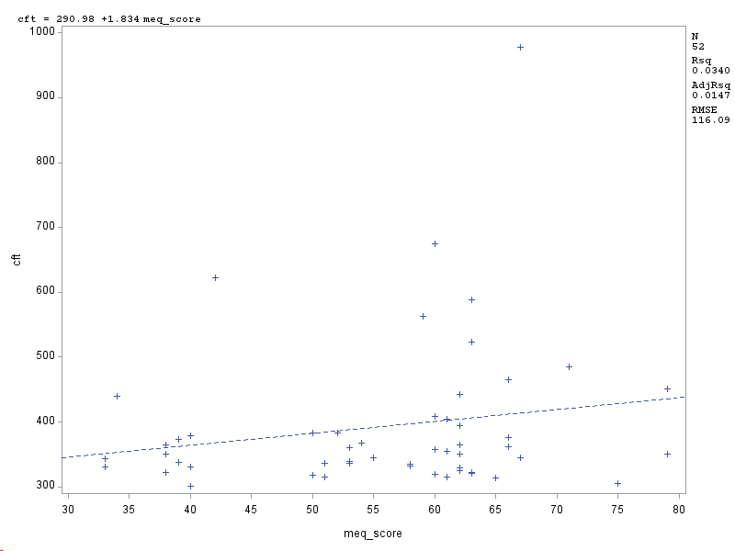
MEQ Group Distribution
Central Subfield Thickness vs MEQ Score
Figure 3 is a pie chart showing the distribution of groups based off the MEQ scores. Of the 52 patients, 28 of them fell into the morning group, followed by 13 intermediate and 11 evening.
Figure 5 is a linear regression showing an insignificant, weak positive correlation (R²=0.0340) between central foveal thickness (CFT) and MEQ scores.
Patient Characteristic | Morning Type | Intermediate Type | Evening Type | P-value
Participants | 28 | 13 | 11 | -
MEQ Score | 64.5±5.4 | 52.3±4.0 | 37.5±2.8 | 0.0001
Age | 62.3±9.8 | 56.8±13.2 | 59.8±4.8 | 0.3126
HbA₁c (%) | 8.2±1.8 | 9.4±2.8 | 7.8±1.3 | 0.4969
CFT (µm) | 421.3±143.8 | 367.3±79.9 | 352.5±37.0 | 0.0251
Visual Acuity (logMAR) | 0.38±0.26 | 0.55±0.35 | 0.58±0.52 | 0.1752

Slide 3
Summary
Our study suggests that most individuals with DME are morning type, followed by intermediate then evening types
The correlations between MEQ and other parameters observed were not statistically significant, but initial trends are described below:
  There was a weak, positive correlation between HbA1c and MEQ scores
  There was a weak, positive correlation between central subfield thickness (CFT) and MEQ score
  There was a weak, negative correlation between MEQ score and visual acuity
  There was a weak, positive correlation between age and MEQ score
The comparisons between patient demographics are described below:
  The average age was insignificantly higher in morning-type individuals compared to evening types
  HbA1c was insignificantly higher in morning types compared to evening types
  Visual acuity was insignificantly better in morning type individuals compared to evening types
  Individuals classified under morning type had significantly higher retinal thickness (CFT) than those from the evening types
References
Wang W, Lo ACY. Diabetic Retinopathy: Pathophysiology and Treatments. Int J Mol Sci. 2018;19(6).
Bhatwadekar AD, Rameswara V. Circadian rhythms in diabetic retinopathy: an overview of pathogenesis and investigational drugs. Expert Opin Investig Drugs. 2020;29(12):1431-42.
Duphare C, Desai K, Gupta P, Patel BC. Diabetic Macular Edema. StatPearls. Treasure Island (FL)2022.
Sun JK, Josic K, Melia M, Glassman AR, Bailey C, Chalam KV, et al. Conversion of Central Subfield Thickness Measurements of Diabetic Macular Edema Across Cirrus and Spectralis Optical Coherence Tomography Instruments. Translational Vision Science & Technology. 2021;10(14):34-.
PA Harris, R Taylor, R Thielke, J Payne, N Gonzalez, JG. Conde, Research electronic data capture (REDCap) – A metadata-driven methodology and workflow process for providing translational research informatics support, J Biomed Inform. 2009 Apr;42(2):377-81.
PA Harris, R Taylor, BL Minor, V Elliott, M Fernandez, L O’Neal, L McLeod, G Delacqua, F Delacqua, J Kirby, SN Duda, REDCap Consortium, The REDCap consortium: Building an international community of software partners, J Biomed Inform. 2019 May 9 [doi: 10.1016/j.jbi.2019.103208]
Fernández-Buenaga R, Rebolleda G, Muñoz-Negrete FJ, Contreras I, Casas-Llera P. Macular Thickness. Ophthalmology. 2009;116(8):1587-.e3.
References
Wang W, Lo ACY. Diabetic Retinopathy: Pathophysiology and Treatments. Int J Mol Sci. 2018;19(6).
Bhatwadekar AD, Rameswara V. Circadian rhythms in diabetic retinopathy: an overview of pathogenesis and investigational drugs. Expert Opin Investig Drugs. 2020;29(12):1431-42.
Duphare C, Desai K, Gupta P, Patel BC. Diabetic Macular Edema. StatPearls. Treasure Island (FL)2022.
Sun JK, Josic K, Melia M, Glassman AR, Bailey C, Chalam KV, et al. Conversion of Central Subfield Thickness Measurements of Diabetic Macular Edema Across Cirrus and Spectraalis Optical Coherence Tomography Instruments. Translational Vision Science & Technology. 2021;10(14):34-.
PA Harris, R Taylor, R Thielke, J Payne, N Gonzalez, JG. Conde, Research electronic data capture (REDCap) – A metadata-driven methodology and workflow process for providing translational research informatics support, J Biomed Inform. 2009 Apr;42(2):377-81.
PA Harris, R Taylor, BL Minor, V Elliott, M Fernandez, L O’Neal, L McLeod, G Delacqua, F Delacqua, J Kirby, SN Duda, REDCap Consortium, The REDCap consortium: Building an international community of software partners, J Biomed Inform. 2019 May 9 [doi: 10.1016/j.jbi.2019.103208]
Fernández-Buenaga R, Rebolleda G, Muñoz-Negrete FJ, Contreras I, Casas-Llera P. Macular Thickness. Ophthalmology. 2009;116(8):1587-.e3.
Conclusions
Our study suggests DME individuals are mostly morning type instead of evening type. There was a significant increase in CFT among morning types when compared to evening types, but all other comparisons were insignificant. As we recruit more individuals in the future, we hope to establish a more significant relationships that could help get a better understanding of how circadian rhythms and DME are interconnected and could lead to new treatments.

