Slide 1
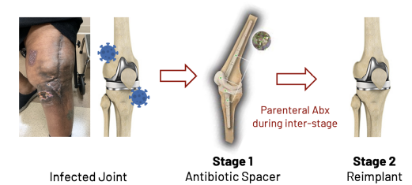
Kidney Function and Mortality Following Two-Stage Revision Total Joint Arthroplasty for Periprosthetic Joint Infection: Background Information
Periprosthetic joint infection (PJI) after primary total hip and knee arthroplasty (THA, TKA) is reported in up to 2% of patients and is a catastrophic and devastating complication.
Treatment:
Notes:
Studies on the effect of antibiotics on kidney function and mortality during contemporary two-stage treatment for PJI with modern perioperative protocols and medical optimization are limited.

Slide 2
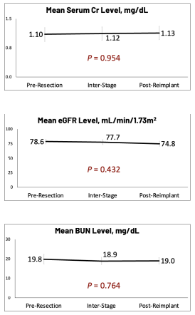
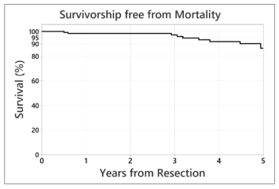
Results
No significant differences.
Mortality was 0% within 90-days of resection, and 1.4% (N=2/138) within 1-year of resection (both unrelated to kidney function; cardiac events).
Survivorship 98% at 2-years and 86% at 5-years post-resection.

Slide 3
Conclusions
Kidney function via Cr levels, eGFR, and BUN was not adversely impacted by the antibiotics associated with the two-stage revision procedure for PJI. In addition, survivorship following two-stage treatment for PJI was high (98%) out to 2 years after resection.
Thus, with proper medical management, the two-stage revision for PJI remains the preeminent treatment for PJI following TJA.

