Slide 1


Indiana Clinical and Translational Sciences Institute
2024 Annual Meeting
“We had no idea what to ask”:
Development and Co-Design of Osteosarcoma
Surgical Discussion Cards for Use at Diagnosis
Clayton Hicks, BA BS; Janet Panoch, PhD; Chris Collier, MD
Notes:
My name is Clayton Hicks and I am presenting “We had no idea what to ask” Development and co-design of Osteosarcoma Surgical Discussion Cards for use at diagnosis.
Dr. Janet Panoch and Dr. Chris Collier served as Pis on this project. And this project was funded from a CTSI grant.

Slide 2
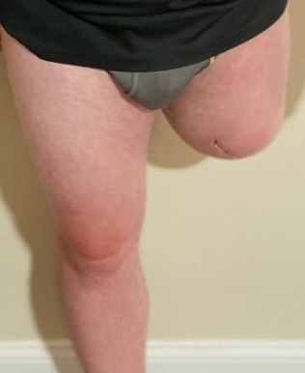
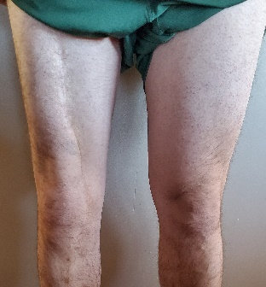
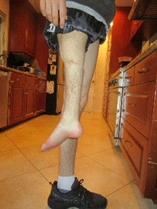
Background
Osteosarcoma (bone cancer) often occurs around the knee; options include:
Each option has a very different appearance and different long-term functional outcomes. It is a complex, high-stakes decision that feels overwhelming to families.
Orthopedic oncologists at the 2023 Musculoskeletal and Tumor Society Meeting requested an discussion cards to help discuss options to patients at their initial visit.
With funding from the CTSI Pediatrics team, development started using a co-design model with patients, caregivers, and surgeons.
Amputation
Limb Salvage
Rotationplasty
Notes:
Osteosarcoma is a rare pediatric bone cancer that often occurs around the knee. Management includes surgery and there are three main surgical options. Amputation, limb salvage, and rotationplasty all pictured on the slide. Each option has a very different appearance and different long-term functional outcomes. It is a complex, high-stakes decision that feels overwhelming to families.
At the musculoskeletal and Tumor Society Meeting last year, orthopedic oncologists expressed that they desired a discussion aid they could use to help navigate the first conversation about surgical options with newly diagnosed families. This conversation is often overwhelming and difficult for families to have, so the use of a discussion card would help more clearly explain options.
With funding from the CTSI pediatrics team, development started using a co-design model with patients, caregivers, and surgeons

Slide 3
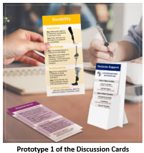
Building the Prototype
Study 1: Patient Focus Group (n=6), Parent Focus Group (n=9)
Goal of working with patients/caregivers to determine what would be helpful to have on discussion cards used by orthopedic oncologists with newly diagnosed families.
Study 2: Prototype 1 reviewed by attendees (n=24) at the Osteosarcoma Conference. Participants were asked what they liked and what recommendations they had. Recommendations included important questions to consider, values to focus on, pros/cons of options, and suggestions on the timeline of conversation.
“I like the idea of the cards because I feel like things are swirling and you need so much information about so many things and you can get latched on to one piece…What I see is nice about the cards is that you can pull up the card that’s the focus and it can kind of help focus a discussion.”
Notes:
In order to develop a prototype of cards, both parent and patient focus groups were used. The goal of these groups was to determine what content and structure would work best for a set of cards to be used by orthopedic oncologists with newly diagnosed families.
For the second portion of the project, a prototype of cards was taken to the osteosarcoma conference and tested with 24 participants (most of who were patients and caregivers). Participants were asked what they liked about the cards and what recommendations they had. These responses went through qualitative analysis utilize Nvivo to code responses. Recommendations of content included: important questions to consider, values to focus on, pros/cons of each options, and suggestions on the timeline of when to have further conversation about the surgical decision.
One parent said “I like the idea of the cards because I feel like things are swirling and you need so much information about so many things and you can get latched on to one piece… What I see is nice about the cards is that you can pull up the card that’s the focus and it can kind of help focus a discussion”

Slide 4
Prototype 2
Study 3: A stakeholder group of parents and patients (n=7) reviewed the recommendations and resolved discrepancies.
“Really good starting point for the conversation.
If we had this when we were first diagnosed, it would have facilitated the process.”
Next Steps: In September, prototype 2 will be reviewed with orthopedic oncologists at the Musculoskeletal Tumor Society Meeting. Their feedback will inform Prototype 3.
A final version of the Osteosarcoma Discussion Cards is expected to pilot test with newly diagnosed families at multiple institutions. We aim to develop an evidenced-based timeline for communicating options to establish a standard of care for communicating options.
Notes:
As responses were coded, it appeared that some disagreements/discrepancies came up between different responders. So, a focus group of stakeholder parents and patients was held to resolve these points.
One parent said these cards were a “really good starting point for the conversation. If we had this when we were first diagnosed, it would have facilitated the process”
Next steps for this project included updating the prototype based off of the feedback mentioned. Then, in September prototype 2 will be reviewed at the Musculoskeletal tumor society meeting where the same group of orthopedic oncologists that initially requested the development of these cards can see them and provide feedback. This feedback will inform prototype 3.
A final version of these discussion cards is expected to pilot test across many institutions. We aim to develop an evidenced-based timeline for communicating options to establish a standard of care for communicating options. From clinic, to community, and back to clinic these cards will directly impact physician-patient communication.

