Slide 1

Indiana Clinical and Translational Sciences Institute
2024 Annual Meeting
Müller cell Kir4.1 channel dysfunction in APOE4-KI model of Alzheimer’s disease
Abhyankar, Surabhi D.^{1,2}, Yucheng Xiao³, Mahajan Neha¹, Luo, Qianyi¹, Theodore R. Cummins³, Oblak, Adrian L.⁴, Lamb, Bruce T.⁴, Bhatwadekar, Ashay^{1,2,4}
¹Department of Ophthalmology, Eugene and Marilyn Glick Eye Institute, Indianapolis, Indiana. ²Department of Biochemistry and Molecular Biology, Indiana University, Indianapolis, Indiana. ³Department of Biology, Indiana University, Indianapolis, Indiana. ⁴Stark Neurosciences Research Institute, Indianapolis, Indiana.

Slide 2
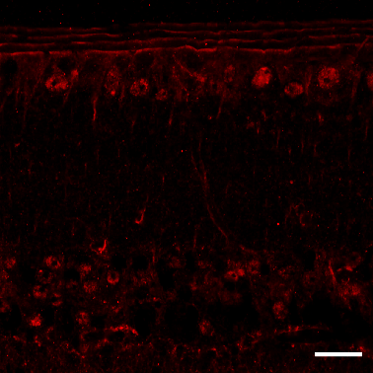
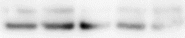
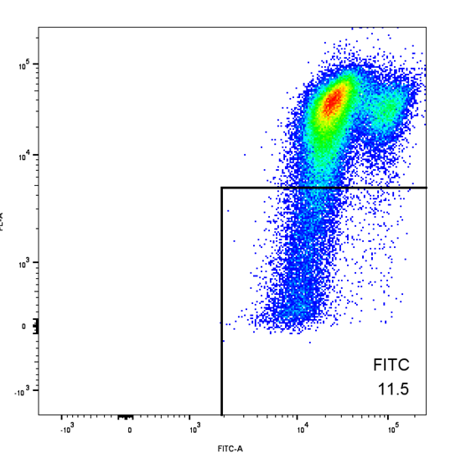
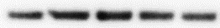
Here’s what we found
52-57-weeks-old APOE4-KI mice showed decreased Kir4.1 expression and reduced Kir4.1 current densities compared to APOE3-KI mice.
RMC-1 expressing APOE4 showed a reduction in the Kir4.1 gene and protein expression.
Flow cytometry analysis showed APOE4 increased mitochondrial dysfunction.
Kir4.1 expression
Kir4.1 current densities
Kir4.1 mRNA, Protein expression
Mitochondrial dysfunction
NT | EV | APOE2 | APOE3 | APOE4
APOE4
APOE4
Kir4.1
α-tubulin
RMC-1: Rat Müller Cells. EV: Empty vector. NT: No transfection. Unpublished data
Notes:
Begin by stating the Super Big Results (state them in 3 key points, like an outline)

Slide 3
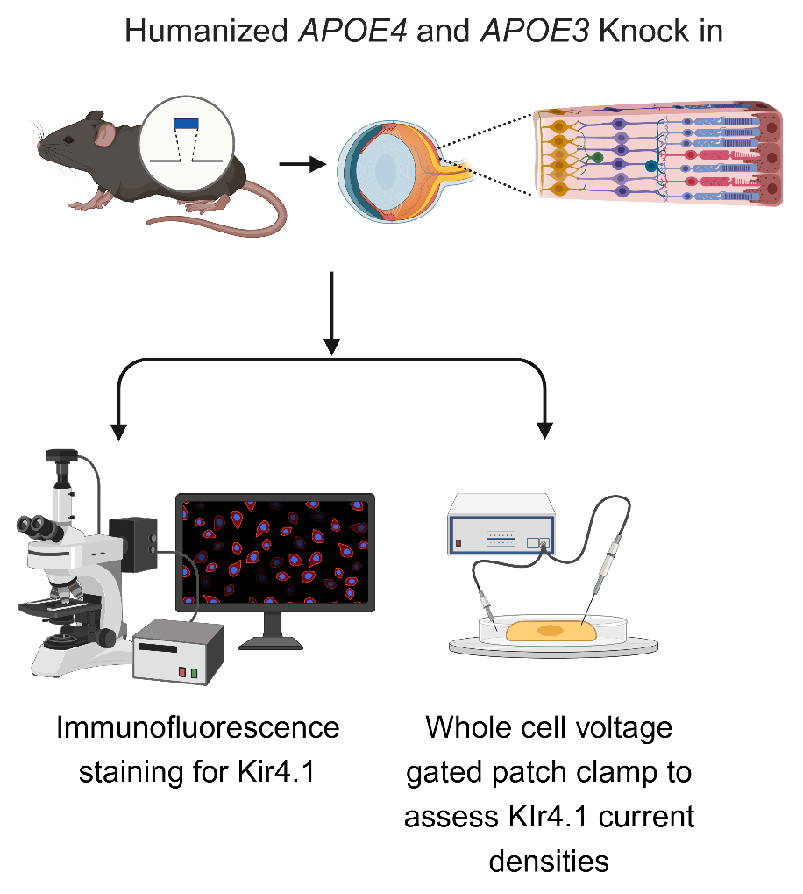
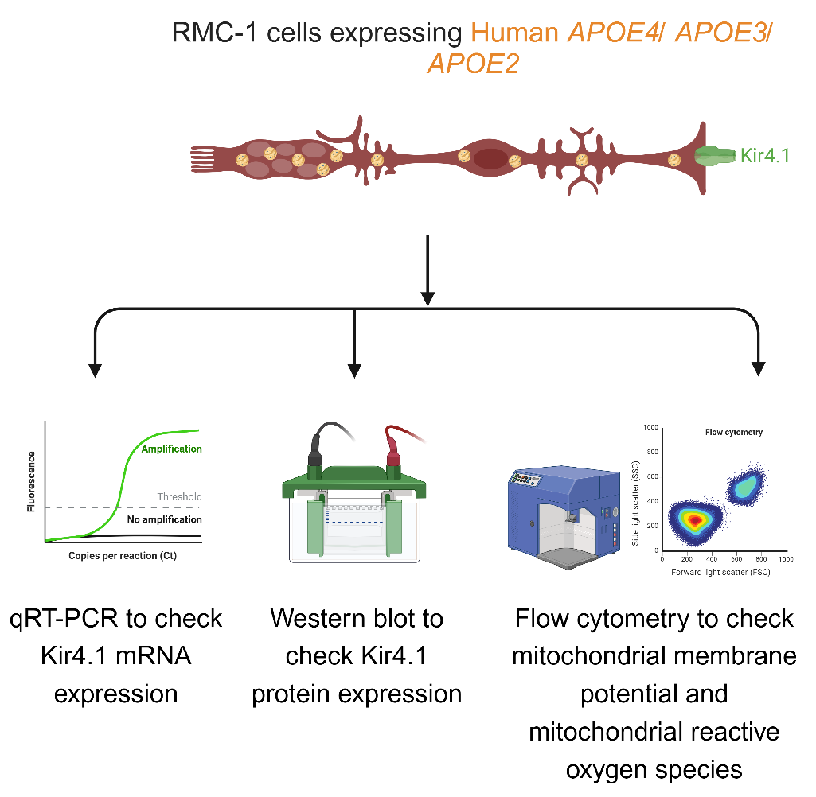
Here’s how we did it
In vivo: Apolipoprotein E4 (APOE4): Genetic risk factor for Alzheimer’s Disease (AD). Apolipoprotein E3 (APOE3): Neutral for AD.
In vitro: Rat Müller Cell (RMC-1)
Cartoon created with Biorender_Surabhi D. Abhyankar

Slide 4
Future implications for patients or the community/ or next steps
Müller cells (MCs), key retinal glia, regulate water and K+ balance via Kir4.1 channels, but how APOE4 impacts Kir4.1 and MC health in Alzheimer's disease (AD) is unknown.
Our study demonstrates that APOE4 causes structural and functional deficits in the MCs, potentially via mitochondrial dysfunction.
These discoveries shed light on the mechanisms behind MC dysfunction in AD and help better understand whether enhancing mitochondrial health improves retinal health.
Notes:
Before creating your 3 slides that will form your 2-minute video, think about how you would present your slides in a TWEET, and use that brief format to guide your points. Provide key takeaways for the most impact.

Slide 5
Grant Acknowledgement
This work is supported by: NIH- NEI R01: R01EY027779, R01EY027779-S1 and R01EY032080 and Research to Prevent Blindness: to Dr. Ashay Bhatwadekar.
Dr. Peter J Roach Diabetes and Obesity Training grant, Sigma Xi GIAR: to Surabhi Abhyankar.
The content is solely the responsibility of the authors and does not necessarily represent the official views of the National Institutes of Health or the funding entities.
Notes:
If your project or training has been supported by the Indiana CTSI, your poster and PowerPoint presentation should include acknowledgement of the appropriate Indiana CTSI grant.
For your convenience, we have added this list of award sources to the last slide of the PowerPoint template. Please review the list of award sources and delete those that did not contribute to the conduct of the research reported in your presentation.
If your project or training was supported by other grants, please remember to acknowledge those grants as well.

