Slide 1
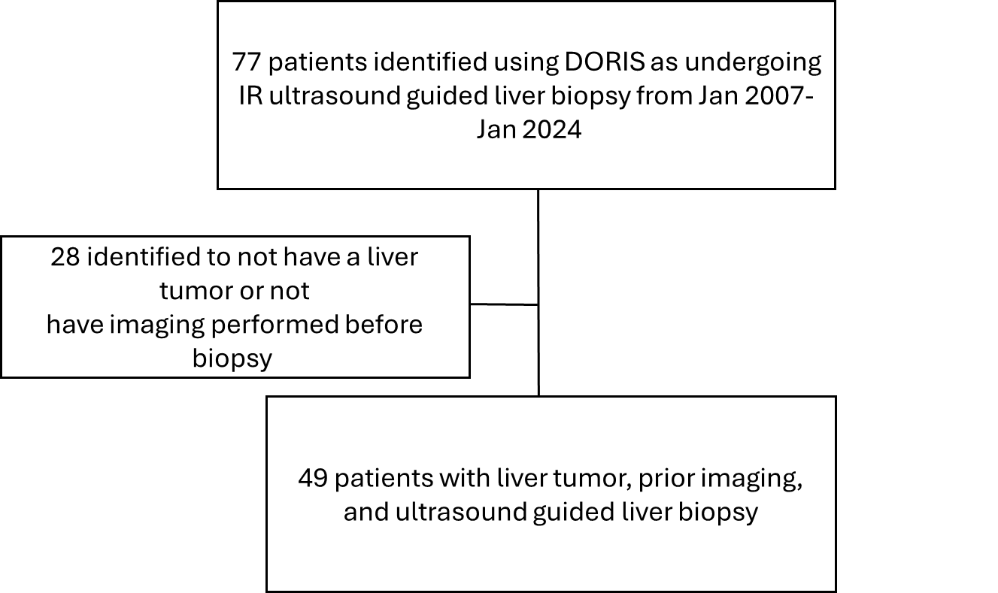
Imaging Accuracy in Pediatric Liver Tumors
In the neonatal period and early childhood, hemangioma and hepatoblastoma are the most common tumors
In school-aged children and adolescents, adenomas and hepatocellular carcinoma are the most common
Risk factors: Beckwith-Wiedemann Syndrome (BWS), prematurity, low birth weight (<1500g), and HBV infection

Slide 2
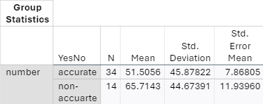
Results
Size of tumor did not correlate with accuracy of Imaging
p=0.8
Biopsy
Imaging
Number of Lesions | Amount
1 | 22
2 | 7
Multiple | 20
Average Lesion Size: 55.3 mm

Slide 3
Results
Form of Imaging | Accuracy
CT | 71%
MRI | 77%
Ultrasound | 33%

