Slide 1
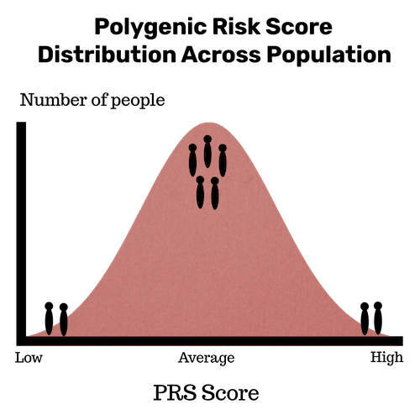

Alcohol Use Disorder (AUD) is a polygenic disease
  Combination of genes + environment
    ~50% heritable (PMID: 33879270)
    Polygenic scores (PGS or PRS):
    Combines the effect of many variants/genes into a single score
    Limited transferability across different populations
    Lacks interpretability
Risk prediction accuracy can be improved by incorporating functional priors (PMID: 34663819) (PMID: 33611520) (PMID: 38036535)
GOAL: Construct a functional gene-based polygenic score (f-PGS) for AUD to improve risk prediction across populations and enable additional discoveries
https://cogastudy.org/aud/polygenic-risk-scores/
Notes:
Typically distill genetic liability to a single number based on aggregation of an individual’s genome-wide risk alleles. This comes with a loss of information about an individual’s genetic profile
multiple genetic liabilities underlie complex diseases, rather than a single genome-wide liability. such as how the burden of genetic risk varies across different biological processes and pathways. Lacks the interpretability needed for patient stratification.
previous work has shown that prioritizing SNPs with strong functional genomic evidence improves PRS accuracy compared to traditional PRS computation
Our goal is to construct functional gene-based polygenic scores that are applicable across population and enable investigations into the heterogeneity of genetic risk.

Slide 2
Genome wide association studies (GWAS) can identify AUD-associated loci but not which variants are “functional”
5’UTR
3’UTR
Most GWAS signals in noncoding regions
  Risk alleles, not causal
  Cell type specific context
Enhancers
Promoter
Alter transcriptional regulation
Alter RNA processing and translation
3. How does altered expression of these genes affect AUD risk?
1. Which variants impact gene expression?
2. Which genes are regulated by which variants?

Slide 3
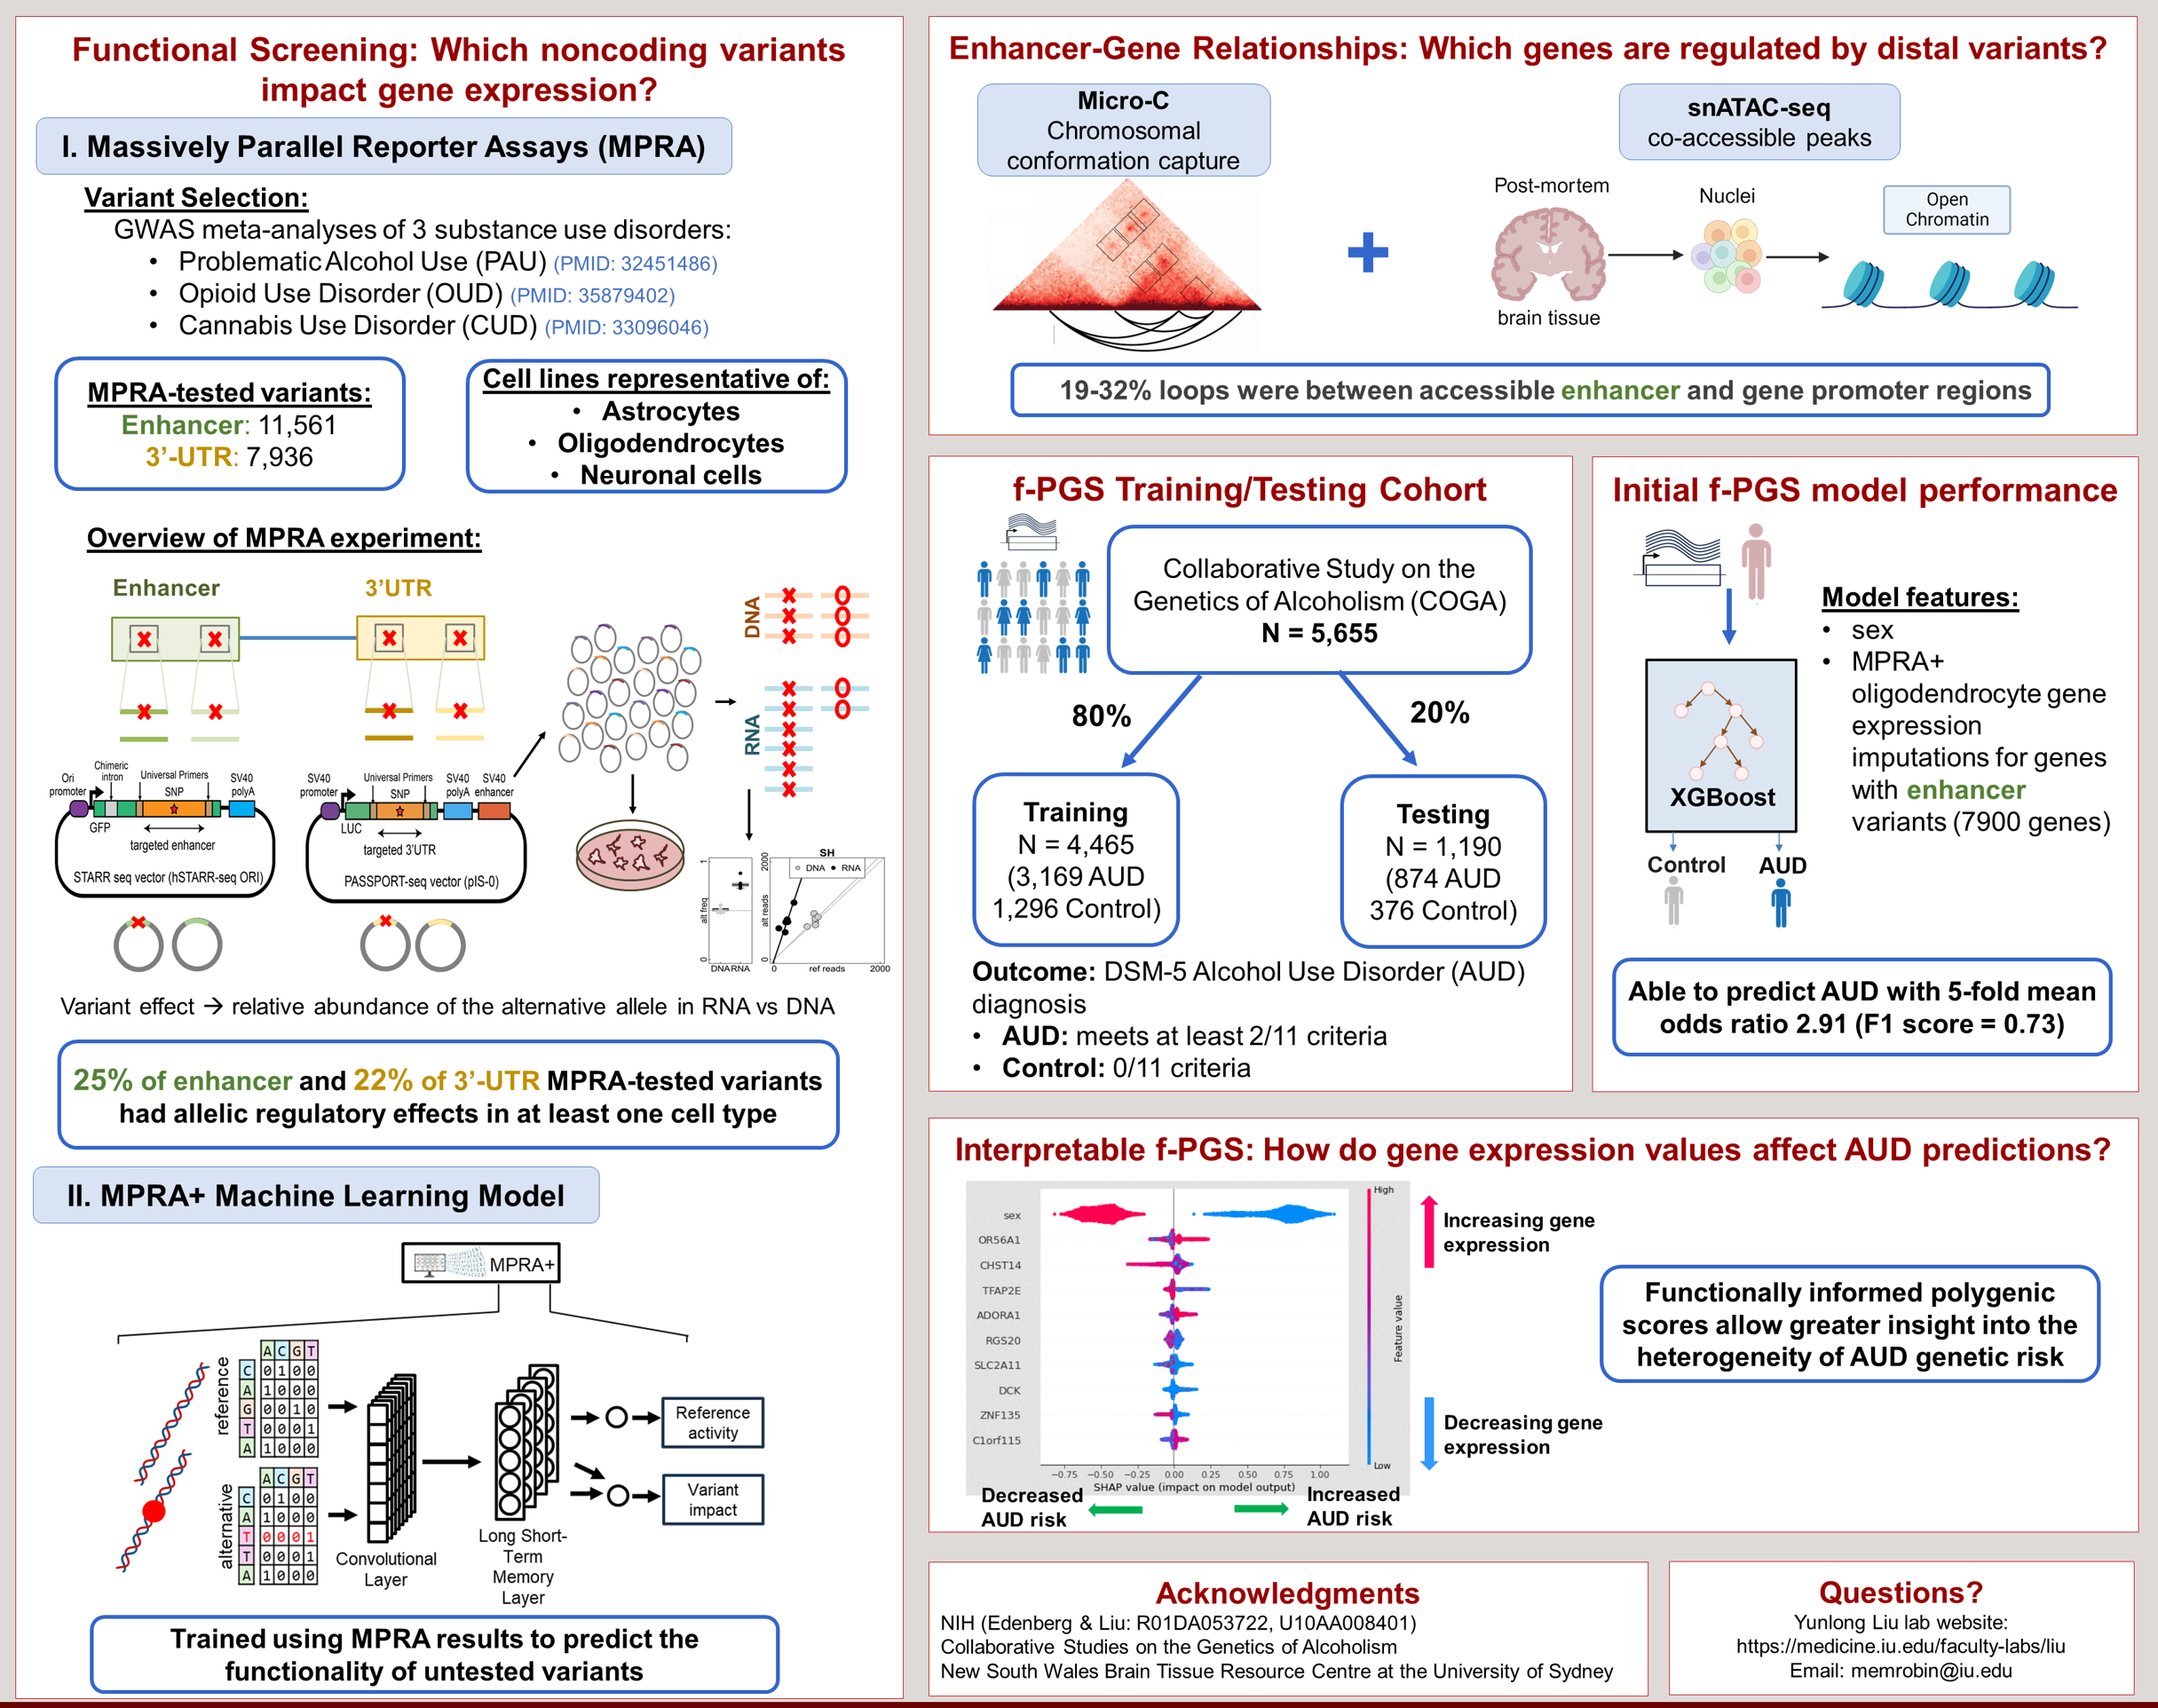
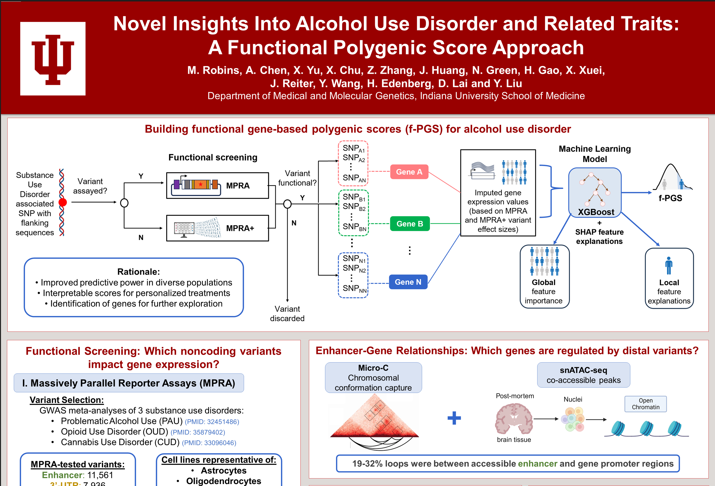
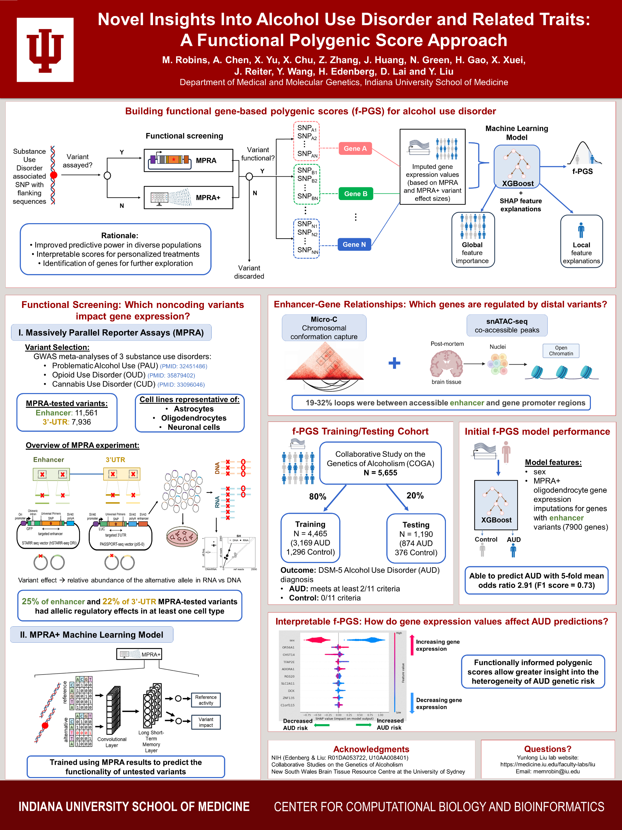
2. Which genes are regulated by which variants?
1. Which variants impact gene expression?
3. How does altered expression of these genes affect AUD risk?

