Slide 1
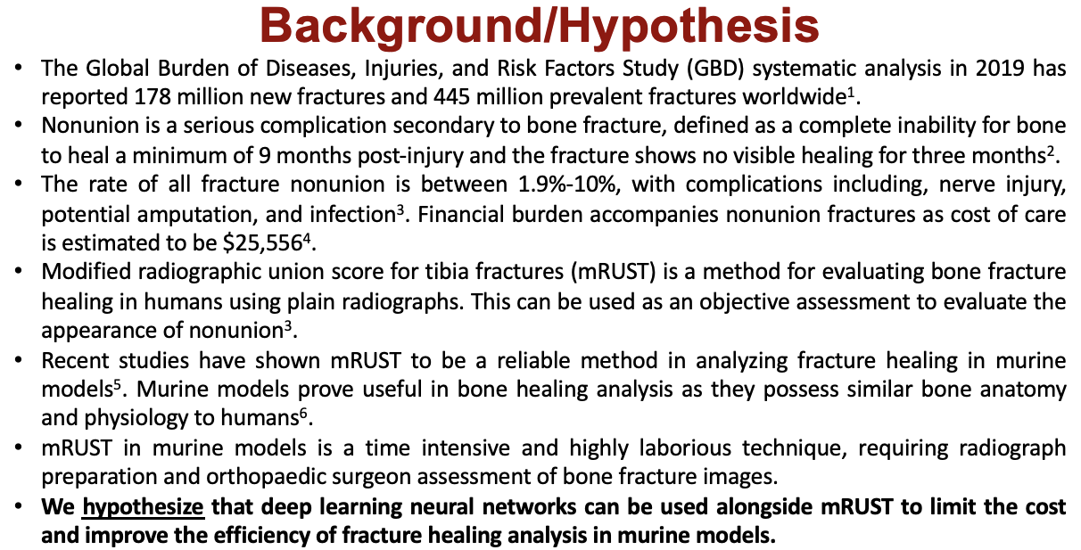
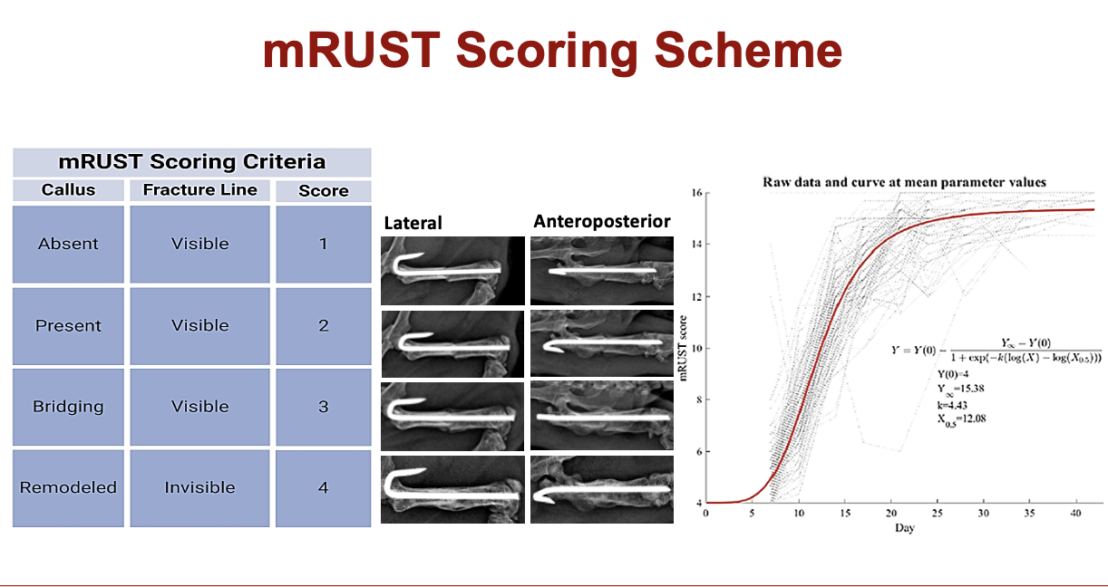

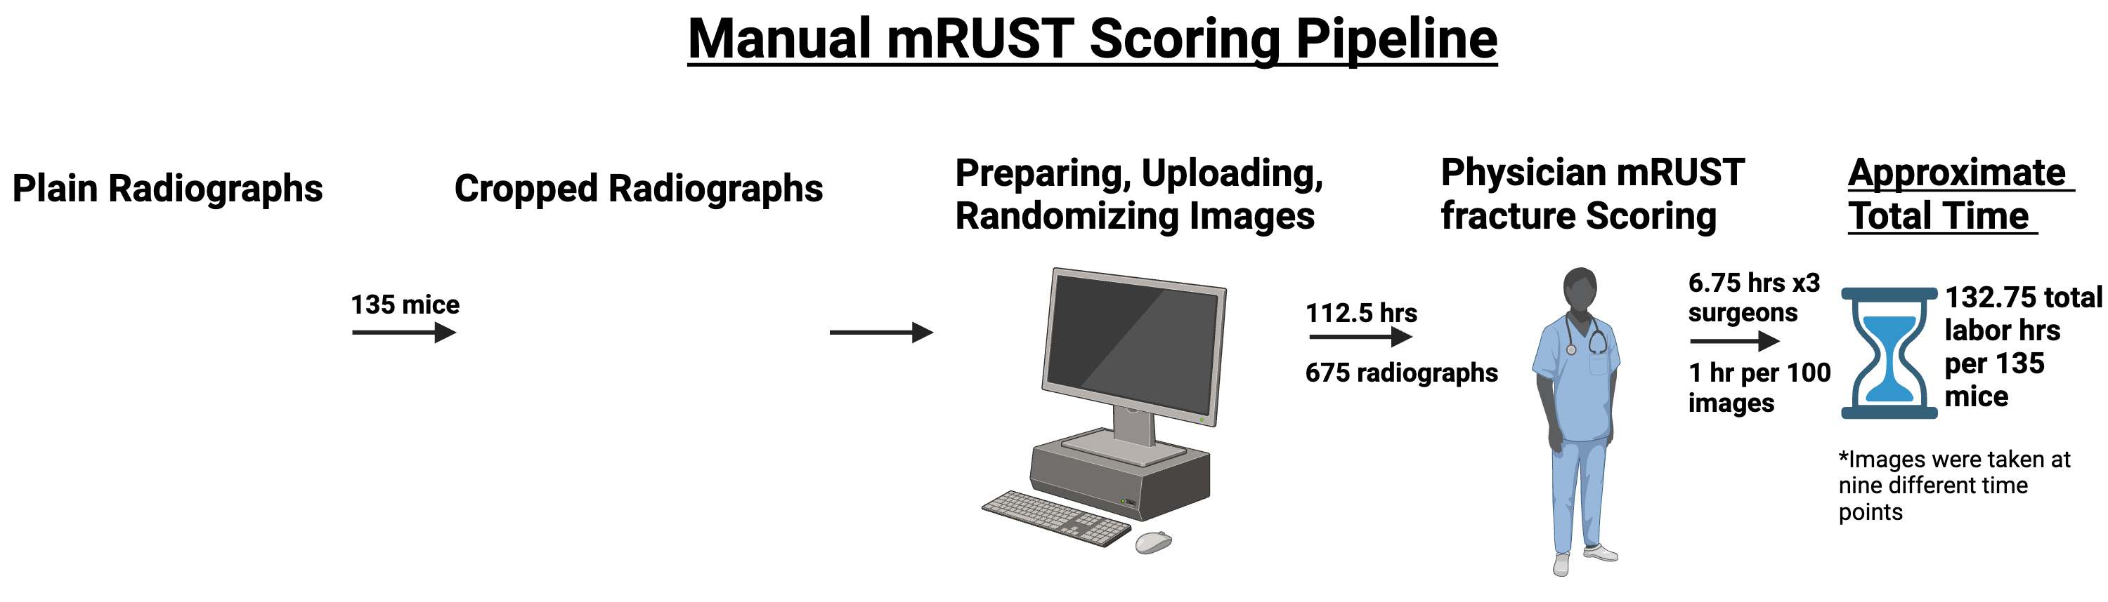
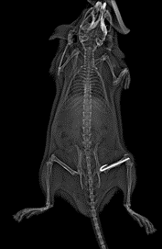
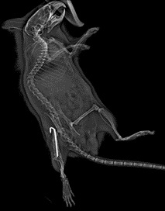
Assessing Mouse Model Based Femur mRUST Scores via Intelligent Fracture Detection and Deep Learning Neural Networks
Cooper R. Parish^{1;2}, Jie Chen³, Sarah L. Mostardo^{1;2}, Sonali J. Karnik^{1;2}, Rachel J. Blosser^{1;2}, Istvan Gergely¹, Nian Wang^{3;4}, Roman M. Natoli¹, Melissa A. Kacena^{1;2}
¹Department of Orthopaedic Surgery, Indiana University School of Medicine, Indianapolis, IN, USA; ²Richard L. Roudebush VA Medical Center, Indianapolis, IN, USA; ³Advanced Imaging Research Center, University of Texas Southwestern Medical Center, Dallas, TX, USA; ⁴Department of Biomedical Engineering, University of Texas Southwestern Medical Center, Dallas, TX, USA

Slide 2
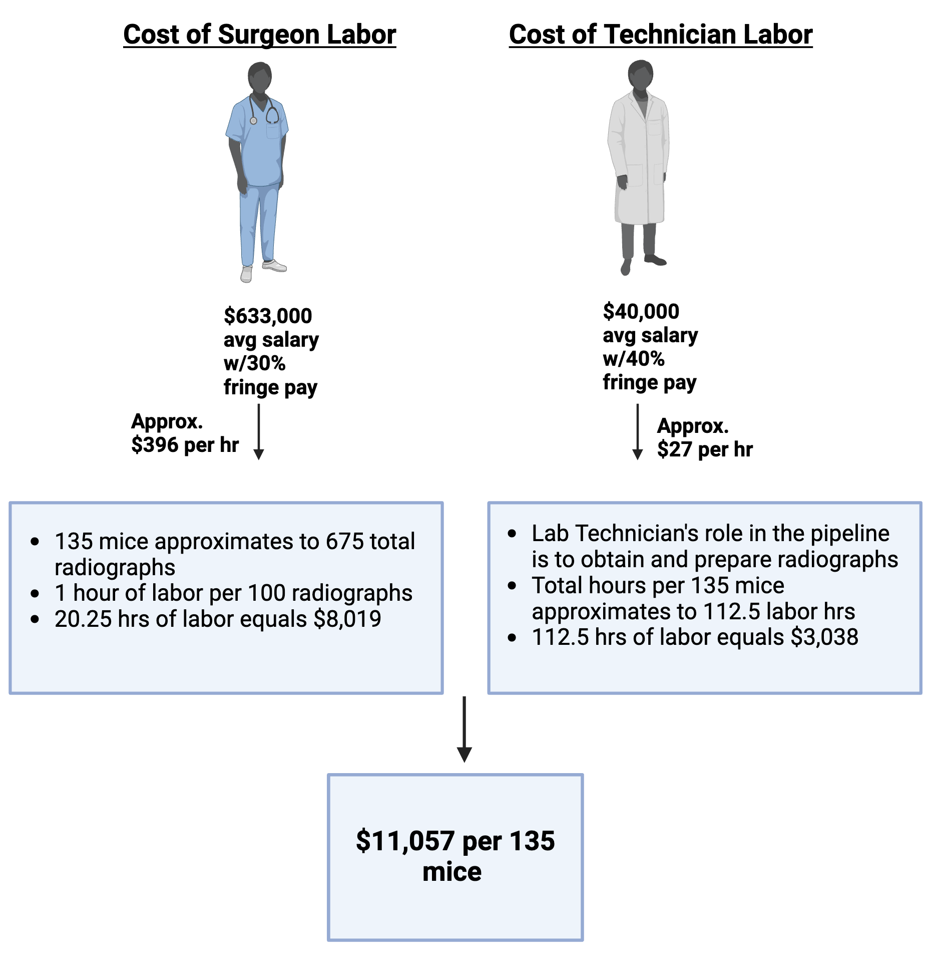
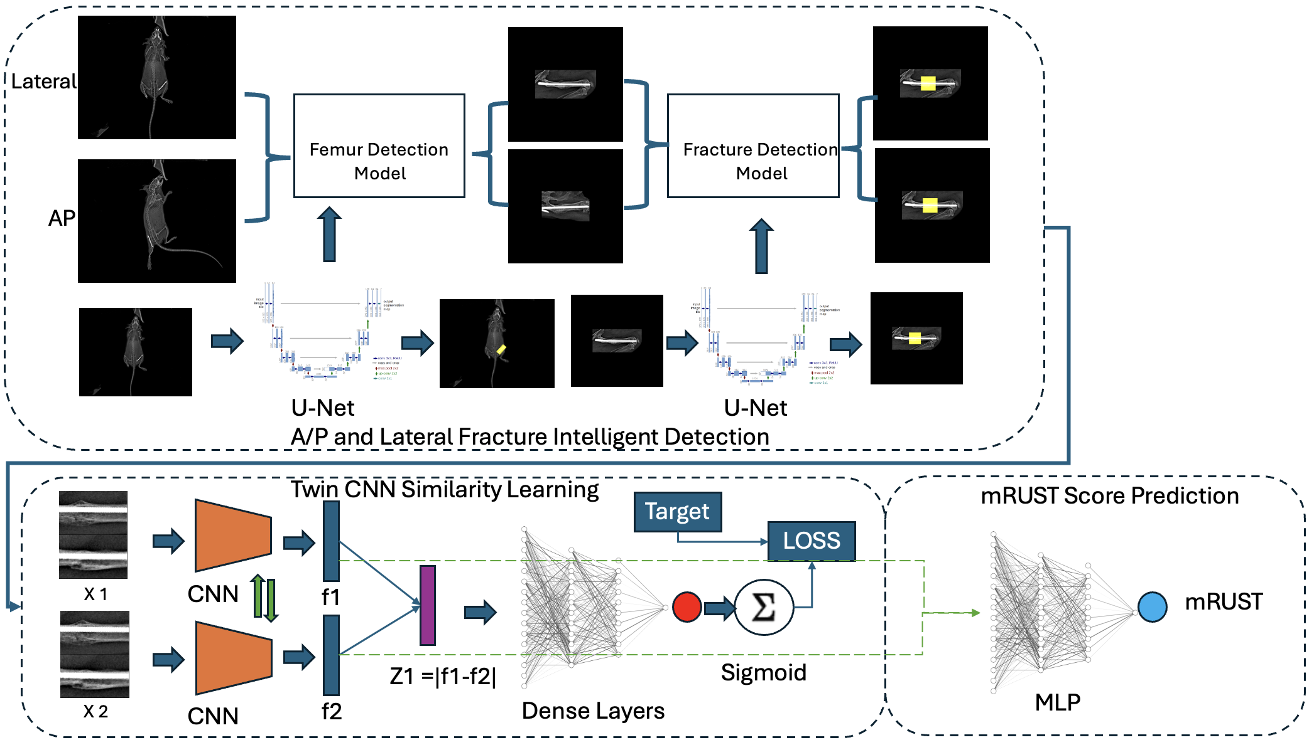

Slide 3


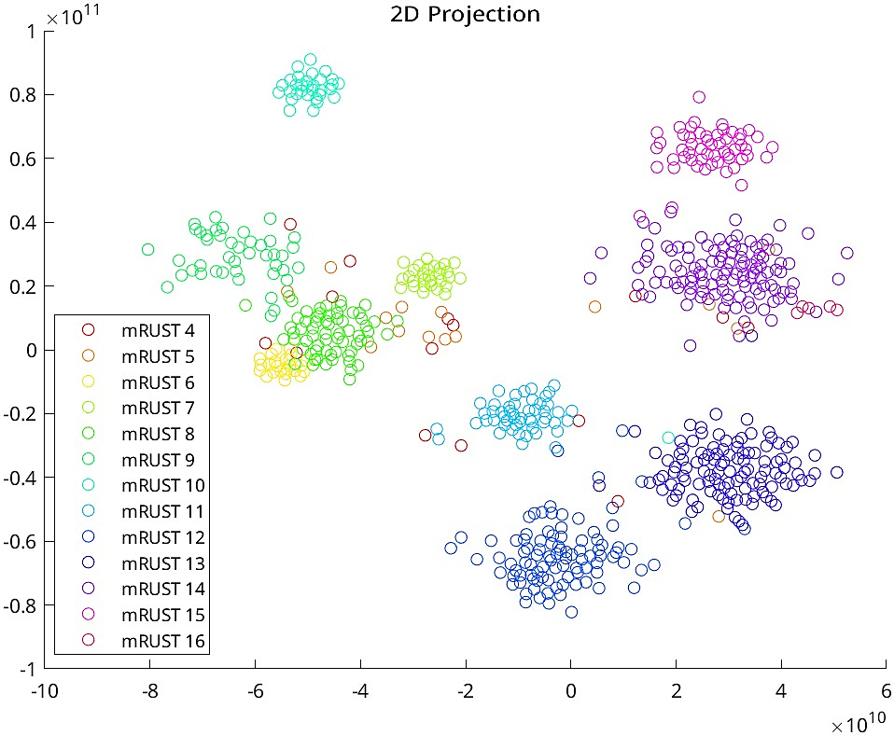
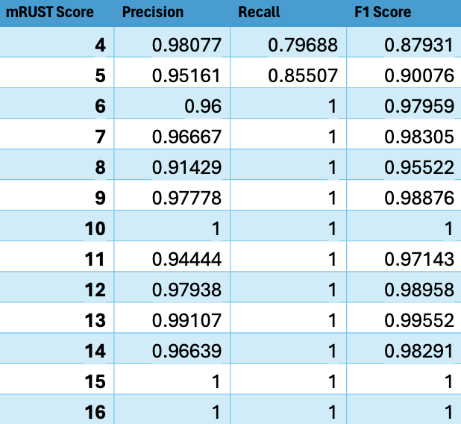
The overall accuracy in the AI’s ability to predict mRUST scores is 96%.
We previously accessed intraclass correlation coefficients (ICCs) calculated for manual mRUST scored radiographs at .94, .87, .80, and .75 for days 14, 18, 21, and 28, respectively.
The results of this study will decrease the time and labor that goes into preparing and scoring bone healing in murine models using mRUST.
Eliminating the burden of time and labor results in a more efficient workflow and limits the cost that go into research personnel and medical experts.
We plan on improving the power of our study by increasing the number of radiographs that are analyzed by the AI. Improving the reliability of the AI will allow our work to translate to clinical orthopaedic practice using mRUST as the vehicle for scoring fracture healing.
Future studies will determine whether comparable results can be obtained for different skeletal sites and with human x-rays.
Eventually, the hope is to predict early after surgery who is likely to heal or go on to nonunion. Early intervention could substantially decrease pain, morbidity, and healthcare costs.

