Slide 1
Toxicological Impact of Gold Nanoparticles on Retinal Tissue Health in Mice
Department of Ophthalmology
Kelsey Robinson¹, Ben McCall², Yong Gao¹, Sunland L Gong¹ , Afshin Izadian, Ph.D.^{2,} Amir Reza Hajrasouliha, MD¹
Glick Eye Institute, Indiana University School of Medicine¹,
Department of Engineering and Technology Purdue University, West Lafayette²

Slide 2
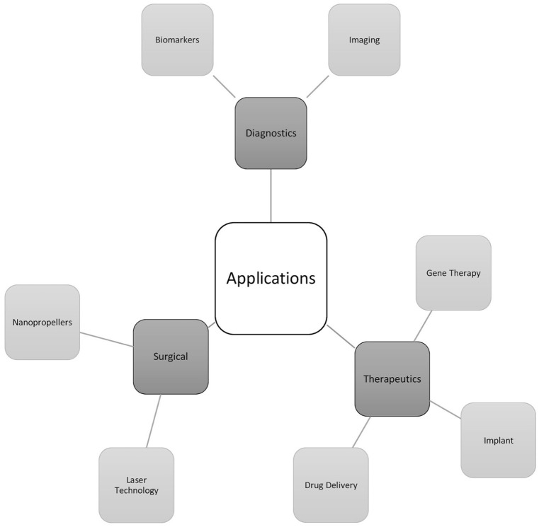
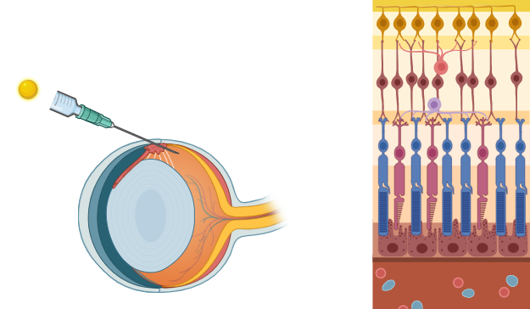
Background
Retinal Degeneration is the leading cause of Blindness in the United States.
No principal treatment or cure for retinal degenerative diseases.
Gold Nanoparticles (AuNPs) possess certain chemical and physical properties that make them of interest for retinal regeneration treatment
This study investigates the toxicity of AuNPs on mice retinal tissue with the intention of utilizing them in future ocular therapies.
NPs
Intravitreal Injection
Optic nerve
Cornea
WT C57 Retina
Figure 1. Intravitreal Injection (IVI) of Nanoparticles (NPs) with WT C57 mice retinal layers.
Scheive M, Yazdani S, Hajrasouliha AR. The utility and risks of therapeutic nanotechnology in the retina. Ther Adv Ophthalmol. 2021 Mar 22;13:25158414211003381. doi: 10.1177/25158414211003381. PMID: 33817552; PMCID: PMC7989128.

Slide 3
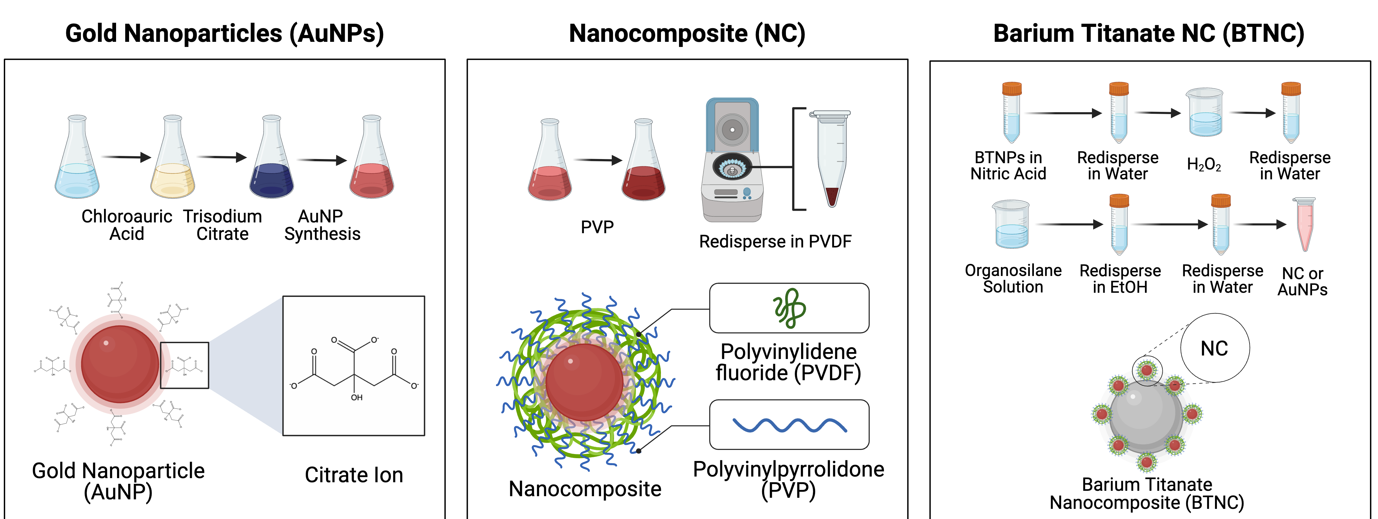
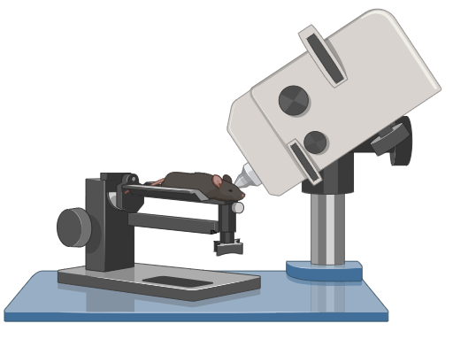
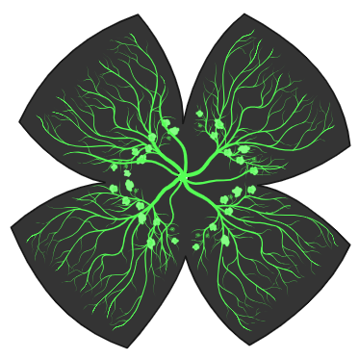
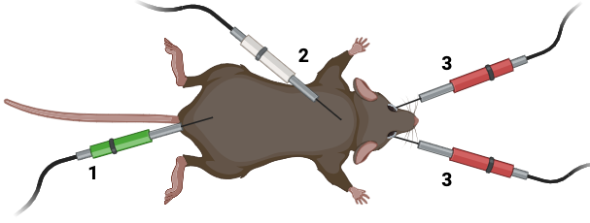
Materials and Methods
Figure 2. Synthesis of nanoparticle solutions of AuNPs, NC, and BTNC.
Figure 3. OCT system set up for mouse retinal imaging.
Figure 4. ERG electrode positions. 1, grounding electrode; 2, reference electrode; 3, corneal electrodes.
Figure 5. Isolectin B4 Immunostaining, flat mount retina

Slide 4
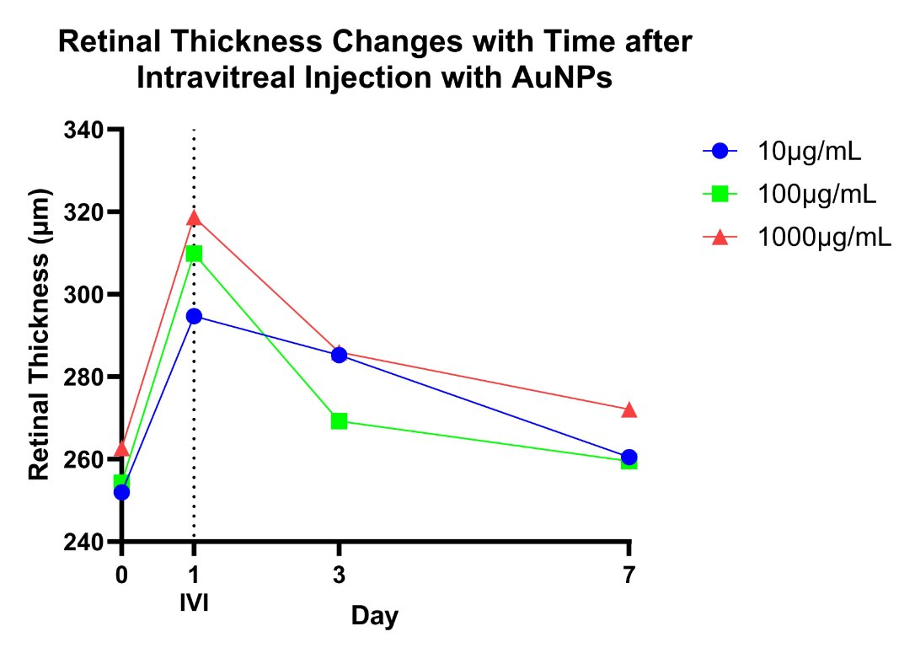
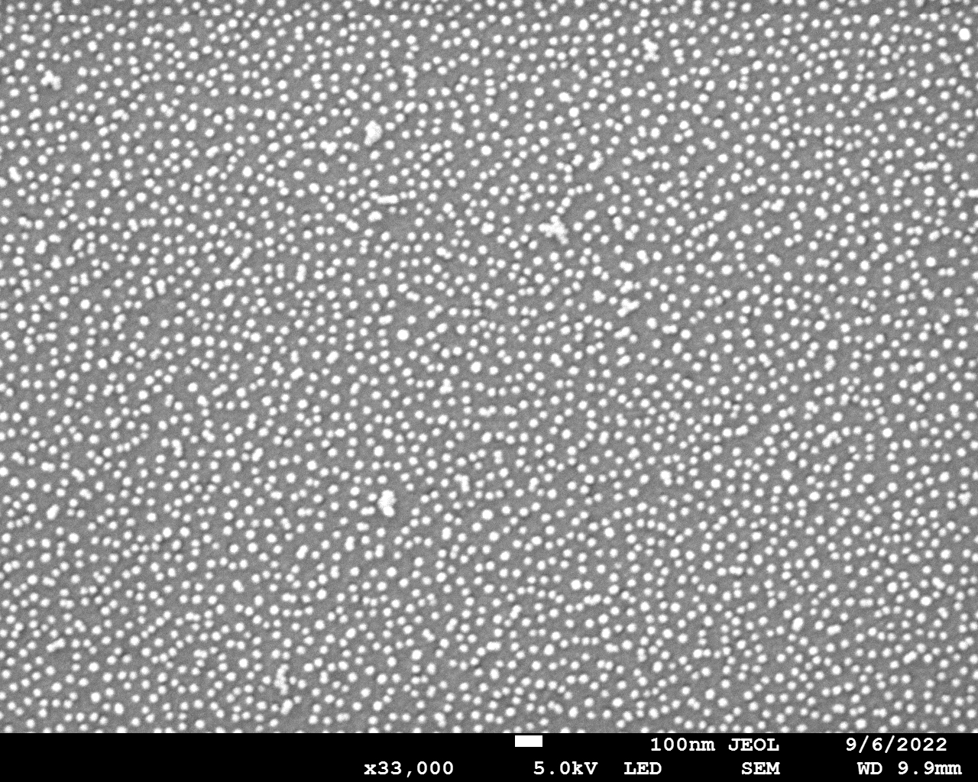
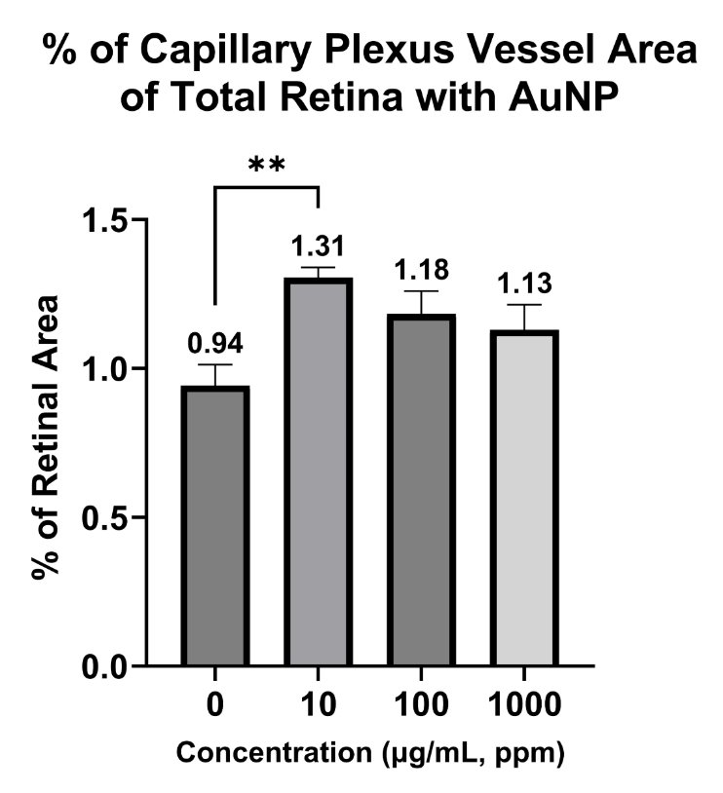
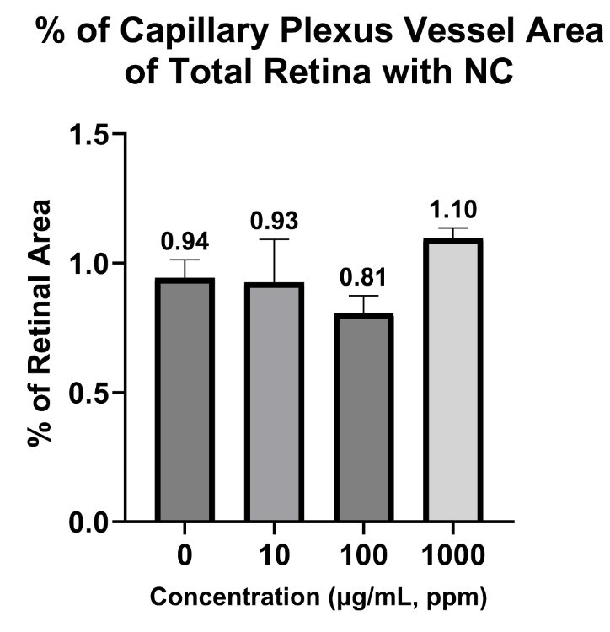
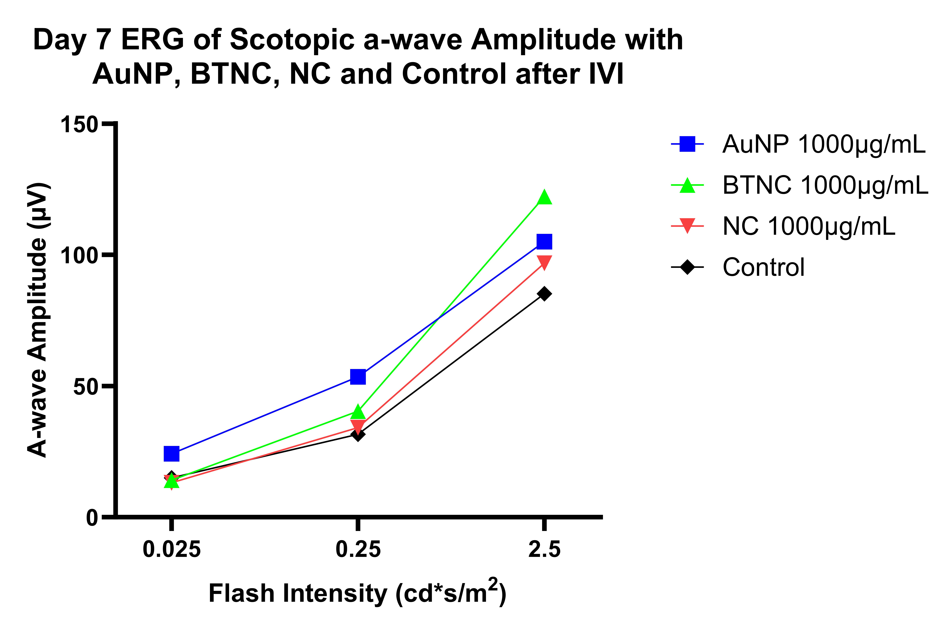
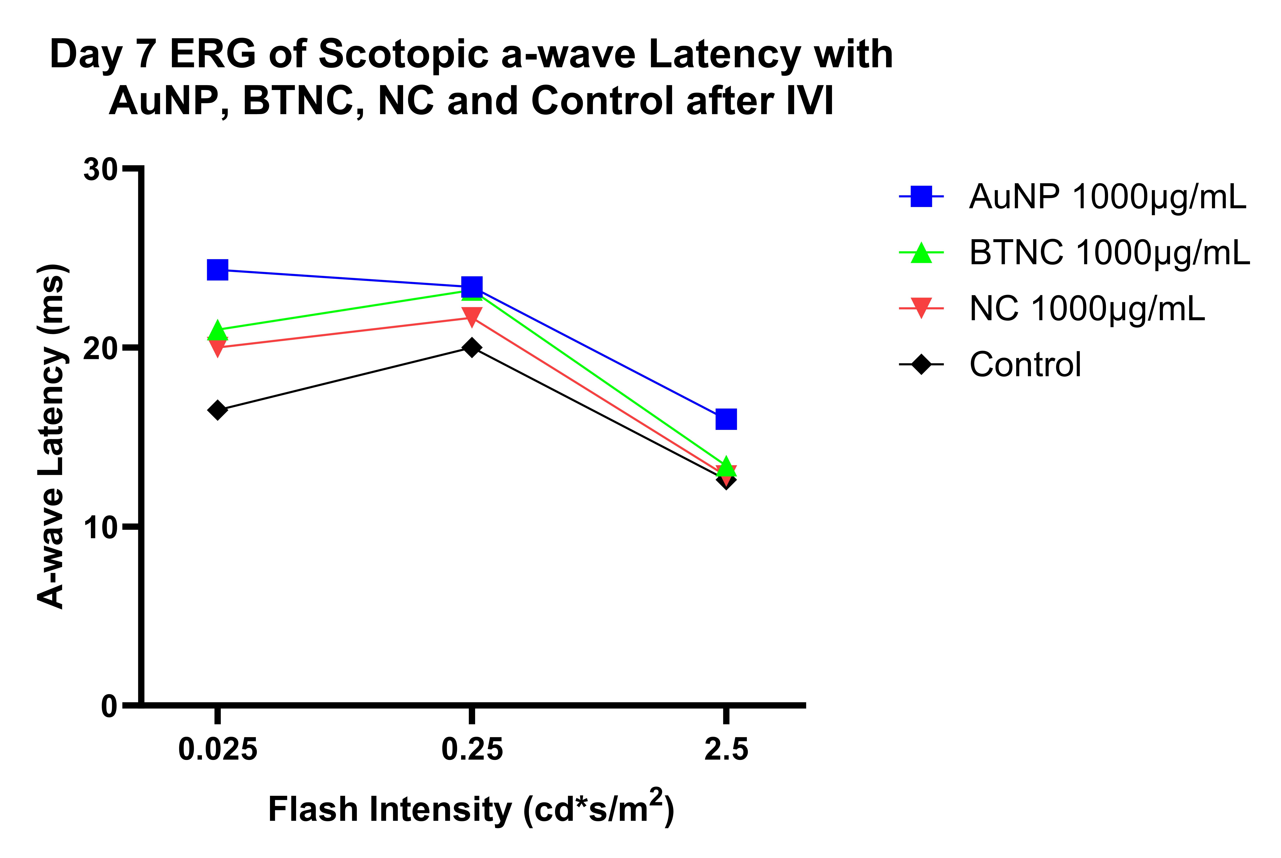

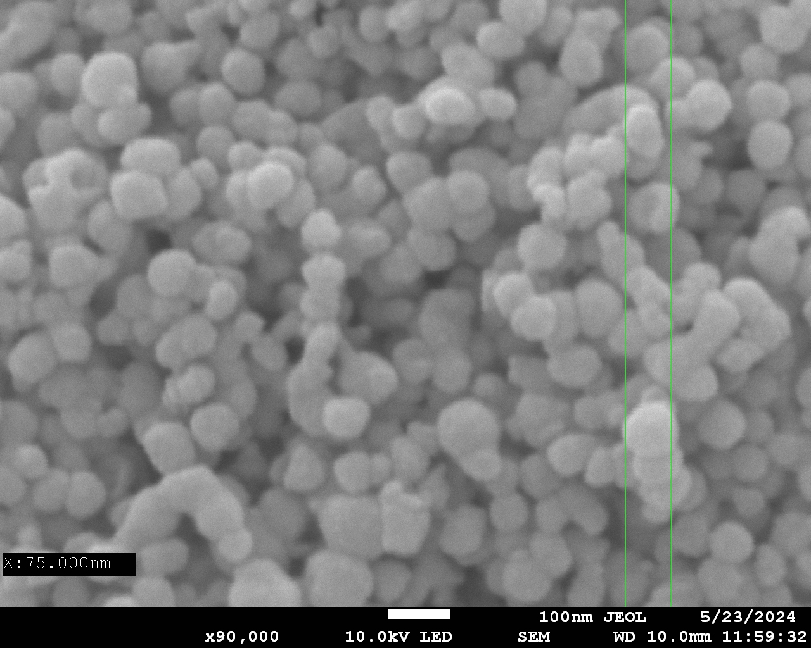
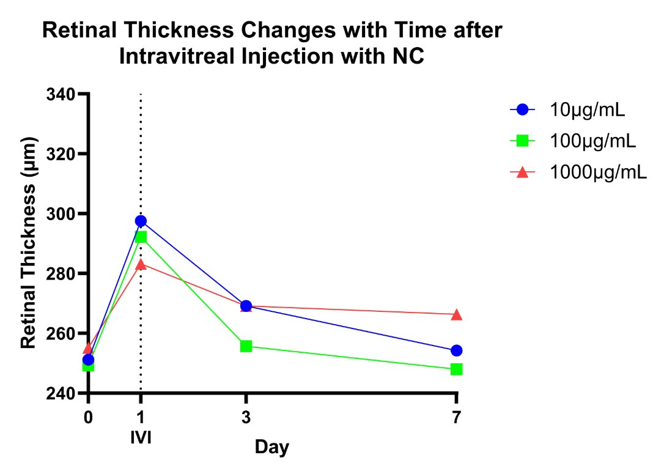
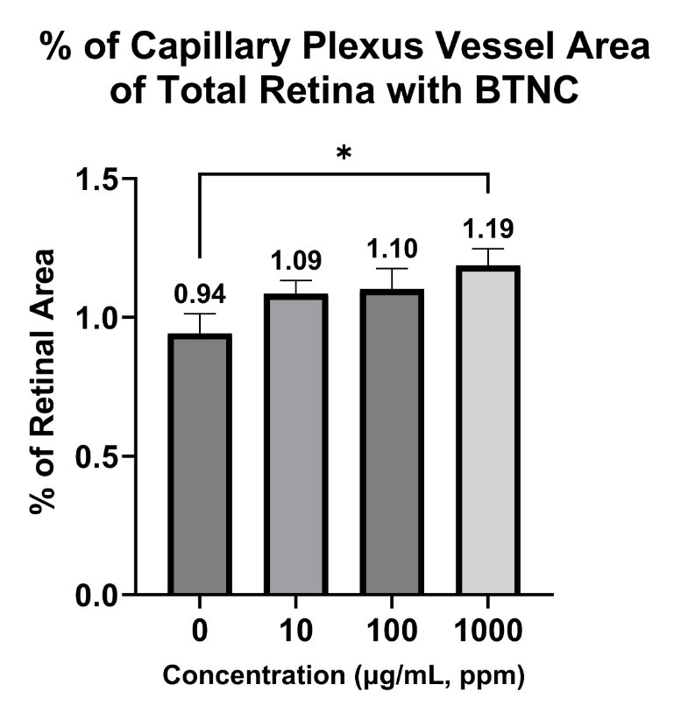
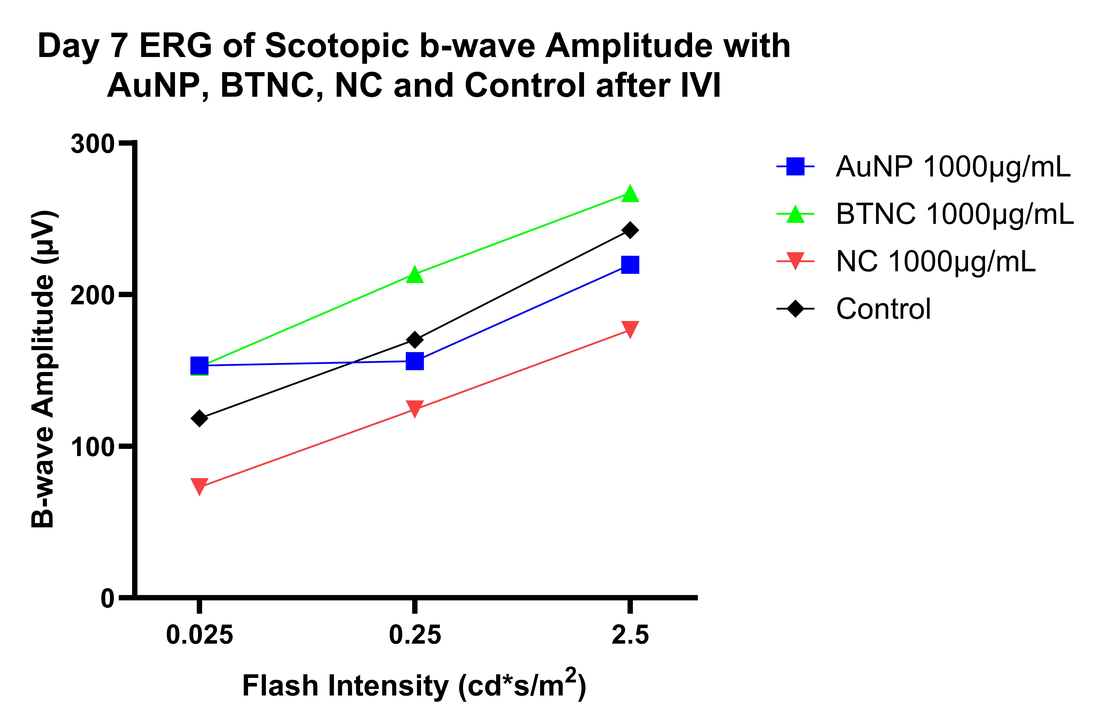
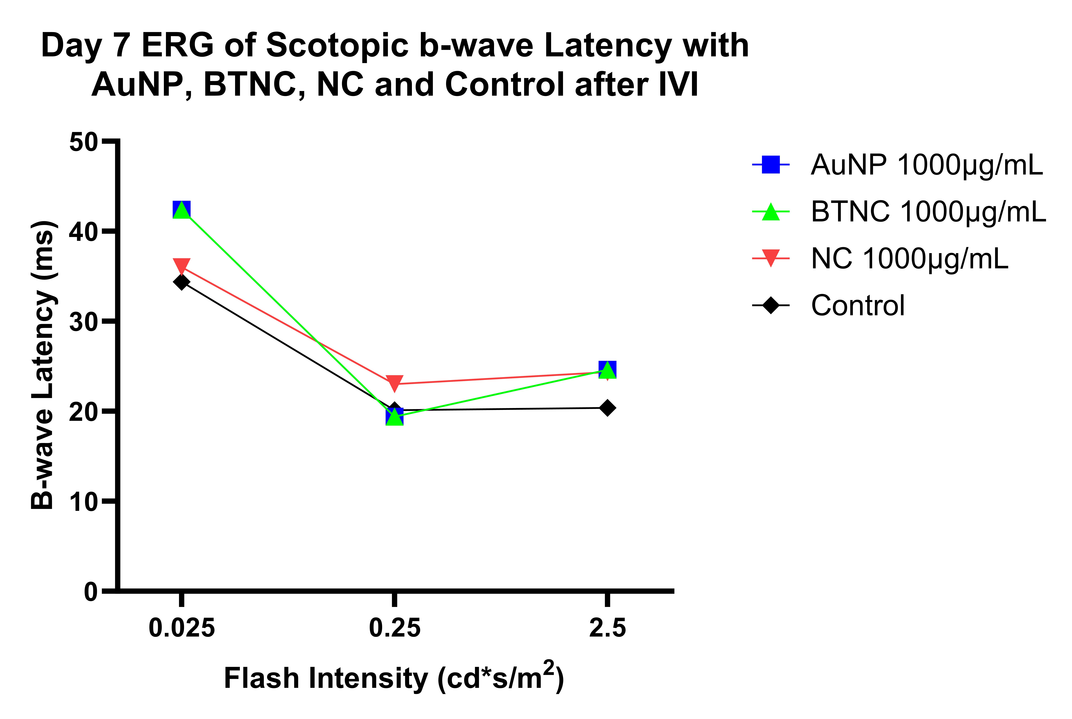
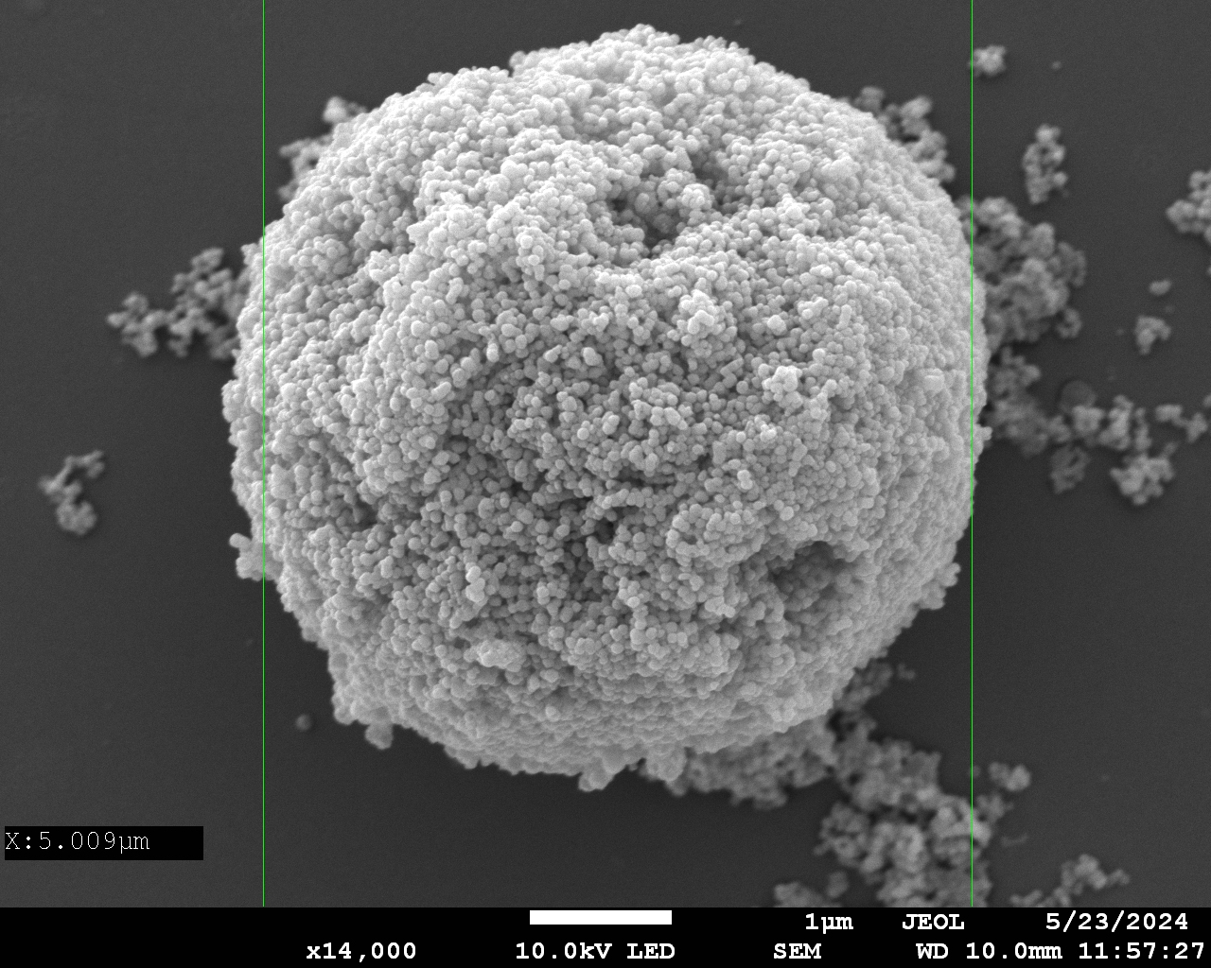
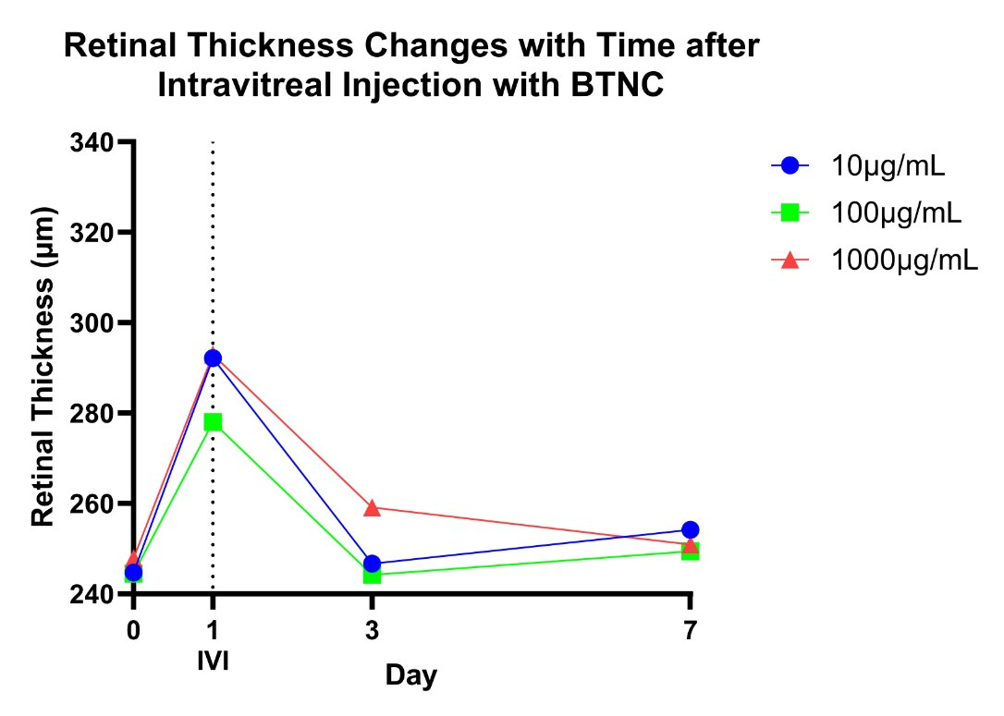
Characterization
OCT Retinal Thickness
IB4 Immunostaining
A
ERG
A
B
Figure 6. SEM and DLS results of AuNPs. Average SEM 20nm, DLS 23.61 nm.
Figure 9. Averages of retinal thicknesses (μm) in OCT images on Day 0, 1, 3, and 7 for 10 ug/mL, 100 ug/mL, and 1000 ug/mL IVI of AuNPs (A), NC (B), and BTNC (C), respectively.
B
Figure 7. SEM and DLS results of NC. Average SEM 100 nm, DLS 290.10 nm.
C
Figure 9. Average amplitude (μV) and latency (ms) of 𝛼 waves from ERG for 1000 ug/mL IVI of control, AuNPs, NC, and BTNC.
Figure 6. IB4 immunostaining of mice capillary vessel area when compared to total retinal capillary area following IVI in mice with AuNP (A), NC (B), and BTNC (C).
C
Figure 8. SEM and DLS results of BTNC. Average SEM 5000 nm, DLS 2785.23 nm.
Figure 10. Average amplitude (μV) and latency (ms) of β waves from ERG for 1000 ug/mL IVI of control, AuNPs, NC, and BTNC.
Notes:
The results of this study highlight the potential of AuNPs, showing that they can be characterized and injected without adverse effects on retinal thickness or function.
AuNPs have significant potential to be used as safe therapeutic approaches to effectively treat retinal diseases.
The future of this project will involve subretinal injections of the Gold Nanoparticles with subsequent testing with the goal of building an artificial retina with hopes to restore vision in patients with retinal degeneration.

Slide 5


Thank you Hajrasouliha Lab
Ben McCall
Yong Gao
Sunland Yong
Christine Taylor
Afshin Izadian
Amir Hajrasouliha
Grant Acknowledgment:
This project was funded, in part, with support from the Short-Term Training in Ophthalmology Research for Medical Students funded, in part by T35 EY 031282 from the National Institutes of Health. The content is solely the responsibility of the authors and does not necessarily represent the official views of the National Institutes of Health.

