Slide 1
Three-Dimensional Modeling of Anterior Communicating Artery Aneurysm for Surgical Simulation
Department of Neurosurgery
Aditi Ravikumar ¹, Matthew Tobin, M.D., Ph.D. ², Bradley Bohnstedt, M.D. ²
¹ Indiana University School of Medicine, ² Indiana University School of Medicine, Department of Neurosurgery
Background and Rationale
Anterior communicating artery (AComm) aneurysms are the most common type of intracranial aneurysms and carry the highest likelihood of rupture.¹ Despite the recent trend towards use of endovascular interventions such as coil embolization, some aneurysms are only amenable to repair using microsurgical clipping.¹ However, the decreasing frequency of open surgery has translated to less opportunities for neurosurgical trainees to acquire intuitive anatomical understanding and practice their procedural skills. Fabrication of cerebrovascular models using 3D printing has recently been done by several groups and some have evaluated model utility in resident training.² The goal of this study is to design a hollow anatomical sized prototype of the circle of Willis with an AComm aneurysm and assemble a simulation to be used in future for resident education.

Slide 2
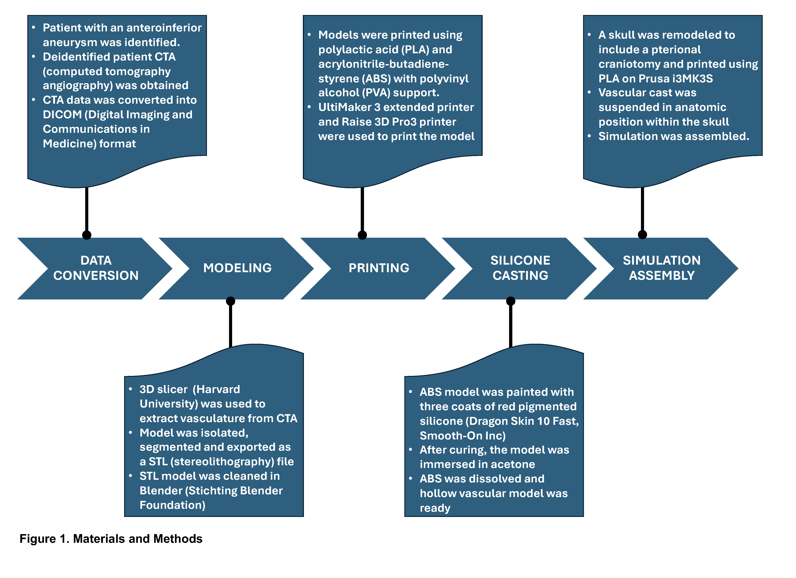
Department of Neurosurgery
References
1. Chen J, Li M, Zhu X, et al. Anterior Communicating Artery Aneurysms: Anatomical Considerations and Microsurgical Strategies. Front Neurol. 2020;11:1020. doi:10.3389/fneur.2020.01020
2. Blohm JE, Salinas PA, Avila MJ, Barber SR, Weinand ME, Dumont TM. Three-Dimensional Printing in Neurosurgery Residency Training: A Systematic Review of the Literature. World Neurosurg. May 2022;161:111-122. doi:10.1016/j.wneu.2021.10.069
Acknowledgements:
This IMPRS project was funded, in part, with support from the Indiana Clinical and Translational Sciences Institute Grant funded, in part by UL1TR002529 from the National Institutes of Health. The content is solely the responsibility of the authors and does not necessarily represent the official views of the National Institutes of Health. We thank the Makerspace at Ruth Lilly Medical Library at IUSM for allowing us the use of their facility to create this project.

Slide 3
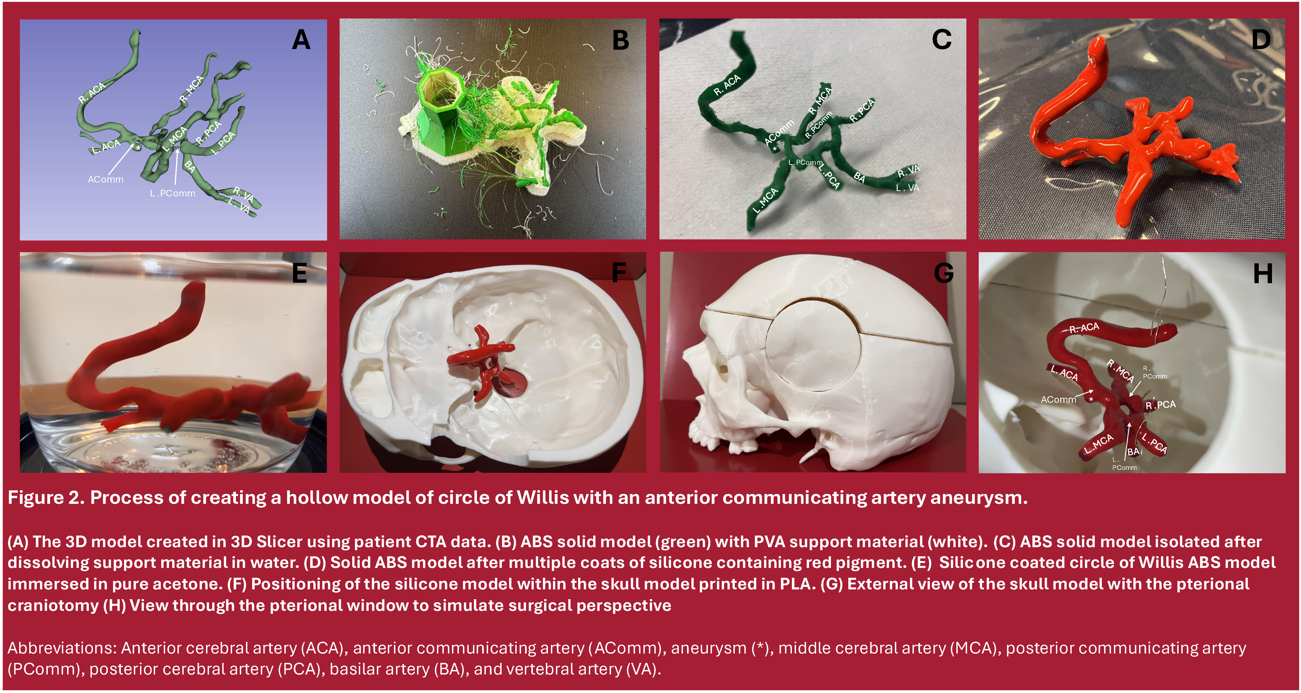
3D fabrication of cerebral aneurysm model is a feasible endeavor to create surgical simulations that can:
Department of Neurosurgery
Simulate patient anatomy and surgical approach.
Provide immediate tactile and visual feedback.
Create a low-acuity practice environment.
Increase exposure to rare cases and anatomy.
Facilitate teaching without impact on patient care.

