Slide 1
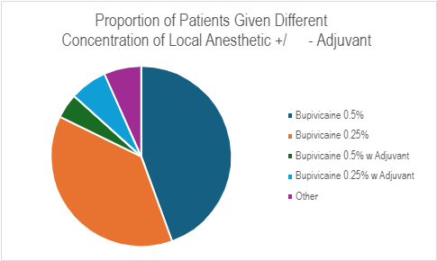
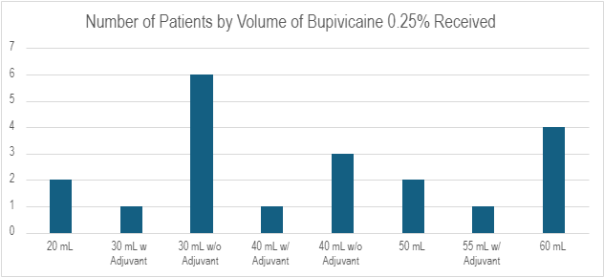
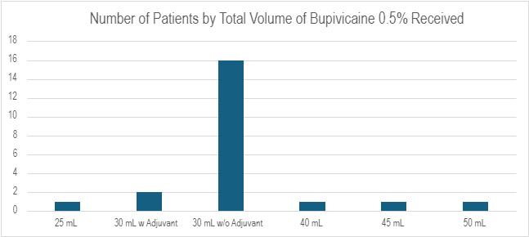

0.5% Bupivacaine Provides Additional Analgesia Than 0.25% Bupivacaine In Fascia Iliaca Blocks For Periacetabular Osteotomy

Slide 2
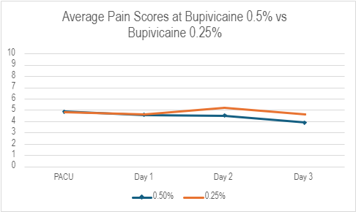
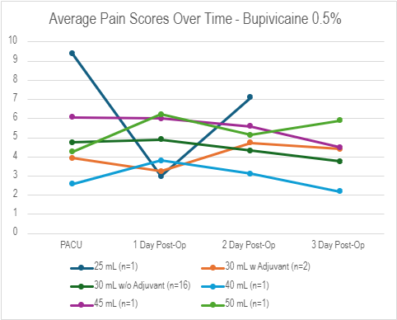
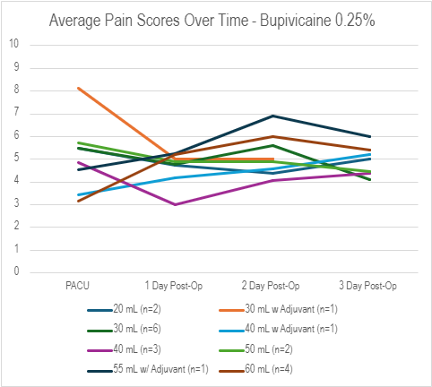
Average Pain Scores By Concentration
P=0.052
P=0.11

Slide 3
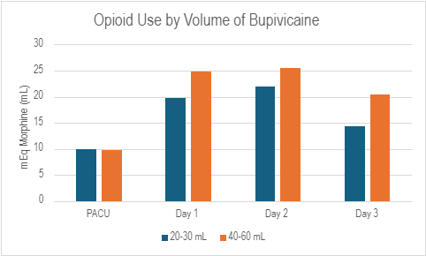
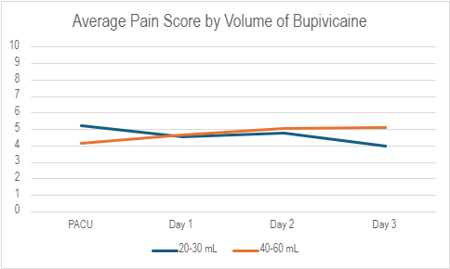
Opioid Use and Pain Score by Volume
P=0.075
P=0.13
P=0.060

