Slide 1

Indiana Clinical and Translational Sciences Institute
2024 Annual Meeting
Peripheral Monoacylglycerol Lipase Inhibition Prevents Neuropathy While Enhancing Tumor-Killing Efficacy of Chemotherapeutic Treatment in a Mouse Breast Cancer Model
Jonah Wirt^{1,2}; Emily Fender-Sizemore¹; Mirjam Huizenga³; Mario Van Der Stelt³; Andrea G. Hohmann^{1,2,4}

Slide 2
Here’s what we found
All findings were using a mouse breast cancer model:
Peripheral monoacylglycerol lipase inhibition using LEI-515 suppressed chemotherapy-induced peripheral neuropathic pain while enhancing tumor-killing ability of chemotherapeutic treatment.
Peripheral fatty acid amide hydrolase inhibition using URB937 attenuated chemotherapy-induced peripheral neuropathic pain without impeding tumor-killing ability of chemotherapeutic treatment.
Global monoacylglycerol lipase inhibition using JZL184 enhanced tumor-killing ability of chemotherapeutic treatment but did not prevent the development of neuropathic pain induced by chemotherapy.
Notes:
Begin by stating the Super Big Results (state them in 3 key points, like an outline)

Slide 3
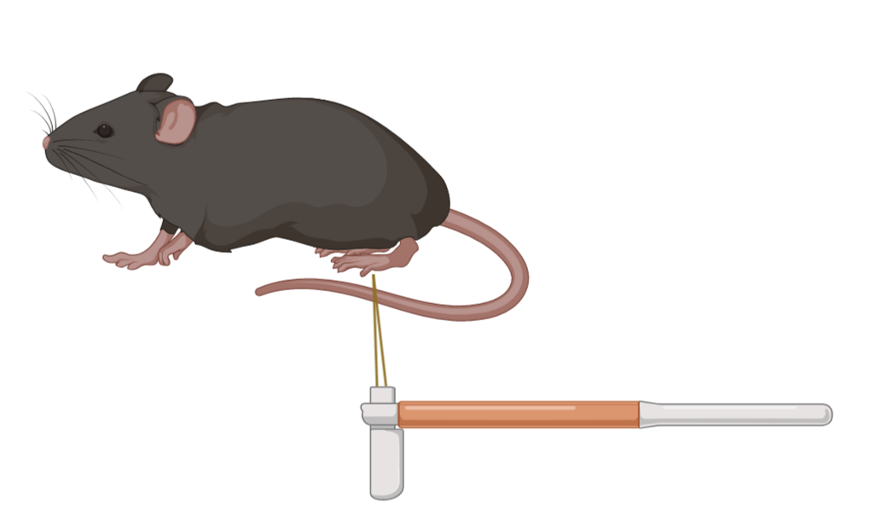
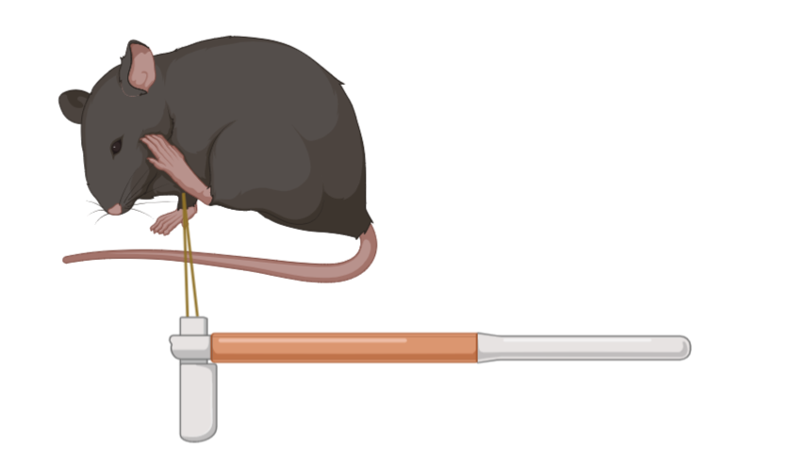
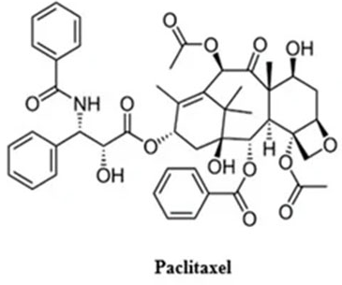

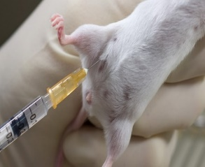

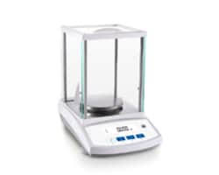
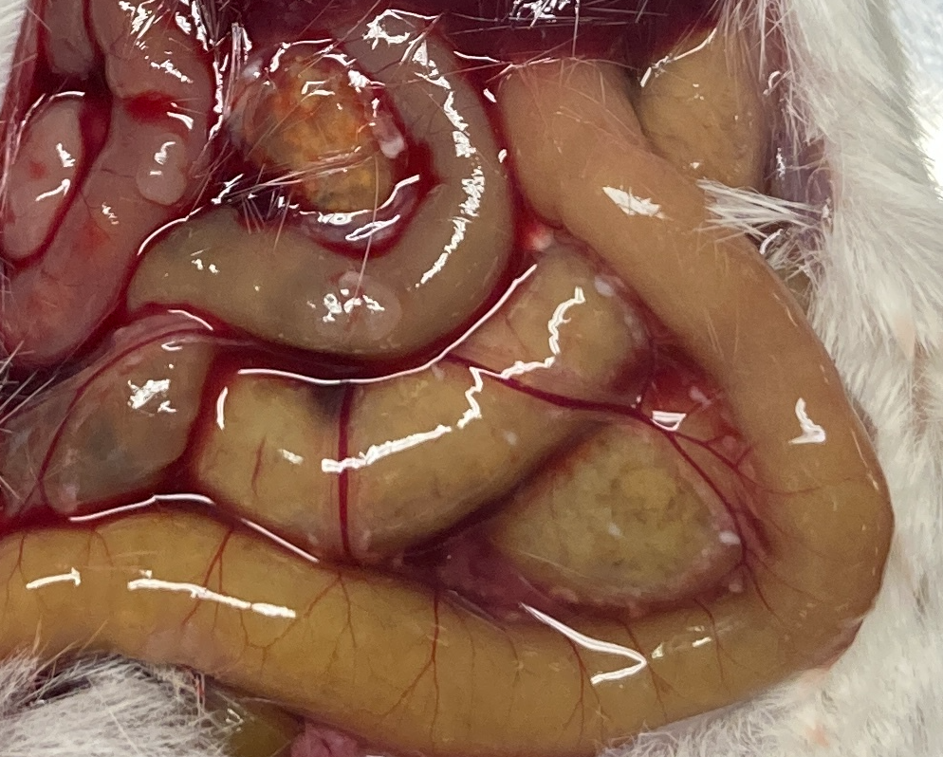
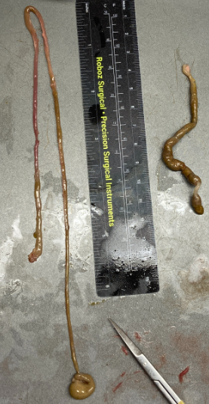
Here’s how we did it
Chemotherapeutic agent paclitaxel (10 mg/kg once every other day) was used to in a mouse model of chemotherapy induced peripheral neuropathy and/or to reduce 4T1 breast cancer tumor growth in female mice.
Mechanical hypersensitivity was assessed using an electronic von Frey anesthesiometer, and cold hypersensitivity was assessed by measuring response times to cold stimuli (acetone). Stimulation was applied to the plantar hindpaw surface.
LEI-515,URB937, JZL184, or vehicle (VEH) were administered prophylactically (i.p.) once daily. On days where both paclitaxel and pharmacological treatment were administered, paclitaxel was administered 2 hours after treatment.
Tumor volumes were measured once daily using calipers before any behavioral assessment or drug treatment.
Colonic content weights were measured at the terminal end of these studies.
Von Frey
Von Frey
Acetone Test
Acetone Test
Baseline Measurement
Paclitaxel Injection (IP)
Pain Behavior Elicited
By Mechanical/Cold Stimuli
Tumor Volumes Measured Daily
Colonic Contents and Tumor Weighed at Terminal Endpoint

Slide 4
Future implications for patients or the community/ or next steps
Cancer is currently the second leading cause of premature deaths worldwide and may soon become the first. Female breast cancer was the most diagnosed cancer worldwide, with over 2.26 million diagnoses in 2020 alone.
Chemotherapeutic agents used to treat breast cancer produce chemotherapy-induced peripheral neuropathy (CIPN), which is a dose-limiting side effect in the treatment of many cancers and can develop into a chronic neuropathic pain state. In addition to finding treatment options that work for CIPN, we need to ensure that pharmacological treatments introduced do not worsen the development of cancer.
Using a mouse model of breast cancer, we were able to show that peripheral inhibition of enzymes controlling endocannabinoid metabolism prevented development of CIPN symptoms without impeding anti-cancer properties of chemotherapeutic treatment in a mouse breast cancer model. Peripheral MGL and FAAH inhibition hold therapeutic potential for breast cancer patients and should be tested clinically alongside chemotherapeutic treatment.
Notes:
Before creating your 3 slides that will form your 2-minute video, think about how you would present your slides in a TWEET, and use that brief format to guide your points. Provide key takeaways for the most impact.

