Slide 1
Loss of NF2 Disrupts Differentiation in Neuroepithelial Stem Cells
Noah Burket¹; Scott Cooper¹; Victoria Dershem¹; Jignesh Tailor, MD, PhD^{1,2,3}
1. Department of Neurosurgery, Indiana University School of Medicine, Indiana 2. Indiana University Melvin and Bren Simon Comprehensive Cancer Center 3. Department of Pediatrics and Herman B Wells Center for Pediatric Research, Indiana University School of Medicine

Slide 2
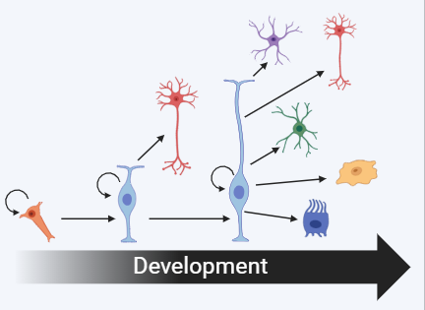
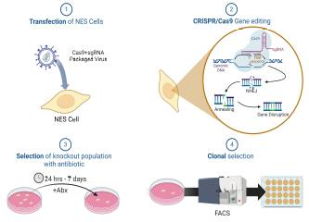
Overview and Methods
Attempting to create a model for spinal ependymoma (SPEPN)
SPEPN associated with NF2 loss
Model utilizes neuroepithelial stem cells, which differentiate into and CNS cell
Methods used include:
  CRISPR lentiviral transfection
  western blot
  sanger sequencing
  real-time polymerase chain reaction

Slide 3



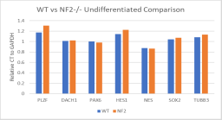
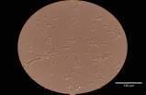
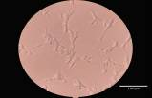



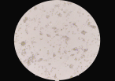
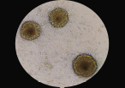
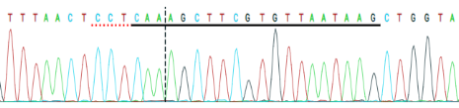

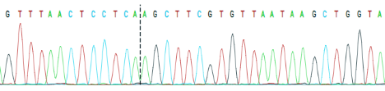
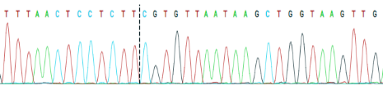
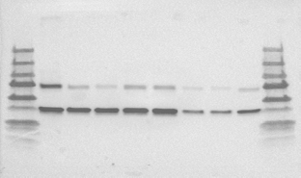
Results and Conclusions
Neural Stem Cell Markers
A
B
C
A
B
Pan-Neural Markers
D
E
F
Figure 3: PCR data comparing undifferentiated WT NES cells to NF2-altered cells.
C
D
Neuronal Markers
G
WT
C1
Figure 4: WT (A) and NF2-altered (B) cells with GF+ media. WT (C) and NF2-/- (D) cells 10 days after removal of GFs.
C13
Figure 5: PCR data of WT vs polyclonal NF2-altered cells following differentiation at day 2, 4, 6, 8, and 10 compared to non-differentiated NES cells.
Figure 6: Sanger sequencing of clone 1 and clone 13 showing homozygous mutation of NF2 gene.
NF2 loss did not affect neural gene expression but did cause cells to retain early gene expression following differentiation
NF2 loss caused cells to cluster and form spheres in vitro
Two of our clones cells show homozygous mutations on Sanger, however, they still retain NF2 protein expression
Clones
L
WT
45
32
13
12
6
5
1
L
Merlin
GAPDH
Figure 7: Western blot of WT vs cloned NES cells.

