Slide 1
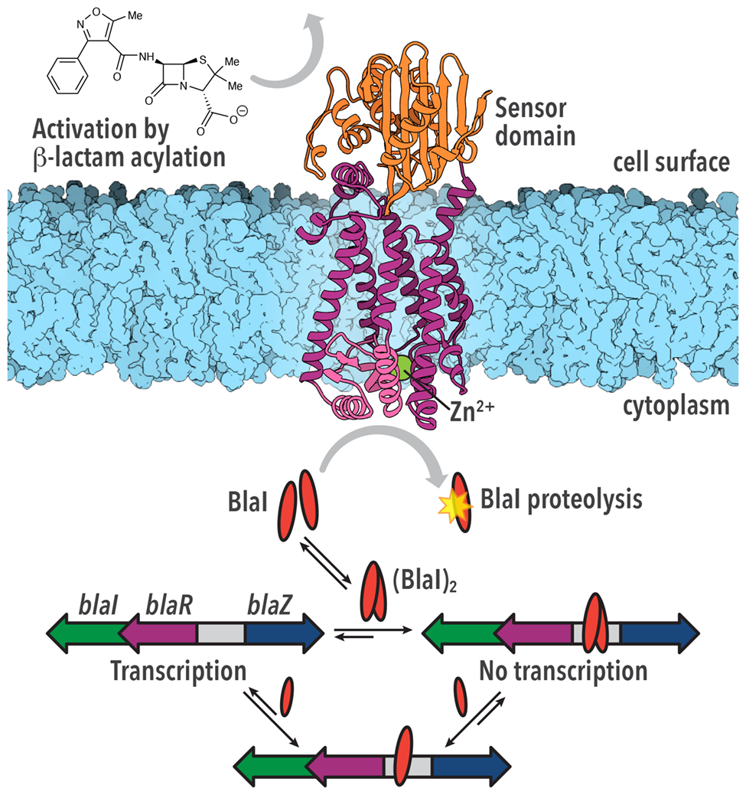
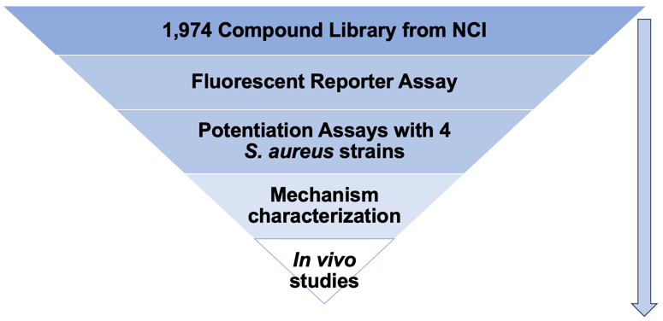
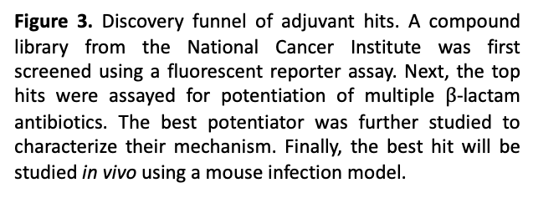
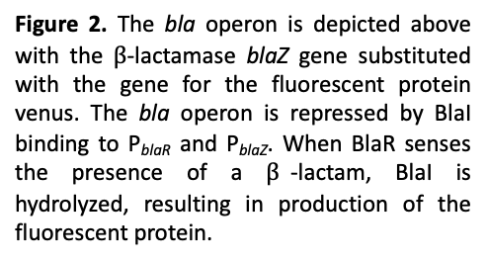
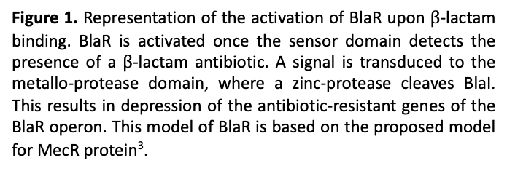
Background
Adjuvants for the Potentiation of the Activity of $β$-Lactam Antibiotics Against
Methicillin-Resistant Staphylococcus aureus
Caitlyn A. Thomas, Choon Kim, Amr M. El-Araby, Biruk T. Birhanu, Mayland Chang, Shahriar Mobashery
Department of Chemistry and Biochemistry, University of Notre Dame, Notre Dame, IN, 46556, USA
PblaR1
PblaZ
blaI
blaR1
venus
Figure 2. The bla operon is depicted above with the $β$-lactamase blaZ gene substituted with the gene for the fluorescent protein venus. The bla operon is repressed by BlaI binding to P_{blaR} and P_{blaZ}. When BlaR senses the presence of a $β$-lactam, BlaI is hydrolyzed, resulting in production of the fluorescent protein.
Figure 3. Discovery funnel of adjuvant hits. A compound library from the National Cancer Institute was first screened using a fluorescent reporter assay. Next, the top hits were assayed for potentiation of multiple $β$-lactam antibiotics. The best potentiator was further studied to characterize their mechanism. Finally, the best hit will be studied in vivo using a mouse infection model.
Figure 1. Representation of the activation of BlaR upon $β$-lactam binding. BlaR is activated once the sensor domain detects the presence of a $β$-lactam antibiotic. A signal is transduced to the metallo-protease domain, where a zinc-protease cleaves BlaI. This results in depression of the antibiotic-resistant genes of the BlaR operon. This model of BlaR is based on the proposed model for MecR protein³.

Slide 2
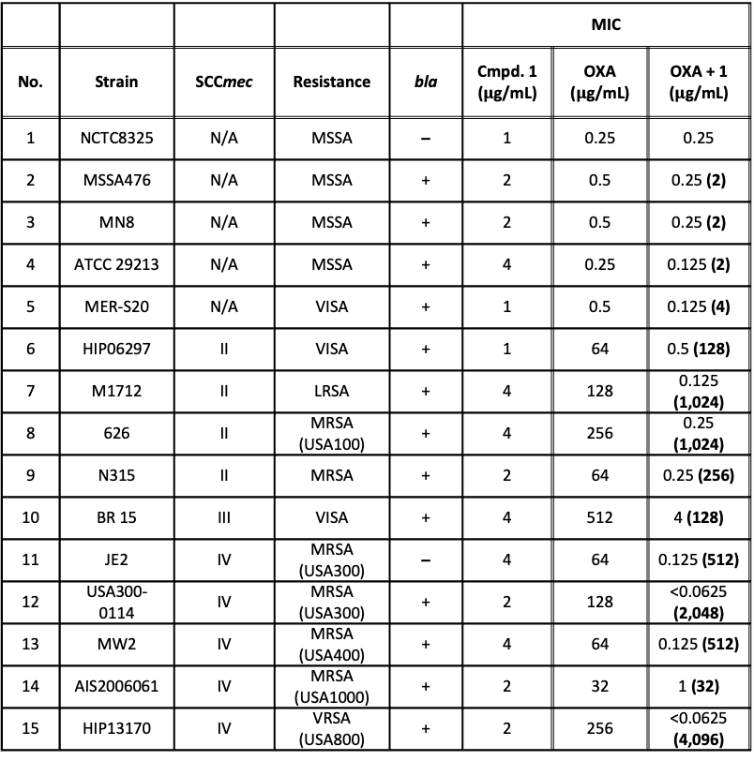
Results
Table 1. Potentiation results for the compound 1 from the diversity compound library. *The ¼ MICs of compounds were used for their potentiation for oxacillin (OXA). The parentheses indicate the fold reduction of the MIC of OXA.
 |  |  |  |  | MIC
No. | Strain | SCCmec | Resistance | bla | Cmpd. 1 ($μ$g/mL) | OXA ($μ$g/mL) | OXA + 1 ($μ$g/mL)
1 | NCTC8325 | N/A | MSSA | ̶ | 1 | 0.25 | 0.25
2 | MSSA476 | N/A | MSSA | + | 2 | 0.5 | 0.25 (2)
3 | MN8 | N/A | MSSA | + | 2 | 0.5 | 0.25 (2)
4 | ATCC 29213 | N/A | MSSA | + | 4 | 0.25 | 0.125 (2)
5 | MER-S20 | N/A | VISA | + | 1 | 0.5 | 0.125 (4)
6 | HIP06297 | II | VISA | + | 1 | 64 | 0.5 (128)
7 | M1712 | II | LRSA | + | 4 | 128 | 0.125 (1,024)
8 | 626 | II | MRSA (USA100) | + | 4 | 256 | 0.25 (1,024)
9 | N315 | II | MRSA | + | 2 | 64 | 0.25 (256)
10 | BR 15 | III | VISA | + | 4 | 512 | 4 (128)
11 | JE2 | IV | MRSA (USA300) | ̶ | 4 | 64 | 0.125 (512)
12 | USA300-0114 | IV | MRSA (USA300) | + | 2 | 128 | <0.0625 (2,048)
13 | MW2 | IV | MRSA (USA400) | + | 4 | 64 | 0.125 (512)
14 | AIS2006061 | IV | MRSA (USA1000) | + | 2 | 32 | 1 (32)
15 | HIP13170 | IV | VRSA (USA800) | + | 2 | 256 | <0.0625 (4,096)
Figure 4. First derivative of the melting temperature of BlaR sensor domain (SD) in the presence of oxacillin and compound 1. All trials were performed in HEPES buffered saline with EDTA and P20 (HBS-EP) buffer, pH 6.6. The concentration of BlaR SD is 0.5 mg/mL.
Compound 1
Figure 5. Surface plasmon resonance sensorgram (top, left) and steady-state fit kinetics (top, right) for compound 1 binding to BlaR sensor domain are shown. Experiments were performed using a serial dilution of the tested compound in HBS-EP buffer, pH 7.4, supplemented with 4% DMSO. Regeneration was performed at the end of each analytical cycle using 0.05% SDS. Data were analyzed using steady-state fit in the Biacore X100 Evaluation Software.

Slide 3
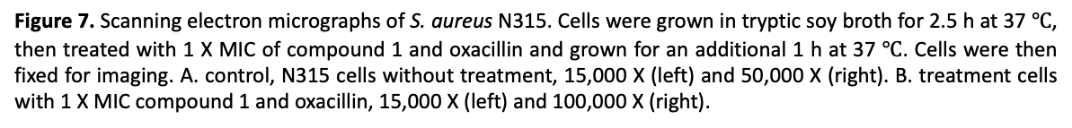
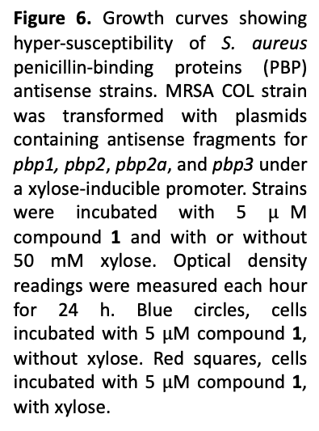
Results and Conclusions
Figure 6. Growth curves showing hyper-susceptibility of S. aureus penicillin-binding proteins (PBP) antisense strains. MRSA COL strain was transformed with plasmids containing antisense fragments for pbp1, pbp2, pbp2a, and pbp3 under a xylose-inducible promoter. Strains were incubated with 5 $μ$M compound 1 and with or without 50 mM xylose. Optical density readings were measured each hour for 24 h. Blue circles, cells incubated with 5 $μ$M compound 1, without xylose. Red squares, cells incubated with 5 $μ$M compound 1, with xylose.
A.
B.
Figure 8. Time-kill assay results for compound 1 in combination with oxacillin (OXA) using MRSA strains N315, USA300-0114, and HIP13710.
Figure 7. Scanning electron micrographs of S. aureus N315. Cells were grown in tryptic soy broth for 2.5 h at 37 $℃$, then treated with 1 X MIC of compound 1 and oxacillin and grown for an additional 1 h at 37 $℃$. Cells were then fixed for imaging. A. control, N315 cells without treatment, 15,000 X (left) and 50,000 X (right). B. treatment cells with 1 X MIC compound 1 and oxacillin, 15,000 X (left) and 100,000 X (right).

