Slide 1
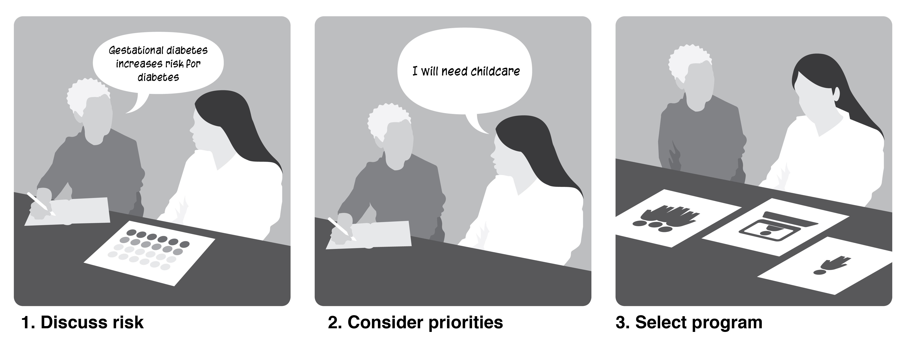

A Tailored Approach to Increase Engagement in Lifestyle Change Programs
in Women with Previous Gestational Diabetes
Julie M. Pike¹, Kathryn M. Haberlin-Pittz¹, Luz A. Machuca¹, Brett M. McKinney¹, Lisa G. Yazel¹, Aric Kotarski², Tamara S. Hannon¹
, ¹ Department of Pediatrics, Indiana University School of Medicine, Indianapolis, IN
² Department of Biostatics and Health Data Science, Indiana School of Medicine, Indianapolis IN
BACKGROUND
Gestational diabetes mellitus (GDM) is highly predictive of type 2 diabetes. Intensive lifestyle change programs decrease risk for T2D by 50 percent in women with previous GDM. Yet, engagement in lifestyle change programs is low. We engaged women with previous GDM in an informed decision-making process to;
Discuss T2D risk and prevention,
Explore individual priorities for a lifestyle change program
Provide participation in a lifestyle change program free of charge.
The primary of objective was to evaluate program selection and engagement. We evaluated changes in BMI, HbA1c, and questionnaires.
LIFESTYLE CHANGE PROGRAMS
Dietitian Consult
Encourage
HabitNu
Health Coaching
Healthy Me
NDPP
Weight Watchers
Online NDPP
Health coaching
Health coaching
YMCA NDPP
Point-based weight loss program
3 months
Virtual
1 year
DPP adapted for women with previous GDM
1 year
In person
Virtual
In person or virtual
6 months
1 year
In person
In person and/or virtual
6 months
Medical nutrition therapy
In person or virtual
1-2 sessions
PROGRAM SELECTION
METHODS
At baseline, research staff and participants discussed T2D risk after GDM and efficacy of lifestyle change programs.
Decision-making cards were used to facilitate a discussion about desired attributes of a lifestyle change program.
Participants were offered free participation in one of seven lifestyle change programs.
BMI, HbA1c, and questionnaires were completed at baseline (B), 6 months (T1), and 12 months (T2).

Slide 2
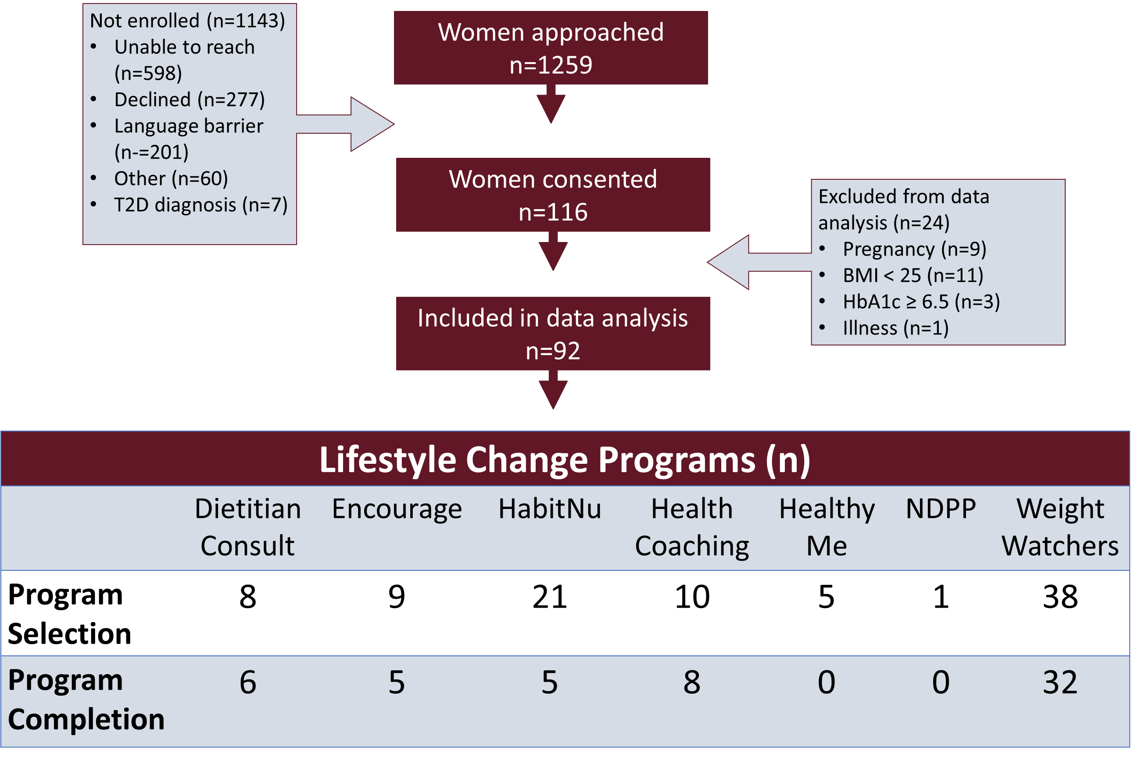
A Tailored Approach to Increase Engagement in Lifestyle Change Programs in Women with Previous Gestational Diabetes
PROGRAM SELECTION AND COMPLETION
RESULTS
116 women (34.9 ± 5.7 y; 57.3% white; 47.3% college degree) were recruited
92 women were included in data analysis after exclusions due to pregnancy, BMI < 25, HbA1c ≥ 6.5, and illness.
Almost half selected WW (41%), followed by Habit Nu (22%), health coaching (11%), Encourage (10%), the dietitian consult (9%), Healthy Me (5%), and the YMCA NDPP (1%).
WW (84%) remained engaged in the study at T1 and/or T2.
About one-fourth of Habit Nu participants and half of the Encourage participants completed the lifestyle change program.
Health coaching and the dietitian visits were completed by 80 percent and 75 percent of program participants, respectively.
BMI, HbA1c, and questionnaires were stable from baseline to T1 and T2.

Slide 3
Offering a choice of lifestyle change programs and completing program enrollment at the time of type 2 diabetes risk discussion may enhance engagement in diabetes prevention efforts among women with pGDM.
A Tailored Approach to Increase Engagement in Lifestyle Change Programs in Women with Previous Gestational Diabetes
DISCUSSION
Women most often selected app-based programs that could be completed on their own time and without the need for childcare. This is consistent with previous research; women want programs that offer flexibility and virtual options
Only one participant selected the traditional NDPP, and this person was never enrolled in the program. This underlines the need for tailored options for lifestyle programs.
Apart from Habit Nu, programs that required a referral for enrollment rather than enrollment at baseline, had no engagement. Program enrollment at the time of the conversation about T2D risk may enhance engagement.
The lack of significant change in BMI, HbA1c, or questionnaires is notable given the overlap of this study with the COVID-19 pandemic. Participation in a lifestyle intervention may have mitigated excess weight gain and increases in HbA1c.

