Slide 1

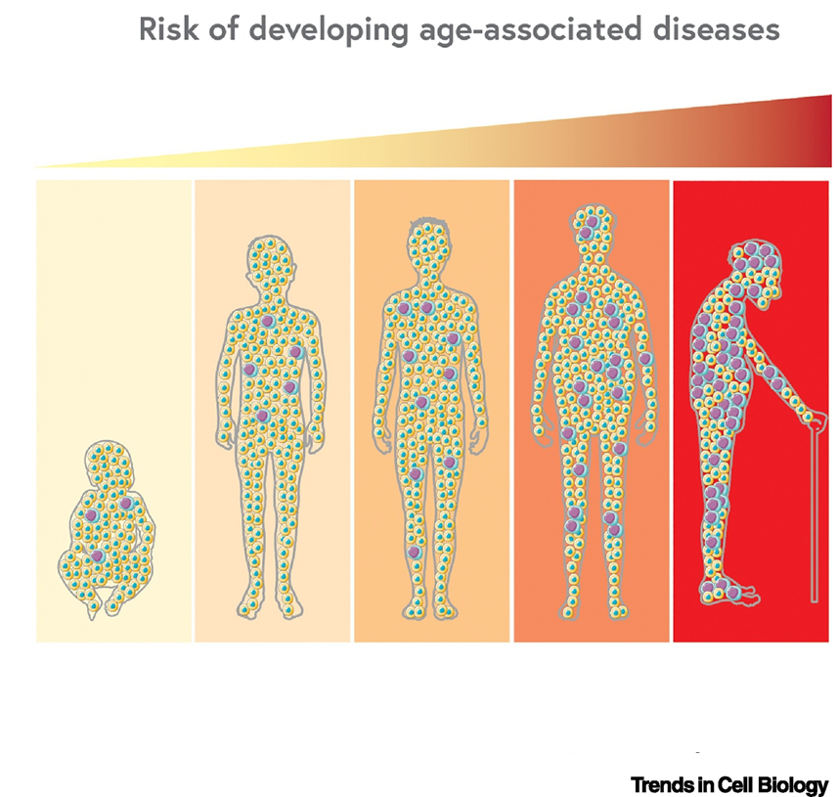
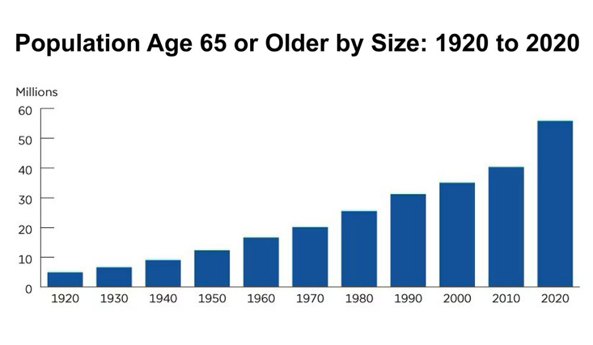
Introduction
US Population Trends : Aging Ahead
CENSUS.GOV, US. Census Bureau, May 2023
Mutlu AS, Wang MC et al., 2021

Slide 2
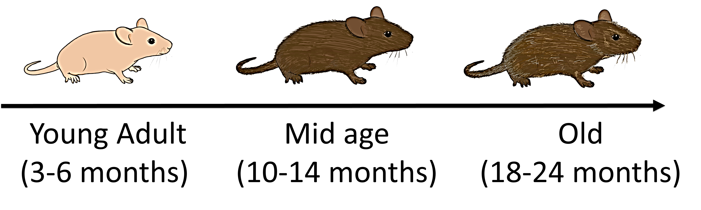
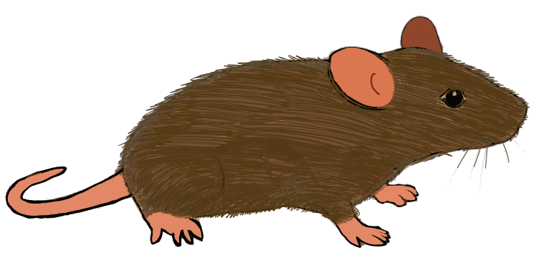
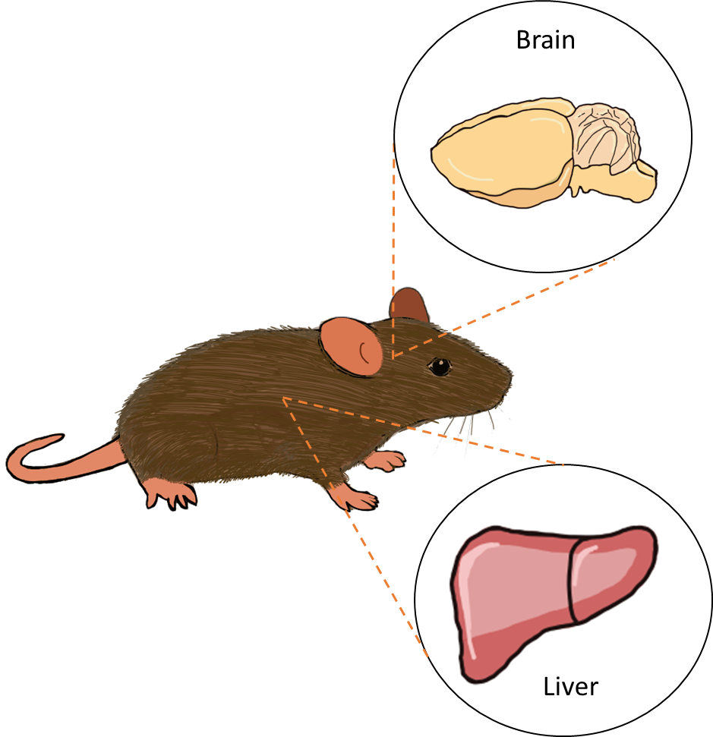
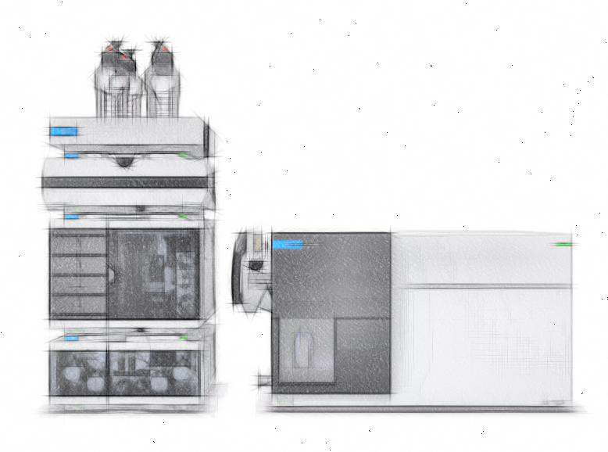
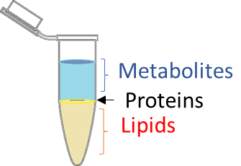
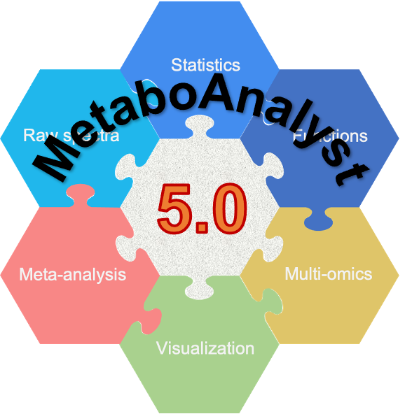
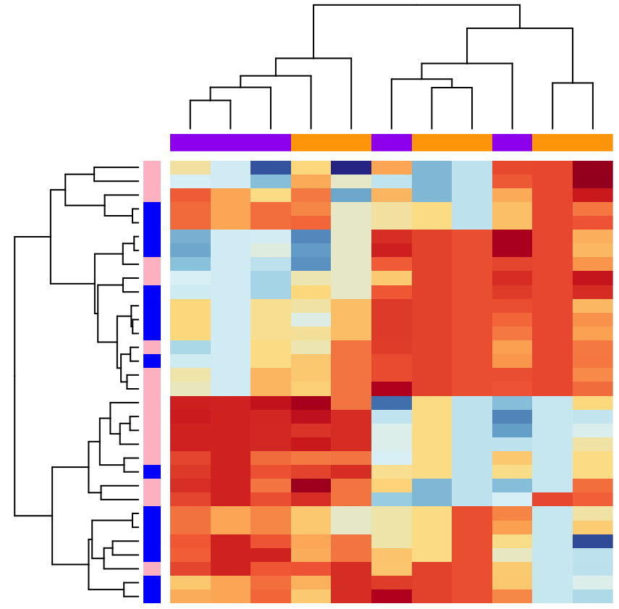
Method
Experimental Workflow
Mass Spectrometry Analysis
(Shotgun MRM + Untargeted LC-MS/MS+ MS Imaging )
Statistical analysis
Tissue Collection
Extraction of lipids

Slide 3
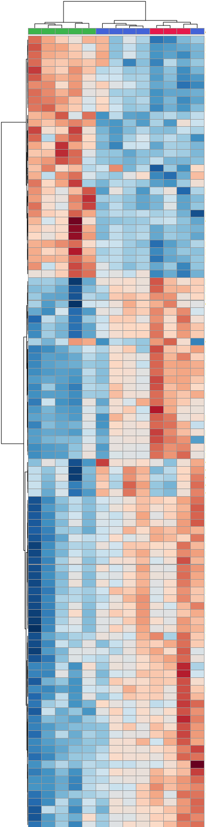
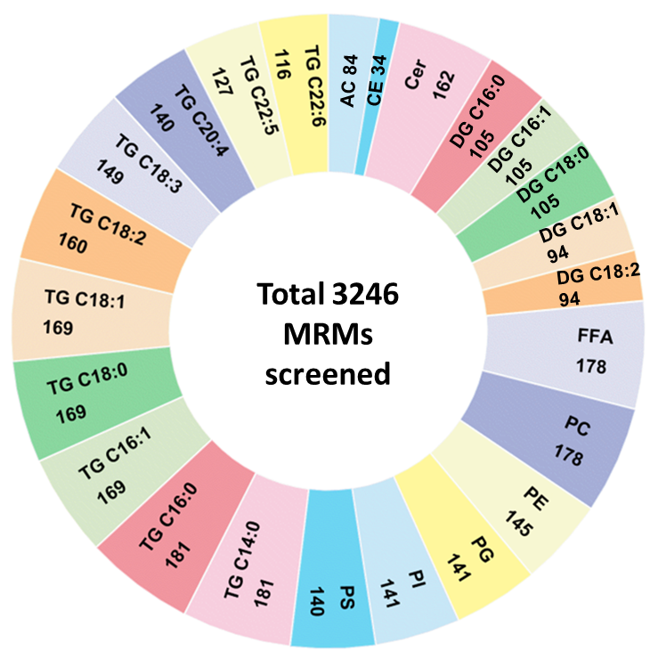
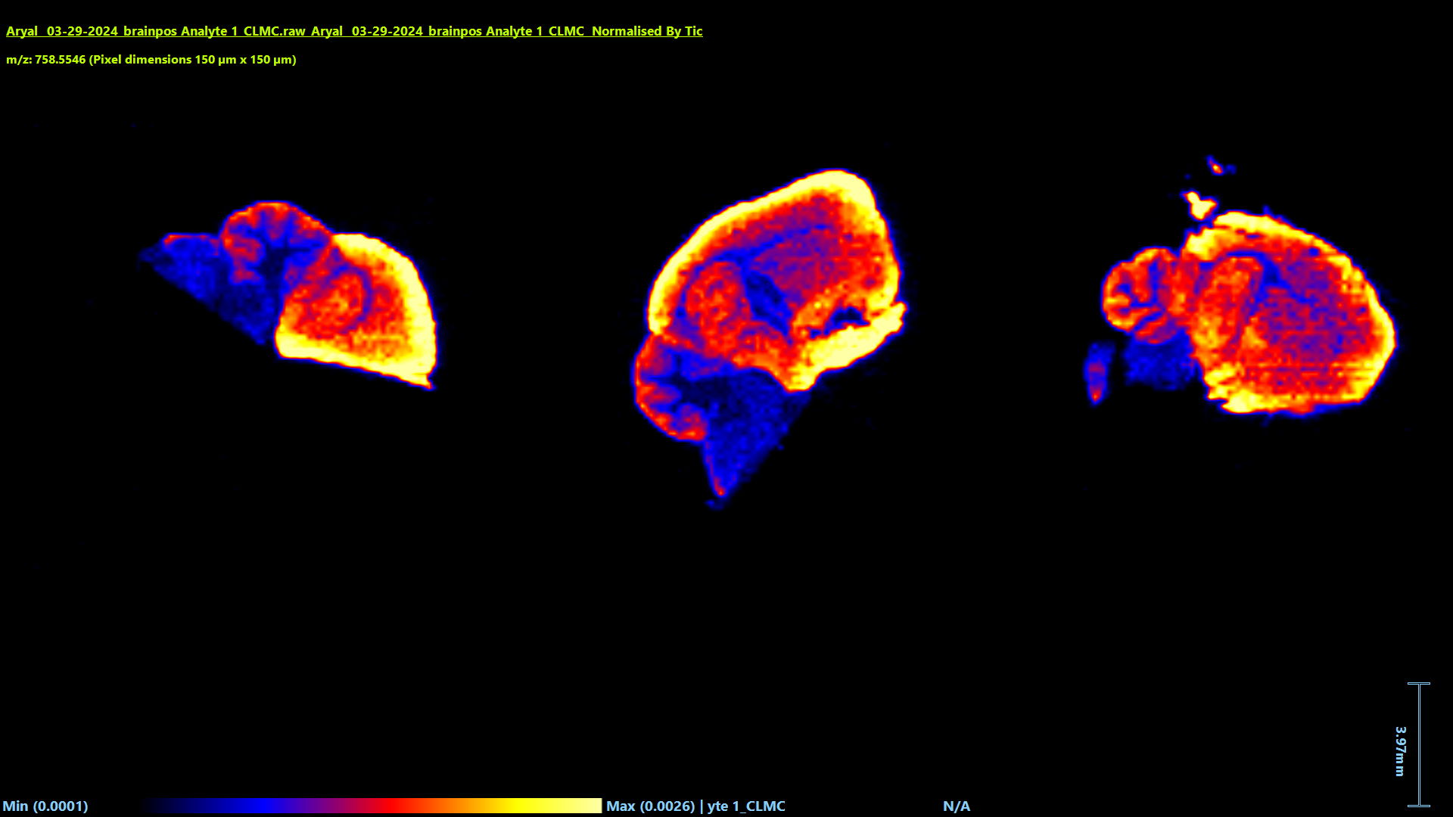
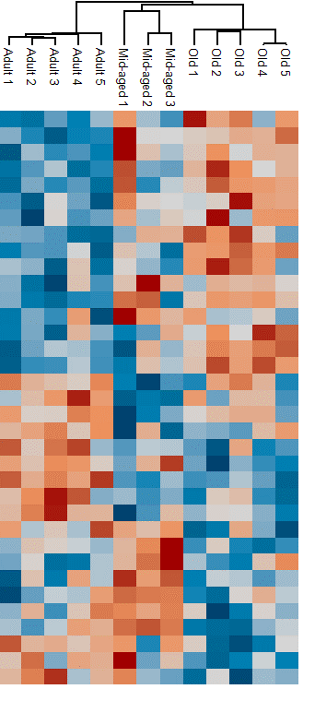
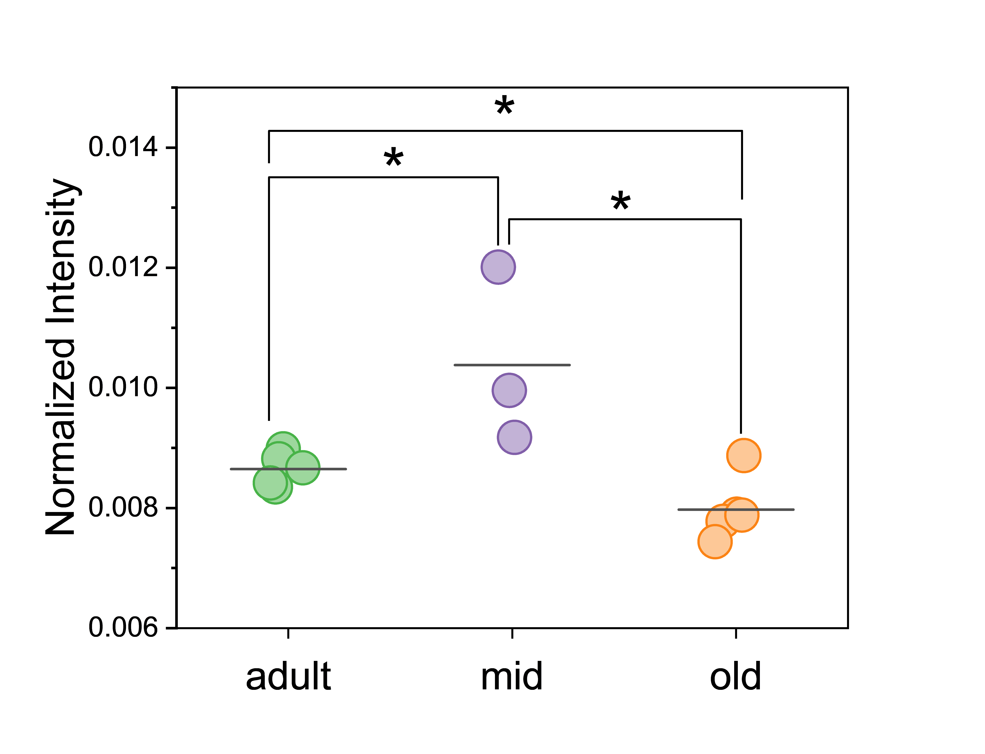
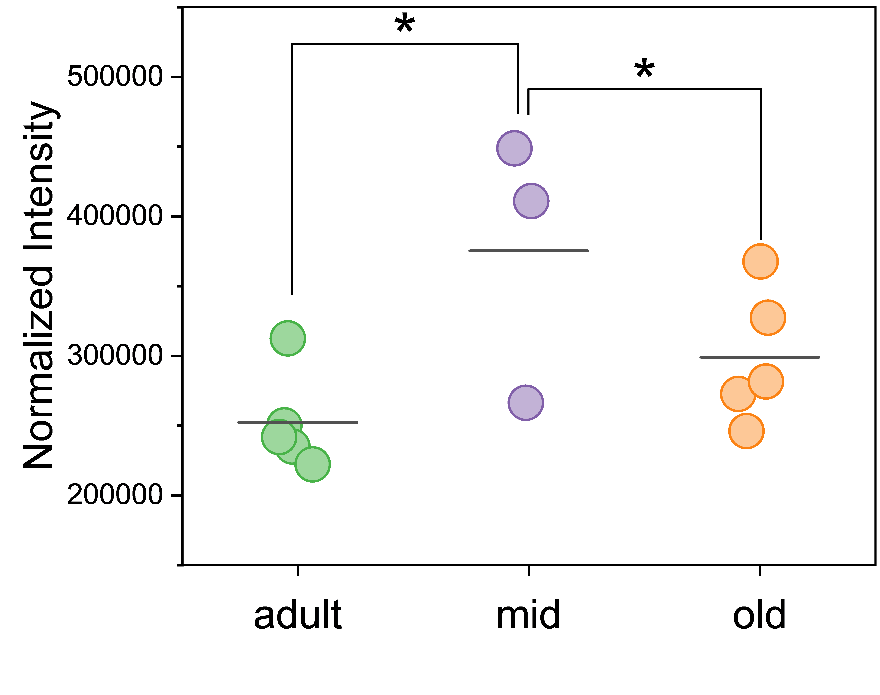
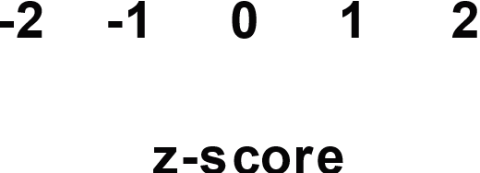

RESULTS
Aging leads to alteration of the brain and liver proteomes
Adult
Mid
Old
Adult
Mid
Old
PC(34:2)
m/z: 758.5566
DESI-MS
MRM
Untargeted LC-MS/MS
PC(34:2)

