Slide 1

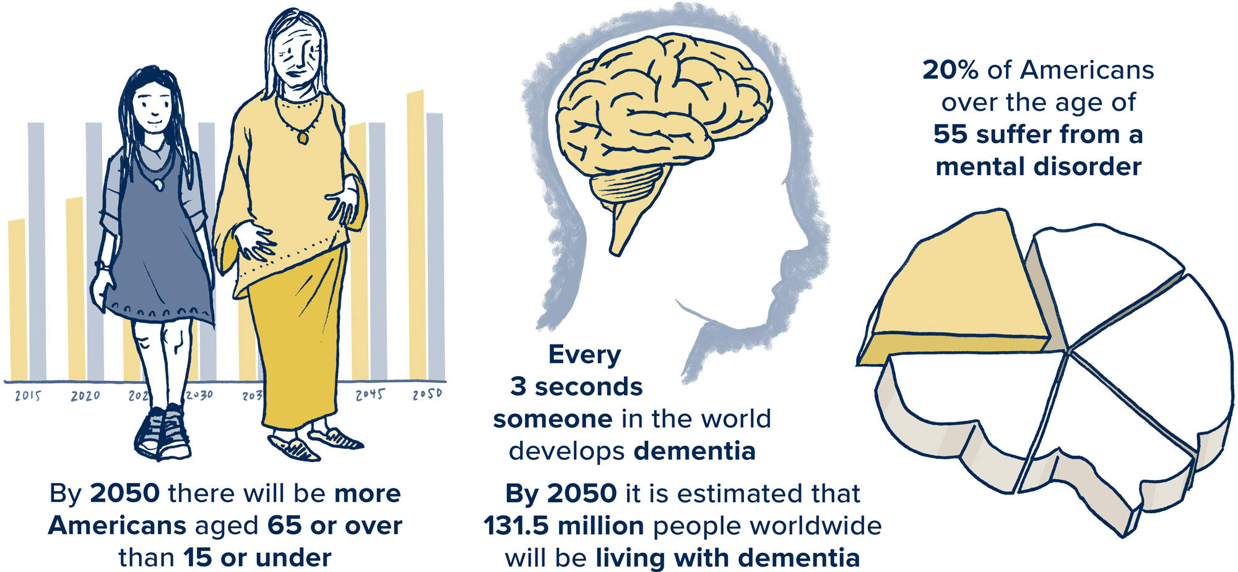
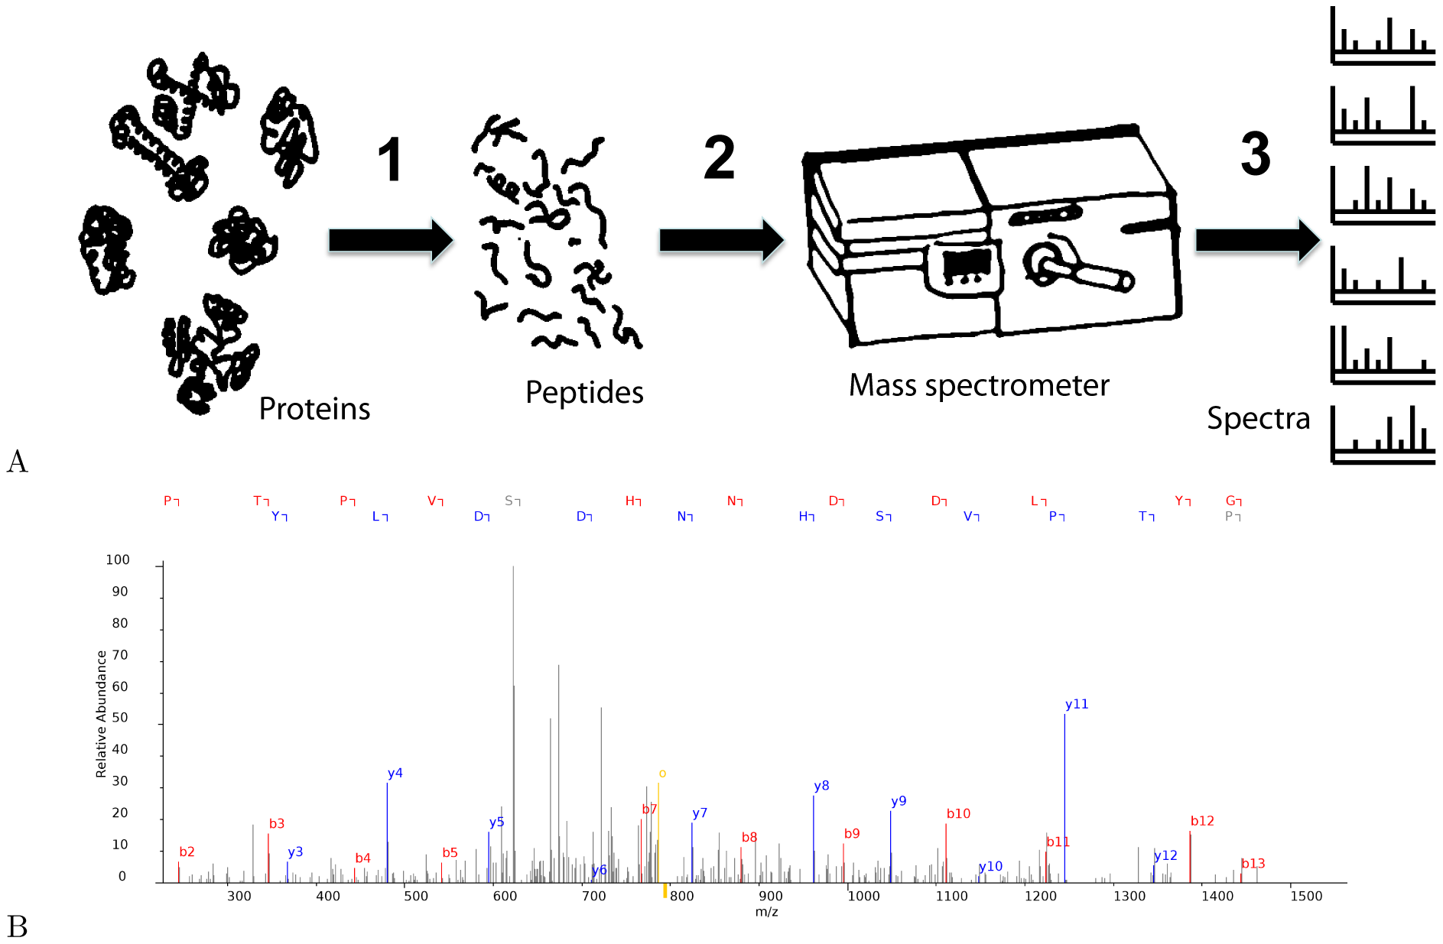
Aging increases the risk for the development of several illnesses, including those that affect brain functions
UC Davis Healthy Brain Aging Initiative

Slide 2
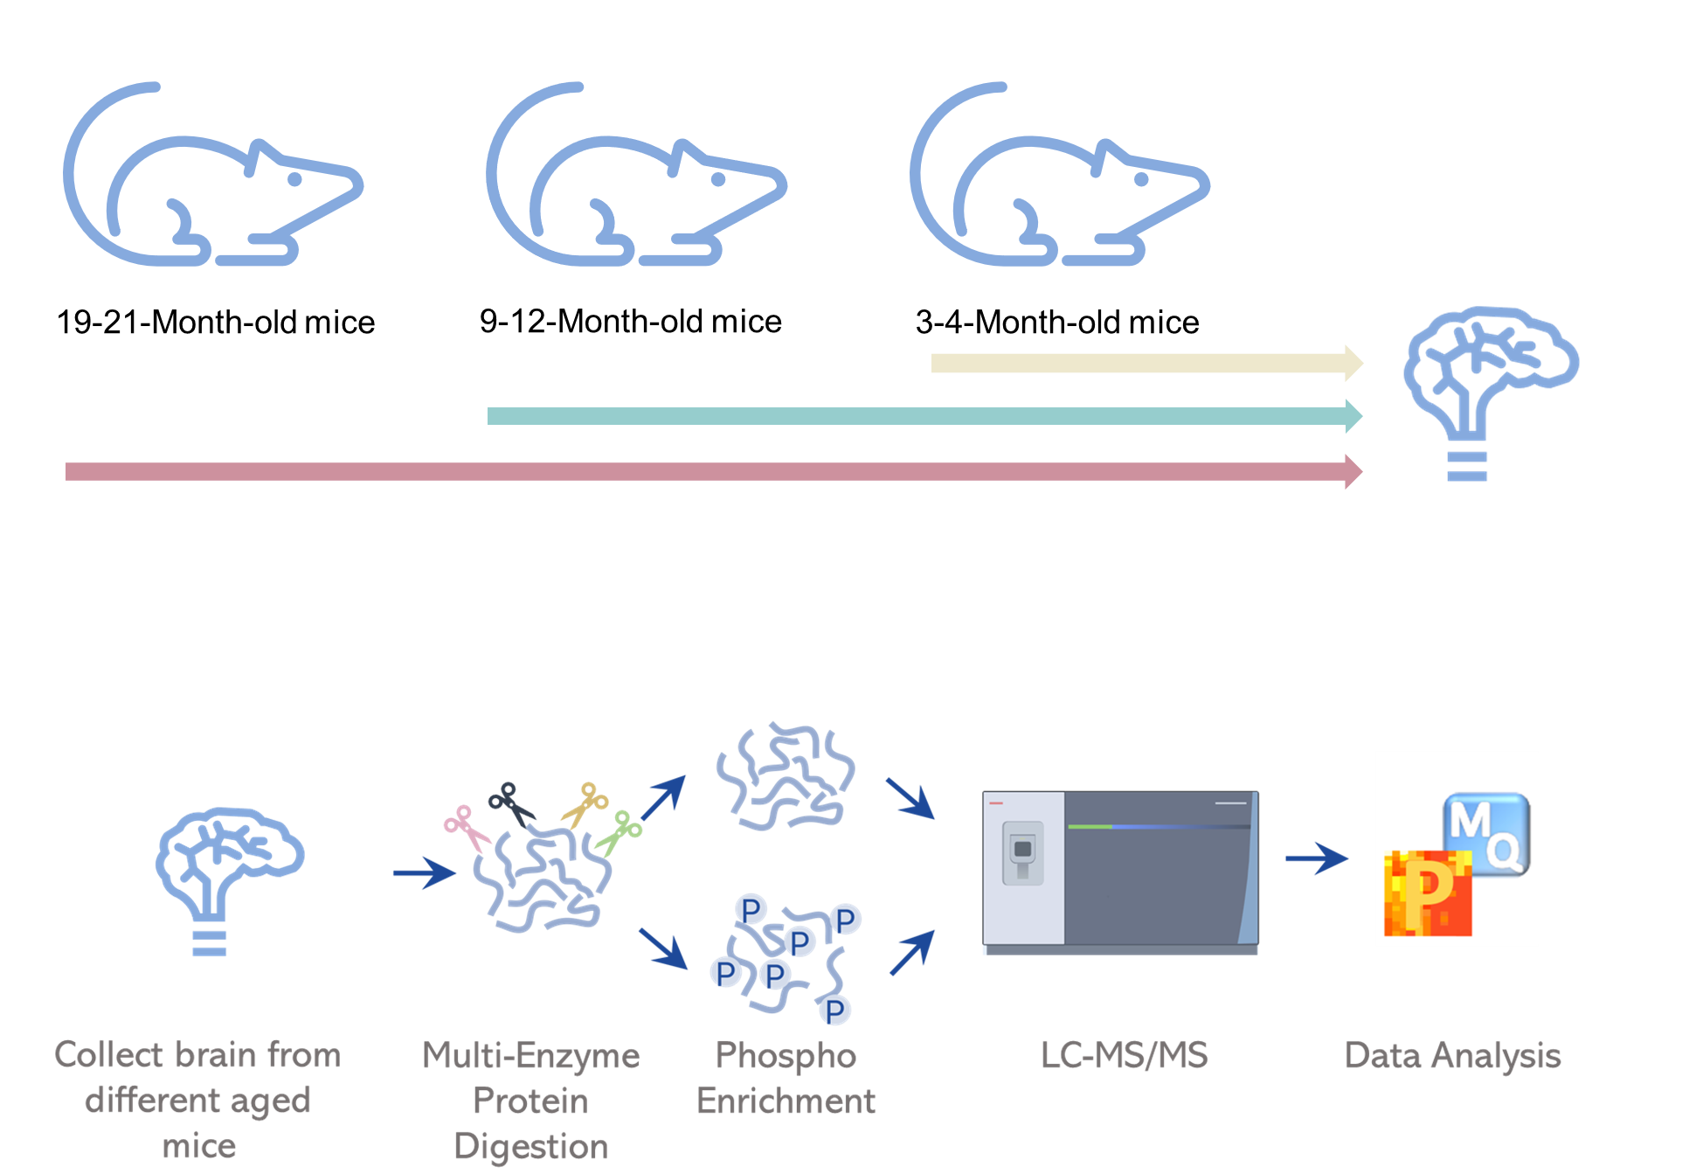

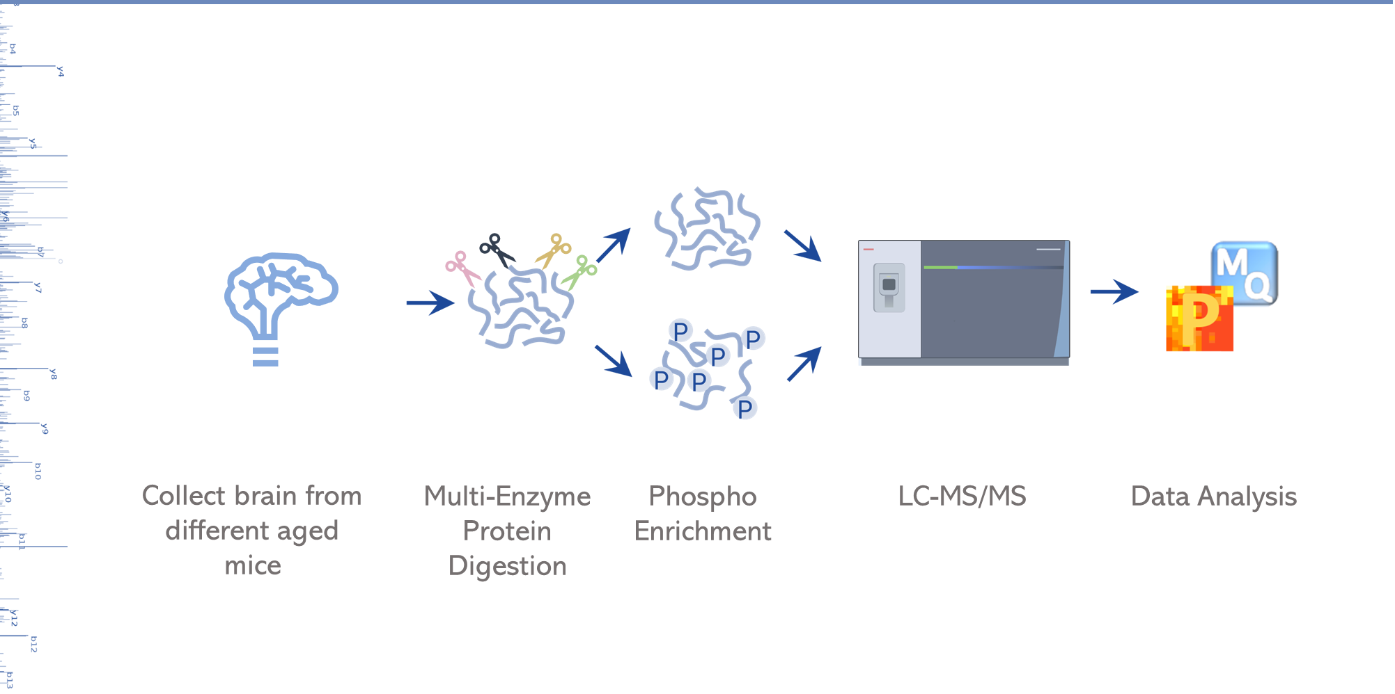
Proteomic analysis of mice brain
19-21-Month-old mice
9-12-Month-old mice
3-4-Month-old mice

Slide 3
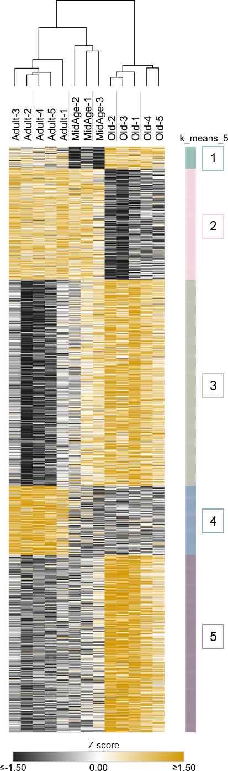
Aging induces the reorganization of tissue phosphoproteome
A.
B.
C.
Pathways of Neurodegeneration
Synaptic vesicle cycle
Long-term potentiation
Glutamatergic synapse
Ras signaling pathway

